Slide 1
How many is represented here?
1)
2)
3)

Slide 2
How many is represented here?
1)
2)
3)
20
20
7

Slide 3
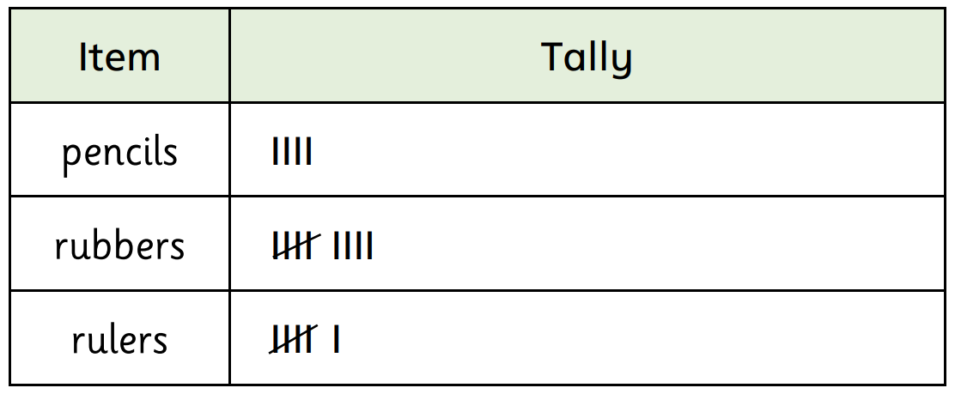
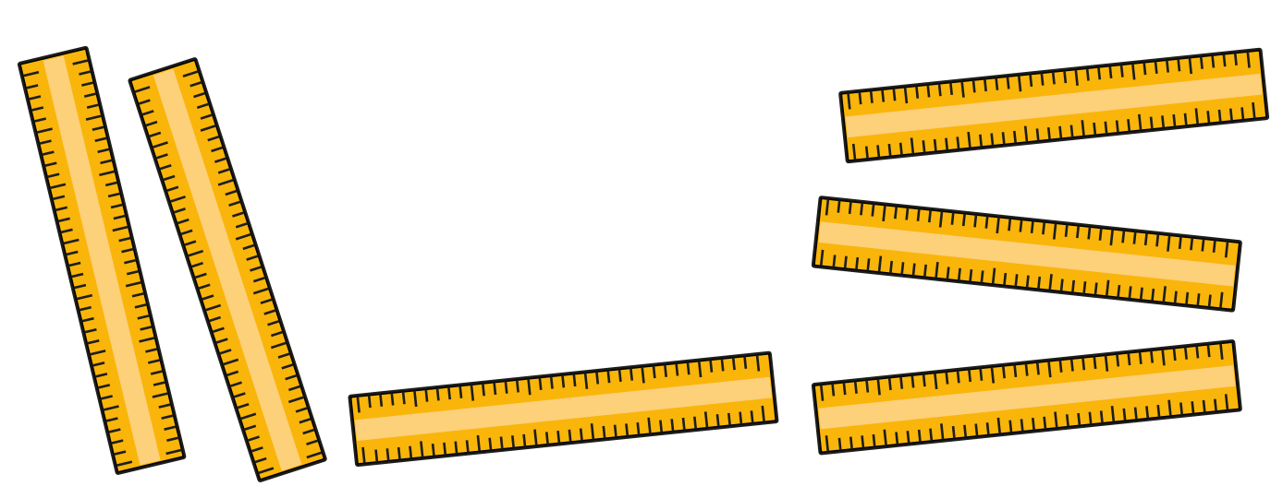
Have a
think
Is the tally chart correct? Does it show the right amount for each object? How do you know?

Slide 4
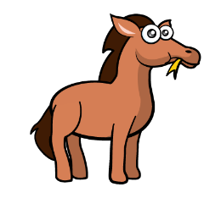
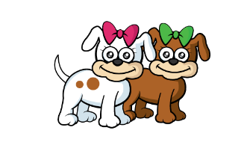
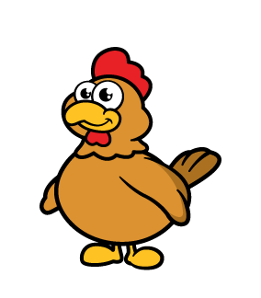
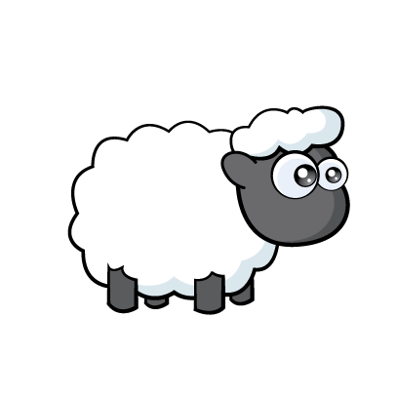
Animals | Tally | Total
Horses
Dogs
Chickens
Frogs
Sheep
1
2
7
4
9
Have a go at creating a tally chart for the number of each animal. Were you correct?

Slide 5
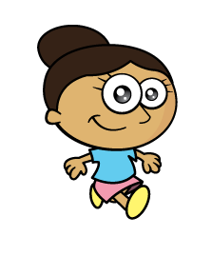
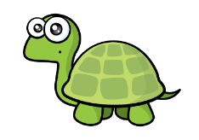
Have a think
Has Tiny recorded his tally marks correctly? How do you know?

