Slide 1


Slide 3
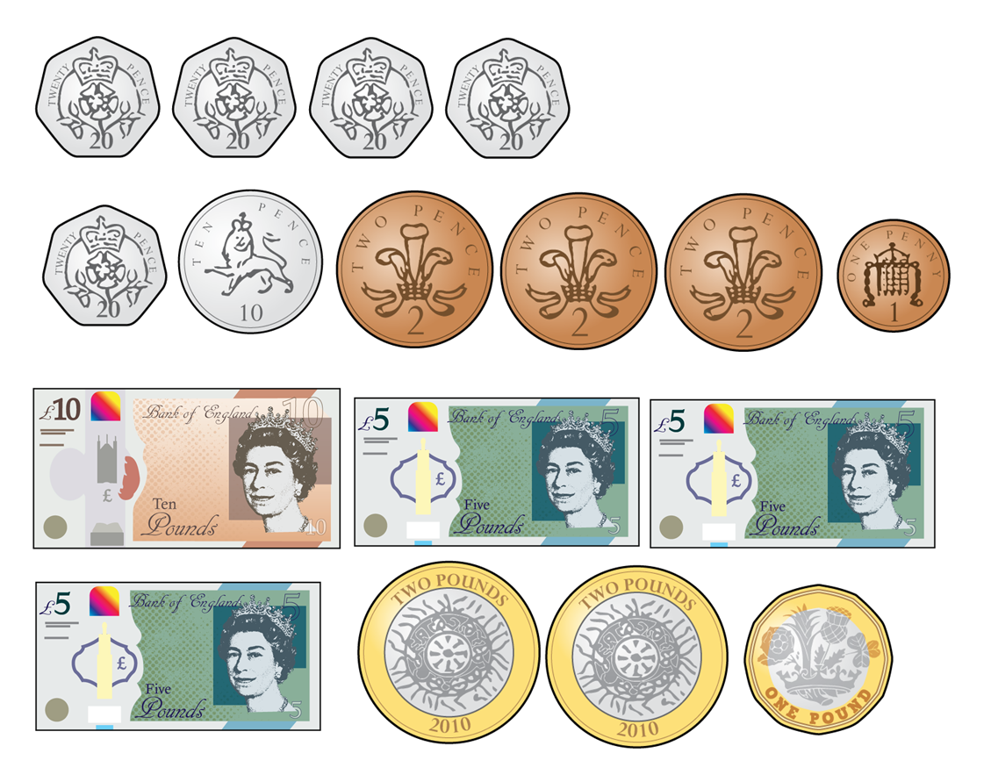
Count the money.
1)
2)
3)
4)

Slide 4
Count the money.
1)
2)
3)
4)
80p
37p
£20
£10

Slide 6
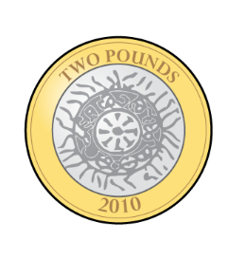
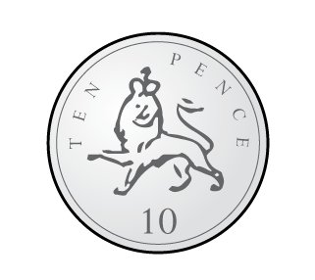
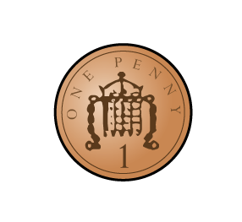
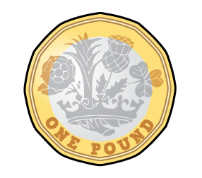

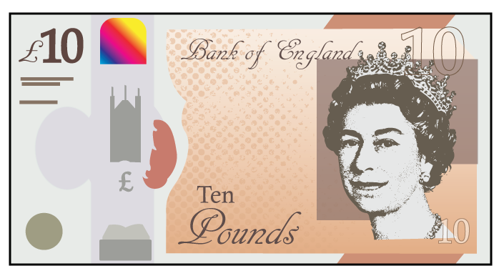
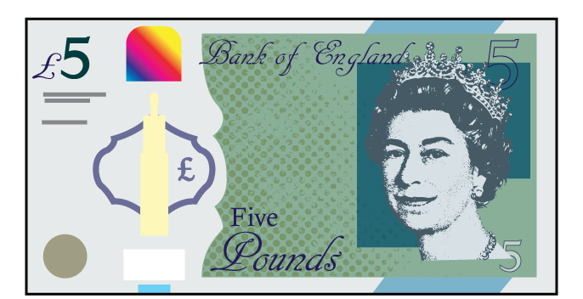
Which of these represent £14?
Have a think

Slide 7
Which of these represent £14?

Slide 8

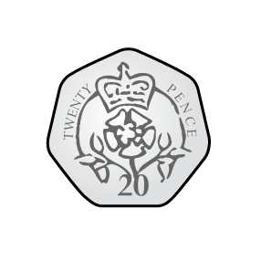
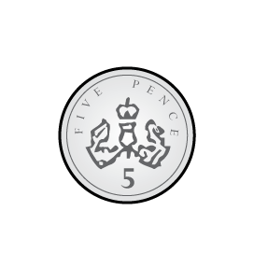

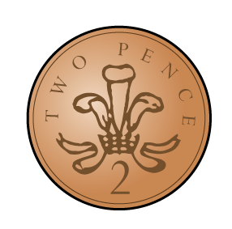
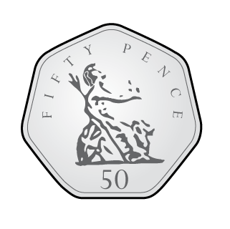

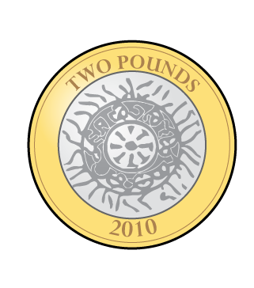
Who has the most money?
Who has the least?
50p
Jack
73p
Amir
£5
Mo
Have a think
Mo has the most money. Jack has the least.

Slide 9

Whitney is making 50p using only silver coins.
There are lots of different ways to do this.
Have a think

Slide 10
Have a go at questions
1 - 4 on the worksheet

Slide 11
How much does Whitney have?
£2
66p
Whitney has £2 and 66p

Slide 12
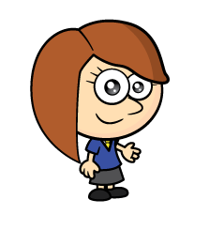
How much does Rosie have?
£7
34p
Rosie has £7 and 34p
Have a think

Slide 13
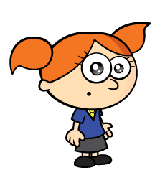
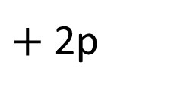
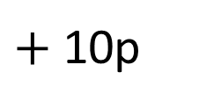


Alex has these coins.
Have a think
50p
$+$ 10p
$+$ 2p
$+$ 1p
$=$ 63p
She drops one of her coins.
How much could she have left?

Slide 14
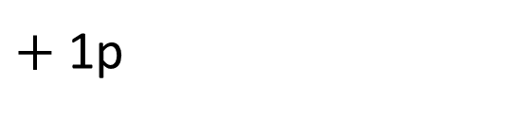
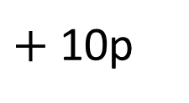
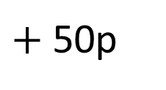
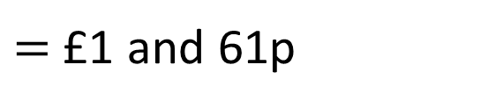
Alex has these coins.
£1
$+$ 50p
$+$ 10p
$+$ 1p
$=$ £1 and 61p
She drops one of her coins.
How much could she have left?

Slide 15
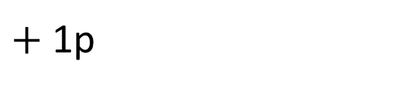
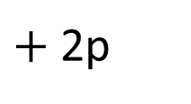
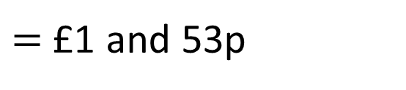
Alex has these coins.
£1
$+$ 50p
$+$ 2p
$+$ 1p
$=$ £1 and 53p
She drops one of her coins.
How much could she have left?

Slide 16
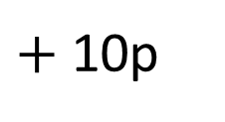
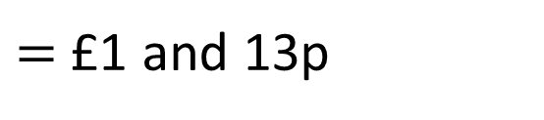
Alex has these coins.
£1
$+$ 10p
$+$ 2p
$+$ 1p
$=$ £1 and 13p
She drops one of her coins.
How much could she have left?

Slide 17
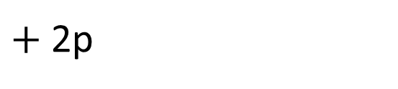
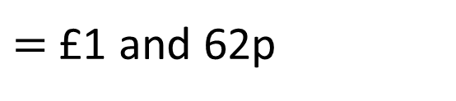
Alex has these coins.
£1
$+$ 50p
$+$ 10p
$+$ 2p
$=$ £1 and 62p
She drops one of her coins.
How much could she have left?

Slide 18
Have a go at the rest of the questions on the worksheet

