Slide 1
1) How many counters?
2) How many counters?
3) Which representations show 6?

Slide 2
1) How many counters?
2) How many counters?
3) Which representations show 6?
5
10

Slide 3
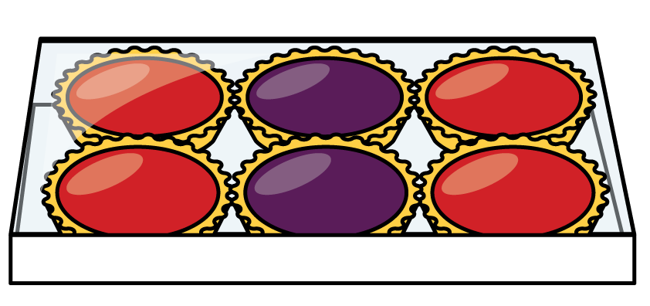
How many tarts?
3
3
2 2 2
How many rows?
How many columns?
How many in total?

Slide 4
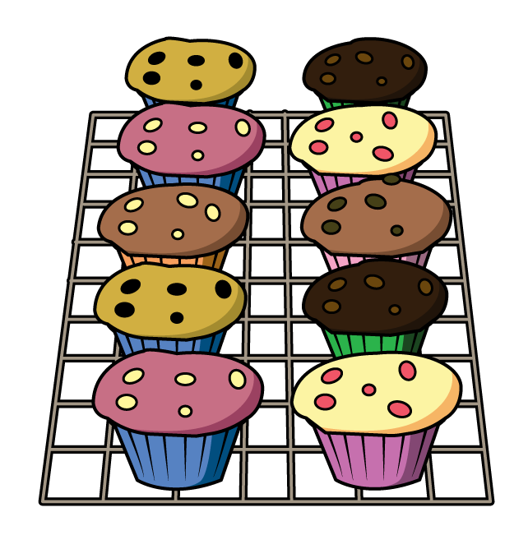
How many cakes?
2
2
2
2
2
5 5
How many rows?
How many columns?
How many in total?

Slide 5

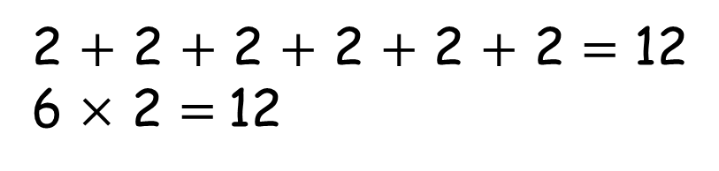
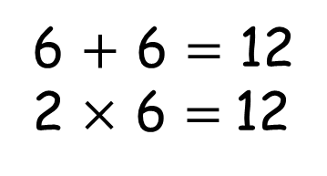
What is an array?
6 columns
2 rows
6 $+$ 6 $=$ 12
2 $×$ 6 $=$12
2 $+$ 2 $+$ 2 $+$ 2 $+$ 2 $+$ 2 $=$ 12
6 $×$ 2 $=$12
We have 2 lots of 6 if we look at the rows. This makes 12.
We have 6 lots of 2 if we look at the columns. This makes 12.

Slide 6


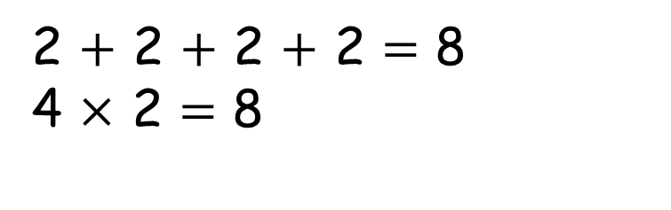
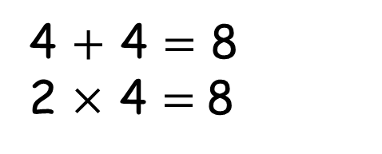
Have a think
4 $+$ 4 $=$ 8
2 $×$ 4 $=$8
2 $+$ 2 $+$ 2 $+$ 2 $=$ 8
4 $×$ 2 $=$ 8
We have 2 lots of 4 if we look at the rows. This makes 8.
We have 4 lots of 2 if we look at the columns. This makes 8.

Slide 7

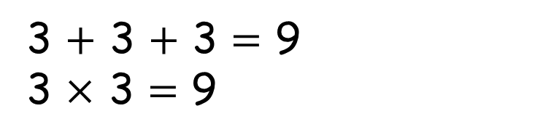
What could we do to make equal groups within this array?
Have a think
You can’t make an array because 9 is an odd number
3 $+$ 3 $+$ 3 $=$ 9
3 $×$ 3 $=\text{9}$

Slide 8
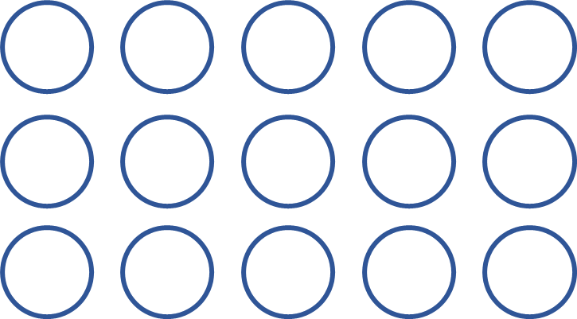
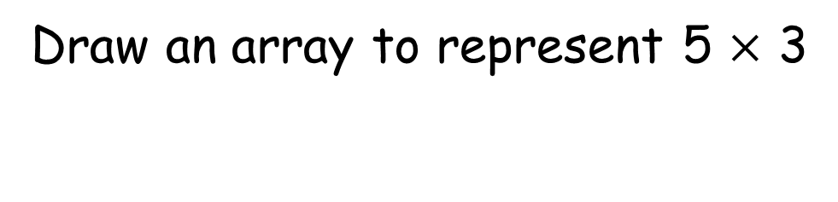
Draw an array to represent 5 $×$ 3
Have a think
Is there more than one way to draw this?

Slide 9
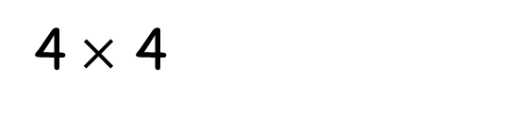
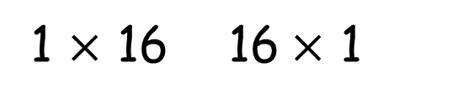
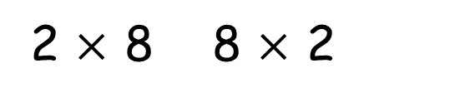
How many different arrays can you build with 16 counters?
1 $×$ 16 16$×$ 1
4$×$ 4
2 $×$ 8 8 $×$ 2
Have a think

Slide 10



16$×$ 1
halve
double
8 $×$ 2
halve
double
4$×$ 4
What do you notice?

Slide 11






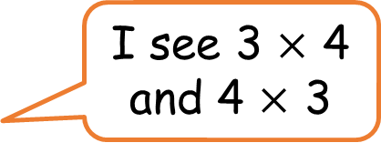
What do you see?
Have a think
I see 6 $×$ 2
I see 2 $×$ 6
I see one 12 and twelve 1s
I see 3 $×$ 4
and 4 $×$ 3

