Slide 1
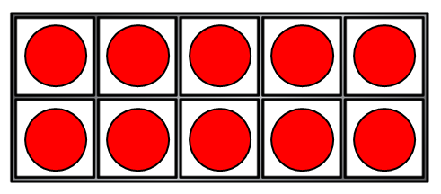
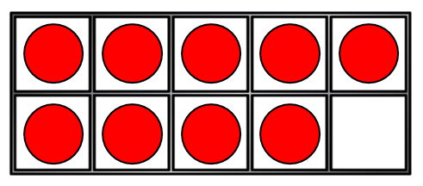
1) What is one more than 19?
2) 16 + ? = 20
3) How many?
4) These are number bonds to ___
6 + 2
3 + 5

Slide 2
1) What is one more than 19?
2) 16 + ? = 20
3) How many?
4) These are number bonds to ___
20
4
19
8
6 + 2
3 + 5

Slide 3
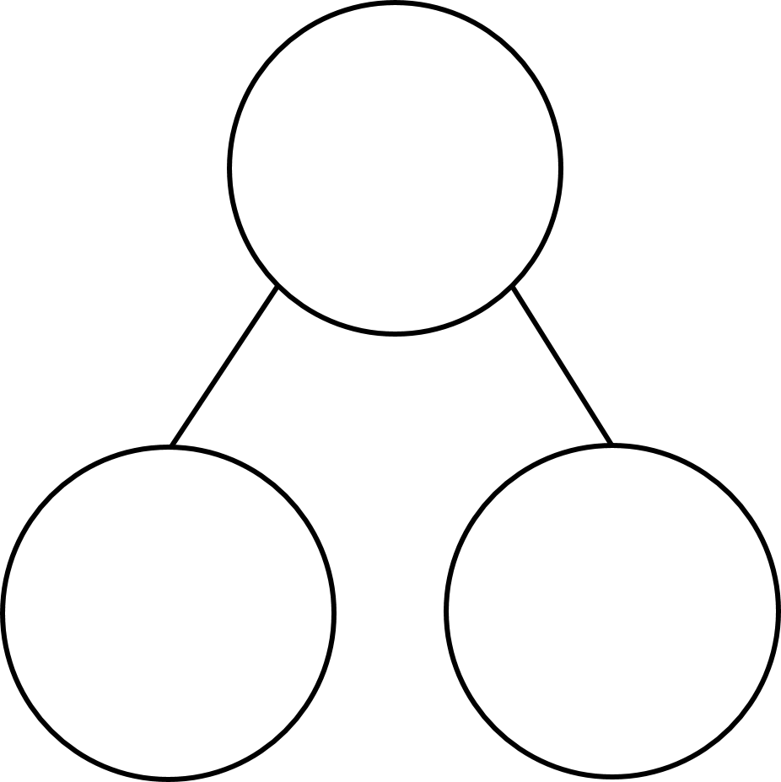
Using number bonds
7 + 2 =
9
9
7
2
7 ones + 2 ones
is equal to 9 ones

Slide 4
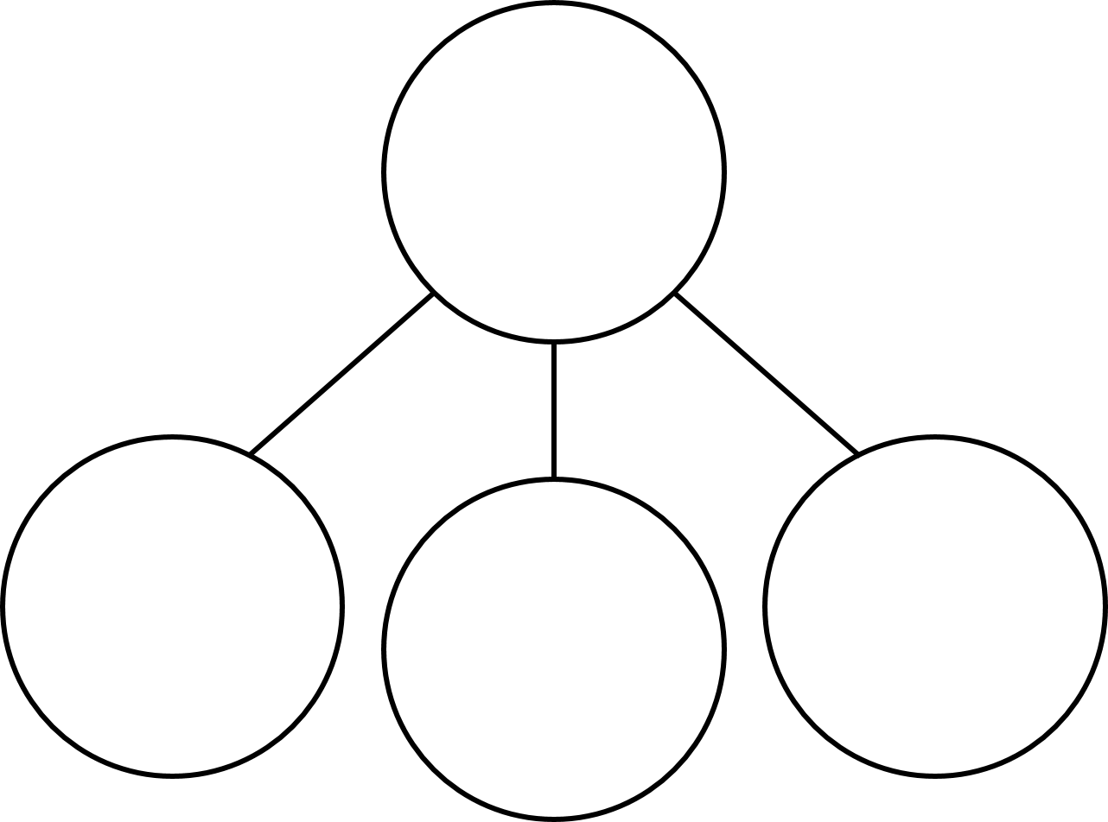
Using number bonds
7 + 2 =
17 + 2 =
19
9
9
19
7
2
10
2
7
7 ones + 2 ones
1 ten + 7 ones
add 2 ones
is equal to 9 ones
1 ten + 9 ones
How can we partition 17 into tens and ones?

Slide 5
Using number bonds
13 + 3 =
16
Have a think
10
3
3
1 ten + 3 ones
add 3 ones
1 ten + 6 ones
How can we partition 13 into tens and ones?

Slide 6
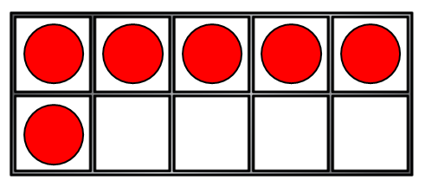
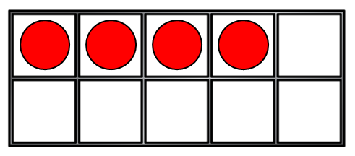
I know
my number bonds to 10!
6 + 4 = 10
16 + 4 = 20
6 + 14 = 20
Then you know lots of
the number bonds to 20!

Slide 7
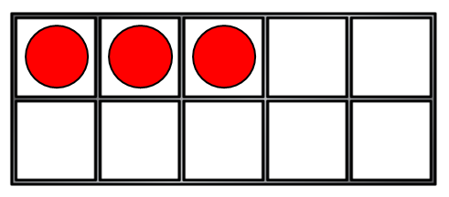
Have a think
If…
4 + 3 = 7
Then…
17
14 + 3 =

Slide 8
Have a think
If…
4 + 3 = 7
Then…
17
4 + 13 =

Slide 9
Have a think
If…
Then…
19
6 + 3 = 9
16 + 3 =
18
4 + 4 = 8
14 + 4 =
17
2 + 5 = 7
12 + 5 =
17
15 + 2 =

