Slide 1
Science - Year 1/2A Summer 2
Living Things and their Habitats
Food Chains
Session 4
Habitats PowerPoint
© Original resource copyright Hamilton Trust, who give permission for it to be adapted as wished by individual users.
We refer you to our warning, at the foot of the block overview, about links to other websites.

Slide 2
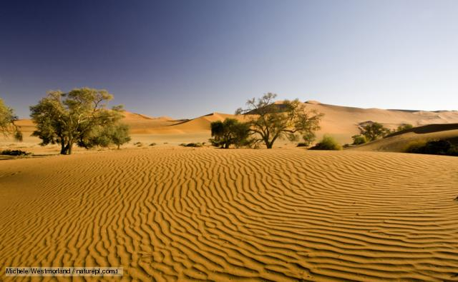
Habitats can be massive.
www.bbc.co.uk

Slide 3
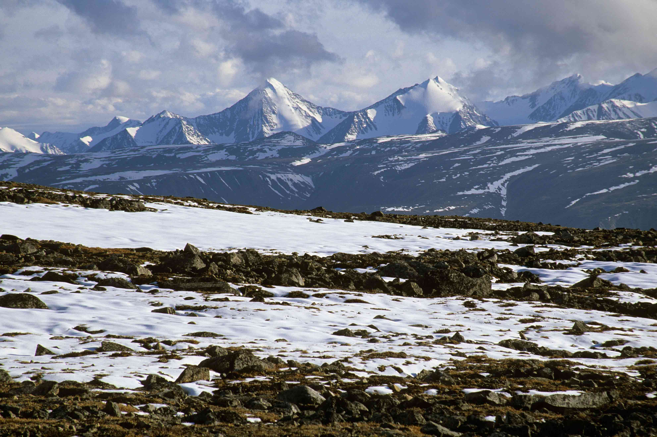
Habitats can be cold.
thearcticwolfblog.wordpress.com

Slide 4
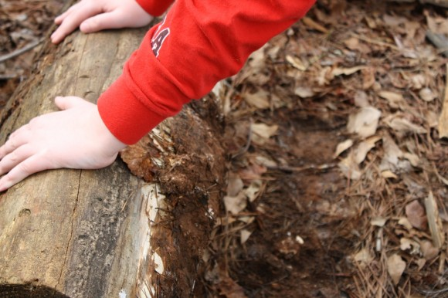
Habitats can be small.
www.hodgepodge.me

Slide 5
What are the features of this habitat?
What would live here?
How would it survive?
www.bbc.co.uk

Slide 6
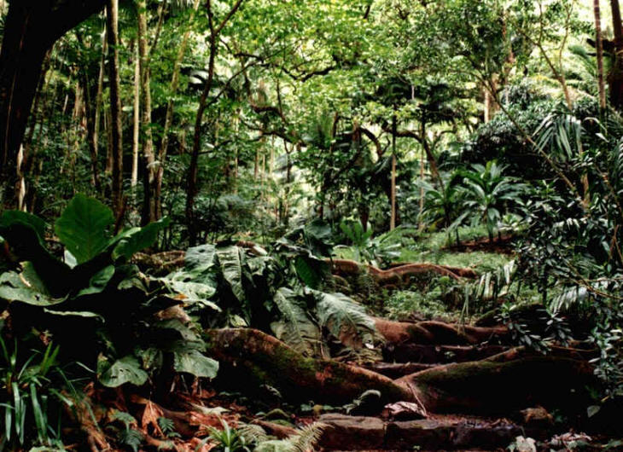
Habitats can be dark.
lajhsslab.com

Slide 7
What are the features of this habitat?
What would live here?
How would it survive?
What would a food chain be like?
thearcticwolfblog.wordpress.com

Slide 8
What are the features of this habitat?
What would live here?
How would it survive?
What would a food chain be like?
lajhsslab.com

Slide 9
What are the features of this habitat?
What would live here?
How would it survive?
What would a food chain be like?
www.hodgepodge.me

Slide 10
lajhsslab.com

Slide 11
www.hodgepodge.me

Slide 12
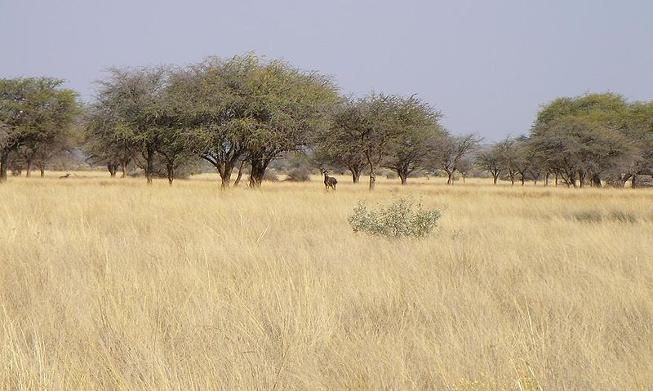
https://commons.wikimedia.org/wiki/File:Savannah_near_Kuruman.JPG

Slide 13
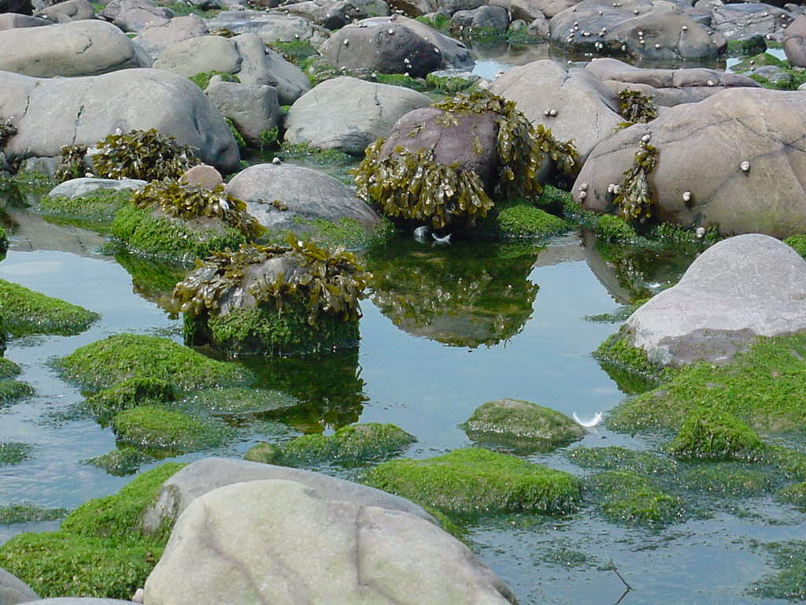
www.edulink.networcs.net

Slide 14
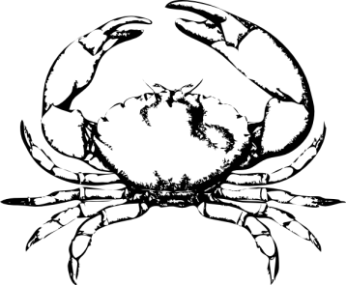
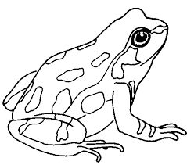
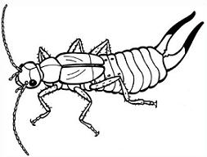
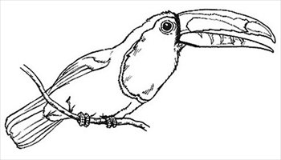
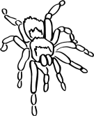
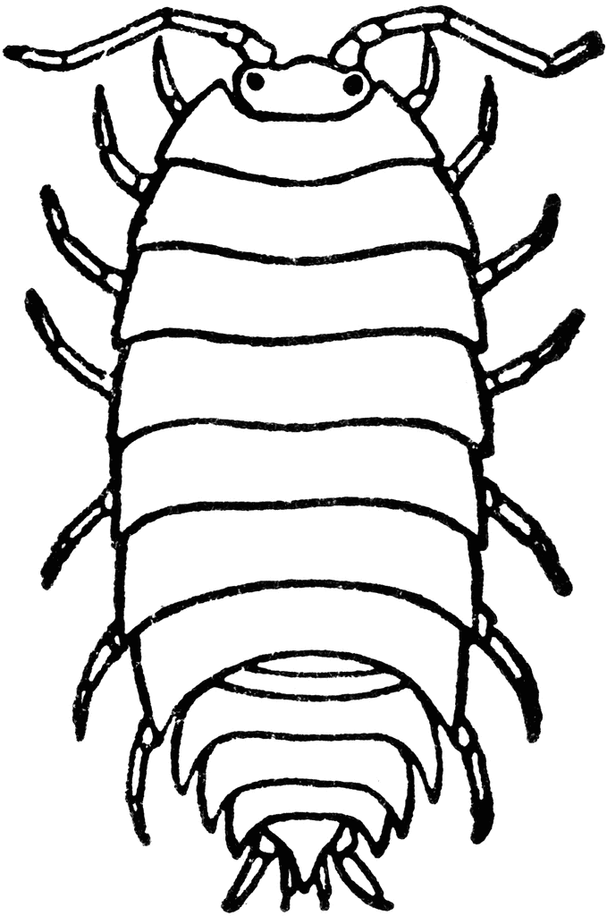
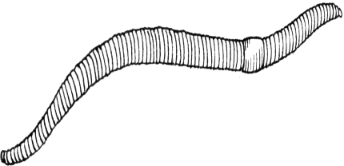
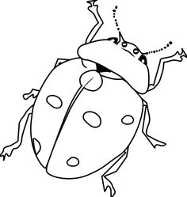
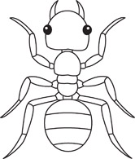
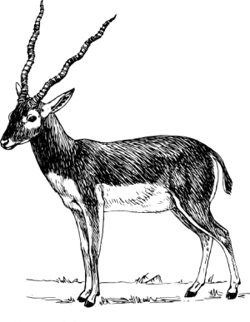
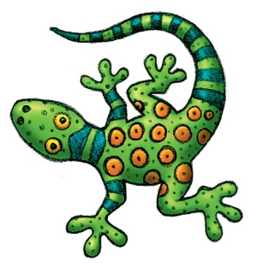
To which habitat do these belong? Why have they chosen to live in that habitat?

