Slide 1
Yarm Primary - Nursery
What lives on a farm? What is the job of a farmer?
Subject Specific Vocabulary​ |  |  | Sticky Knowledge about chicks and farms
egg | An oval object laid by a female bird, reptile, invertebrate or fish, usually containing a developing embryo/baby. | After Easter, we will be exploring the farm and find out about what happens on a farm and what animals live there. We have included some information that you may like to share with your child as well as some suggested activities. Have fun! | It takes 21 days for a chick to hatch out of an egg.
crops | A plant that is grown on a large scale commercially, especially a cereal, fruit, or vegetable. |  | A chick has a special tooth called an ‘egg tooth’ to peck a hole through the shell of the egg. This is called ‘pipping’
young | The baby of an adult animal.
produce | Something that is made raw materials. | Brain Teaser….. | Chickens are omnivores. This means that they eat seeds, grass, grain as well as insects, mice and even lizards!
 |  | ​ What are these pictures of? How are they linked to the farm?
Life cycle | A series of changes in the life of a living thing.
 |  |  | A person who works on a farm is called a farmer.
 |  |  | Farms produce plants, animals, milk, wool and cotton. People need these things to be able to live.
An area of land and buildings, used for growing crops and rearing animals
Farms

Slide 2
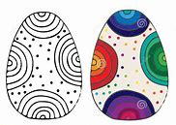
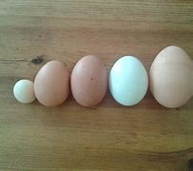
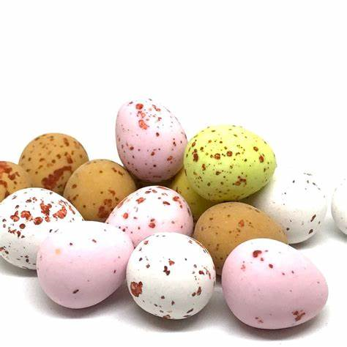
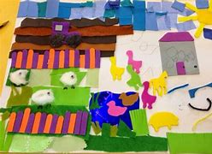
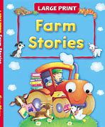
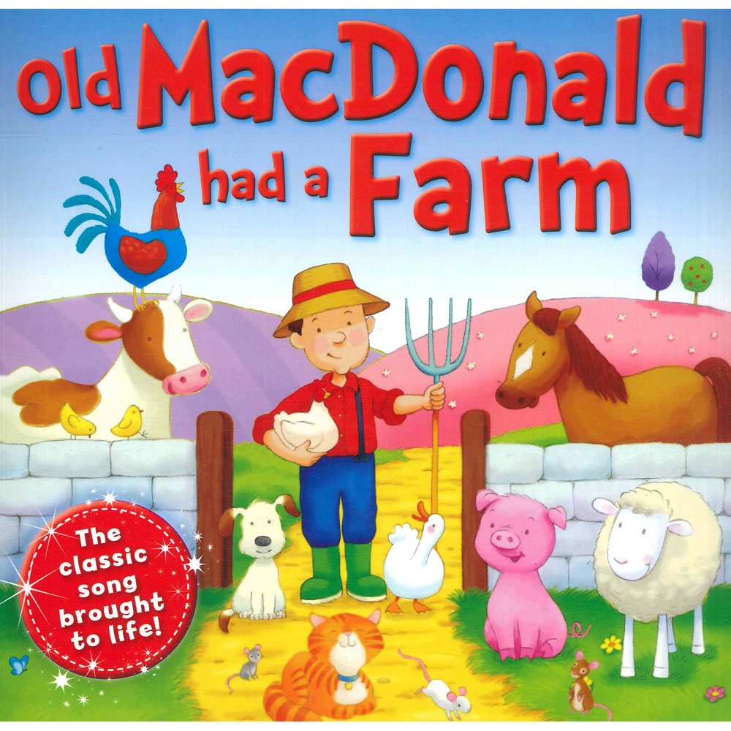
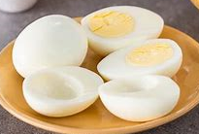
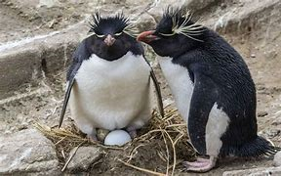
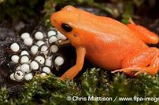
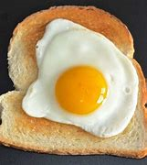
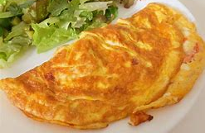
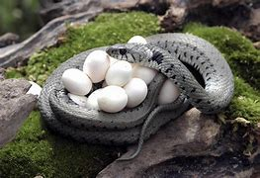
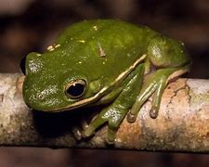
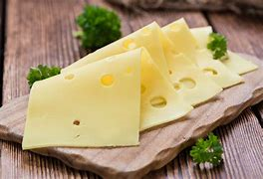
Draw patterns on the template of an egg. | Using a dice and some sweet mini eggs (or smarties will do) Play a game of ‘collecting eggs’. Take turns to roll the dice, count out the correct number of eggs. Who has the most? Who has the least? How many would you have if you added 1 / 2 more? How many would you have left if you ate 1? | Use/make some playdoh. Can you make some egg shapes? How many have you made? Are they all the same size? Can you order your eggs from biggest to smallest?
Can you create a ‘Farm’ picture? You could use pencils, pens or paint or you could even use different materials to make a ‘farm’ collage! | Farm Activities You may want to choose a couple of the activities to complete. | Find a ‘chick’ or ‘farm’ story to read. What was your favourite part of the story? Can you sing the song ‘Old Macdonald’?
Do some cooking with eggs. How many ways can you cook eggs? What was your favourite? | Can you find out which animals lay eggs? Draw your favourite one. | How many things can you think of that begin with a ‘f’ sound? How many things can you think of that starts with a ‘ch’ sound. Draw pictures of them. Write down any sounds that you can hear in each word.

Slide 3
