Slide 1
P.E from Home Reception

Slide 2
Introduction
Physical activity can be lots of things. It can mean all bodily movements that use energy. It includes all types of physical exercise, sports and dance activities. But it also includes indoor and outdoor play, work-related activity, outdoor and adventurous activities, active travel (walking, cycling, scooting) and even something as simple as using the stairs in your home.
For everyone, not just children, who are stuck at home this lockdown it’s important to maintain a physical exercise routine and where possible try and stay as active as you can be. It may even be a great time to increase how active you are if you have more available time.
The following PowerPoint is our second instalment for P.E. at home and has some new ways in which your child can stay active this week as well as those challenges for across this half term. We hope you enjoyed the first lot of activities and are making a start at those longer ones for this half term. Remember to let us know how you got on with the activities on class dojo.
Thanks Elliott

Slide 3
Warm-up: Cosmic Yoga
It’s always important to stretch and warm up before doing any sport to get us ready for our activities.
This weeks cosmic yoga warm-up is an under the sea adventure with Squish the fish. Click the link below to begin.
https://www.youtube.com/watch?v=LhYtcadR9nw&list=PL8snGkhBF7nhEquR7wXbzIXjFrlXsze_H&index=5

Slide 4
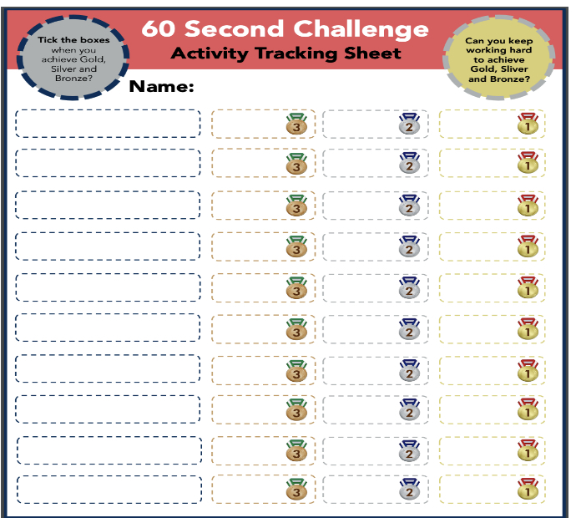
Activity 1: Throwing for Accuracy
Our next activity will test our coordination through throwing accuracy. The video link below shows you how to play and what we are going to practice.
https://www.youtube.com/watch?v=tHRvquNKf1Q
Courtesy of Yorkshire Sport Foundation
Different ways to make it harder;
Stand further away
Use a smaller target
Use your non-writing hand
For our medal challenge can you try and get the ball, socks or whatever you are using in as many times as you can in 60 seconds. Do it from a distance that you feel comfortable! Just use one item and run to collect it in between to make it more challenging.
Gold: Get your item in the target 10 times.
Silver: Get your item in the target 6 times.
Bronze: Get your item in the target 3 times.
Submit your high score for keep ups and rallies to class dojo!

Slide 5
Activity 1: Throwing for Accuracy continued..
Another way in which you could do this activity is by creating your own target. Add different size targets to challenge you. You could stick your target to the wall inside or outside (ask for permission first). Try different types of throws to hit the target; underarm, over arm, bounce. If you are successful, move further away or try for the smaller targets.

Slide 6
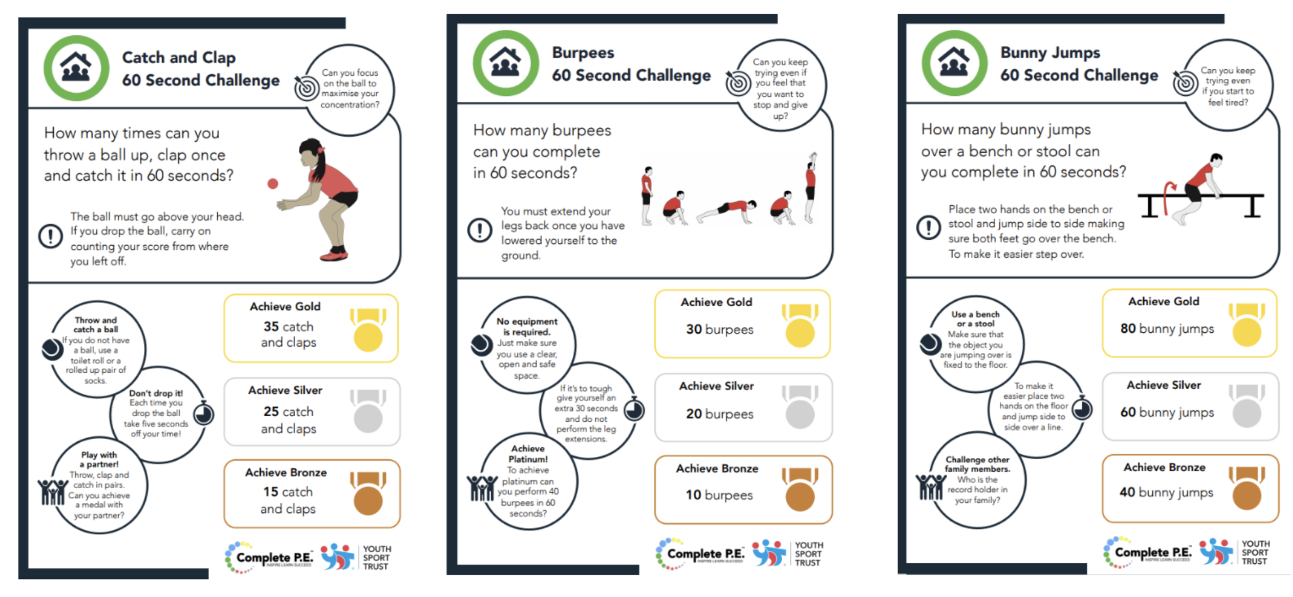
Activity 2: 60 second skill challenge *bonus*
Achieve Gold
15 catch and claps
Achieve Gold
20 burpees
Achieve Gold
30 Bunny jumps
Achieve Silver
10 catch and claps
Achieve Silver 15 burpees
Achieve Silver
20 Bunny jumps
Achieve Bronze
10 Bunny jumps
Achieve Bronze
5 catch and claps
Achieve Bronze 10 burpees
Here are a few more 60 second challenges you can do to earn even more medals. Remember don’t worry if you don’t get Gold straightaway keep practicing to work your way up from Bronze, to Silver, to Gold. Remember to record your scores on the score sheet from the previous slide.*I have simplified the medals for reception to make the challenges more suitable* for bunny hops just try to get them jumping side to side over an object; cushion, teddy, etc.

Slide 7
Activity 3: Workout Challenge
The below are a few links to videos from the wonderful YouTube channel of Joe Wicks who has been keeping the entire nation moving across all three of these lockdowns. They are some short exercise blasts that can be done in one go as a longer exercise workout or as a daily top up.
Active 8 Minute Workout Featuring Izzy | The Body Coach
https://www.youtube.com/watch?v=YIB2SJnBHBQ&list=PLyCLoPd4VxBvPHOpzoEk5onAEbq40g2-k&index=3
5 Minute Move Featuring Noah and Jessie | The Body Coach TV
https://www.youtube.com/watch?v=xbVr38Bhe7E&list=PLyCLoPd4VxBvPHOpzoEk5onAEbq40g2-k&index=5
5 Minute Move | Kids Workout 3 | The Body Coach TV
https://www.youtube.com/watch?v=pnKCGY9ZocA&list=PLyCLoPd4VxBvPHOpzoEk5onAEbq40g2-k&index=7

Slide 8
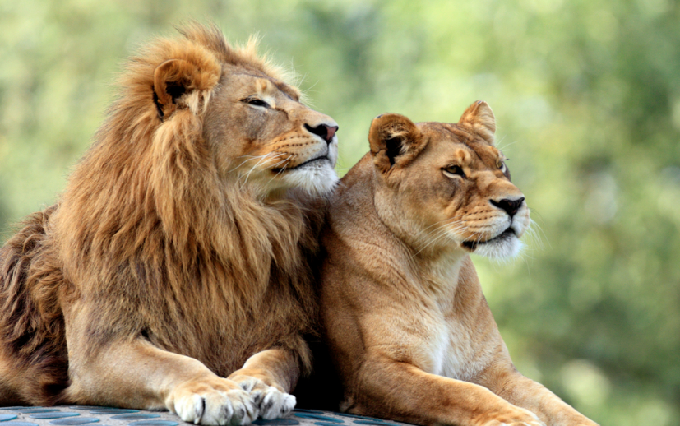
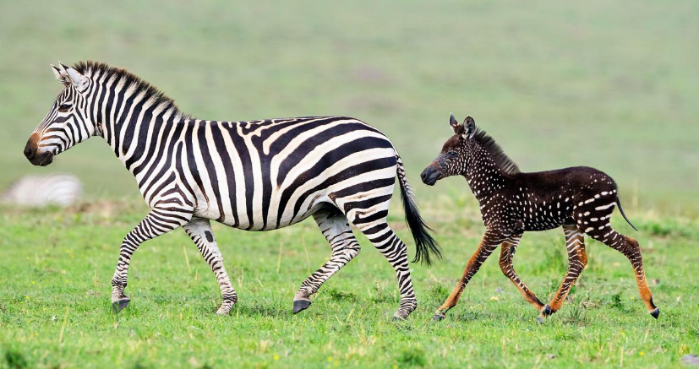
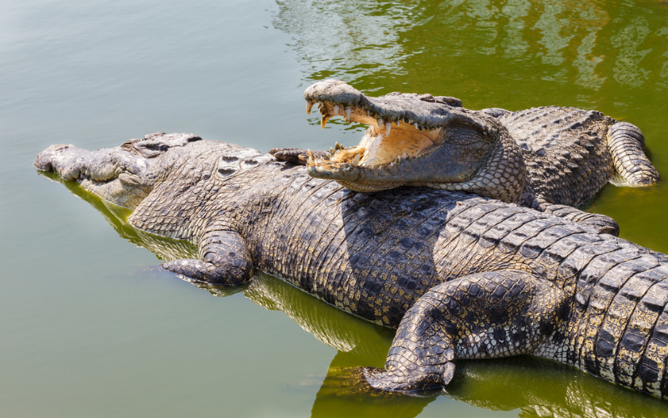
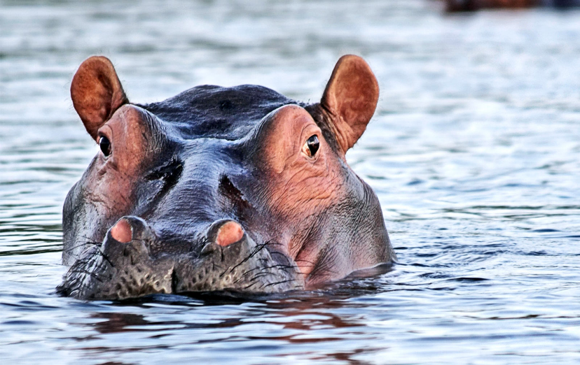
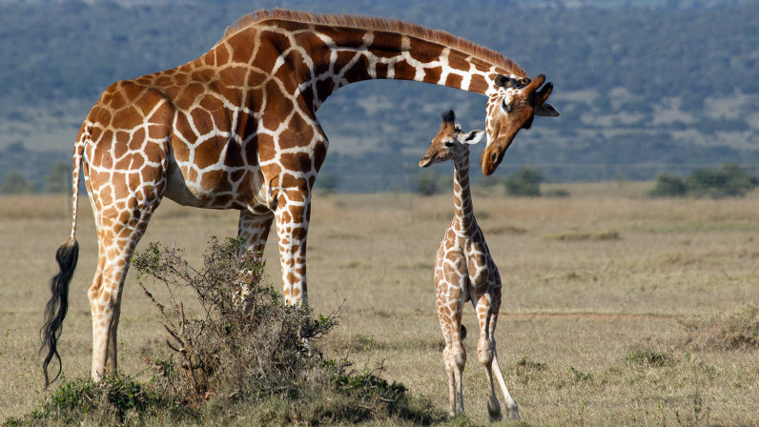
Cool-down: Dance Animals
Building on from the Animal movers from week 1. Could you try and move in the following ways: STOMP, CRAWL, WADDLE, BOUNCE, POUNCE, SCUTTLE and CREEP. Then think about which animals could fit with these moves. Can you think of any other movement words/animal moves that you could add in. Think about how you can move every part of you; arms, legs, head and body.
Now imagine you are going on an animal journey and can you link some of these movements together and move in different directions around your room. Add some music in as well, can you change your moves to match the music. Some moves will be better with slow music some will be better with fast. Which is your favourite?
Watch this following The Lion King dance video to help. How many different types of animals can you spot? What makes some of the dancers moves better than others? Can you pick an animal in the video and copy?
https://www.youtube.com/watch?v=-j-VXtvDhNo

Slide 9
Activities to Keep You Moving This Half-term
Remember there are lots of other ways you can keep active this half term. These next few activities are ones you can complete week by week during lockdown. All the activities from previous weeks are there in case you haven’t had chance to start them yet. Some have been updated with a few bonus challenges as well so look out for them.
This week I’ve added two new ones. Monopoly fitness and create your own workout from week 1 has been added so that you can carry on being creative and improving them so that we could use them for our warmups once we are all back in school.

Slide 10
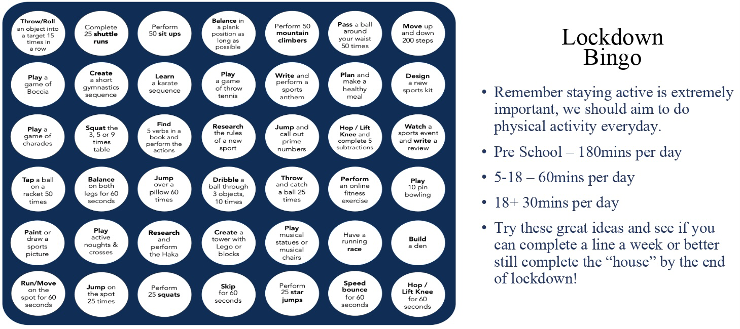
Lockdown Bingo!
Staying active is extremely important, we should aim to do physical activity everyday for 60 minutes if you are aged between 5-18.
Try these great ideas on our bingo sheet and see if you can complete a line a week or better yet complete the entire sheet by the end of lockdown and celebrate getting BINGO!!!
Has anyone got a line yet? Or even bingo?!

Slide 11
Scavenger Hunt
Indoor scavenger hunt is the perfect challenge for being stuck inside.
Find some small items that you could hide around the house.
Get someone at home to hide them - you could start with just one room, or one item in each room.
Time how long it takes to collect them all.
Try it again and try and beat your time.
Ways to make it more challenging;
Add more items and try and make them smaller and smaller so they’re harder to spot.
Add more rooms to the hunt so you have got a bigger area to search in.
Try to do complete the scavenger hunt moving in different ways. Have to move on all fours, only allowed to hop on one leg etc.

Slide 12
Monopoly Fitness
A fitness twist on the classic game. If you can, print off this slide and grab some coins as game pieces and some dice.
Roll the dice, move your game piece and complete each activity.
When you pass go give yourself one point. You could say first to 5 or 10 points is the winner. For a longer workout you could even do first to 20 points.
Good luck and have FUN!

Slide 13
Create your own workout
Following on from everyone enjoying creating their own workouts in the first week. I’ve added it to the half term activities so that you can carry on perfecting your work out routines. Keep working at them and hopefully when we are all back in school and we can use them as a warmups.
Try these extension tasks if your really enjoying this one:
Create your own list of movements to try.
Add some music to your routine and perform it for someone.
Choose 3 different balances and link each balance with a movement from your list e.g. a twist, a jump, a roll. Try and hold each balance for 3-5 seconds.

Slide 14
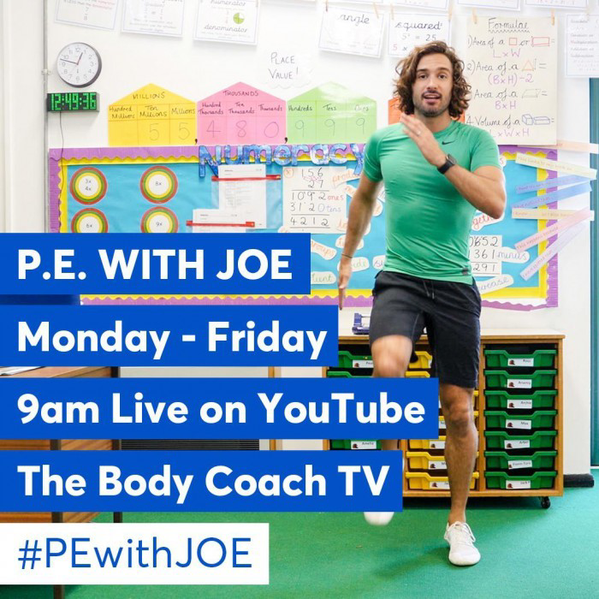
Joe Wicks: P.E at home
If you are still looking for more workout-based activities, Joe Wicks’ weekly workouts are great for kids of all ages.
They are three times a week: Monday, Wednesday and Friday live streamed from 9am.
YouTube channel link: https://www.youtube.com/channel/UCAxW1XT0iEJo0TYlRfn6rYQ
These videos are an excellent tool to use both at school and at home that many schools just like ours are taking advantage off and thankful for.

Slide 15
BBC Supermovers for KS1 and KS2
BBC Supermovers if a fun filled resource for all primary school ages both KS1 and KS2. It is packed with loads of ways to keep young people moving and active but at the same time learning and practicing other key subjects like Maths, English and Science.
The webpage link is: https://www.bbc.co.uk/teach/supermovers
There are up to a 100 different videos to choose from so go have a look and find some fun new ways to learn and be active at the same time.

Slide 16
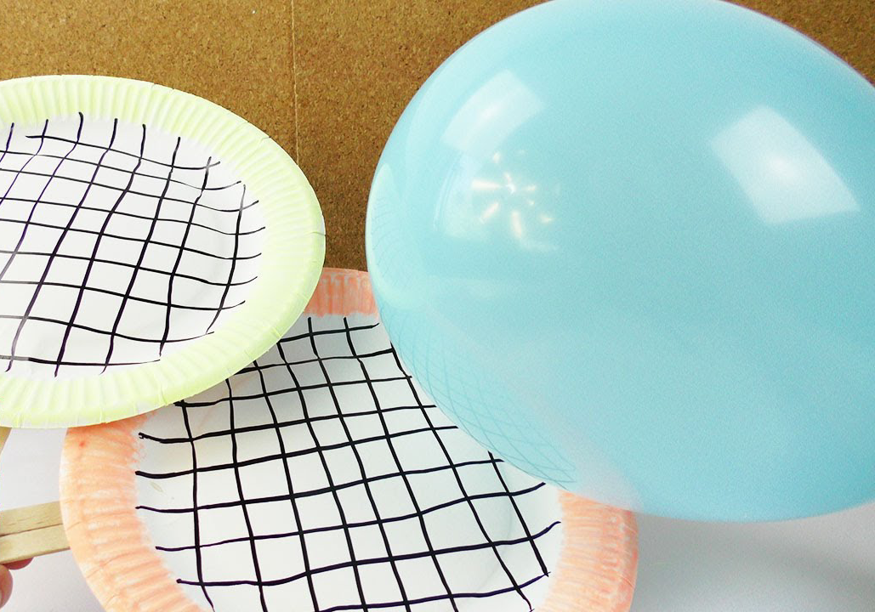
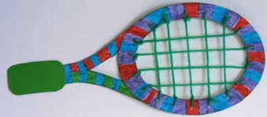
Bonus Challenge
If you haven’t already get creating your own Tennis racket.
Following on from your first online activity set by Miss Puttick that everyone seemed to really enjoy (see last weeks presentation) we thought a way we could make this even more fun is over the next few weeks try and create your own Tennis racket/bat and decorate it how you like.
Here’s a few examples for you. Submit a picture or video of yours to your class dojo so we can see your creations. Elliott, Miss Puttick and Mrs Barber will choose our favourites.

