Slide 1



P.E from Home Year 3 & 4

Slide 2
Introduction
Physical activity can be lots of things. It can mean all bodily movements that use energy. It includes all types of physical exercise, sports and dance activities. But it also includes indoor and outdoor play, work-related activity, outdoor and adventurous activities, active travel (walking, cycling, scooting) and even something as simple as using the stairs in your home.
For everyone, not just children, who are stuck at home this lockdown it’s important to maintain a physical exercise routine and where possible try and stay as active as you can be. It may even be a great time to increase how active you are if you have more available time. Staying active is extremely important, we should aim to do physical activity everyday for 60 minutes if you are aged between 5-18.
Here is our sixth and final P.E. At home instalment as we will be seeing you all back in school on the 8th March. With it being the last week I’ve set you a few more activities than usual to give us one last chance to earn as many medals as possible. Remember just because we are coming back to school that doesn’t mean you can’t play some of the games and challenges we have done over the last weeks at home in future. Look forward to seeing you all back at School!
Thanks Elliott!

Slide 3
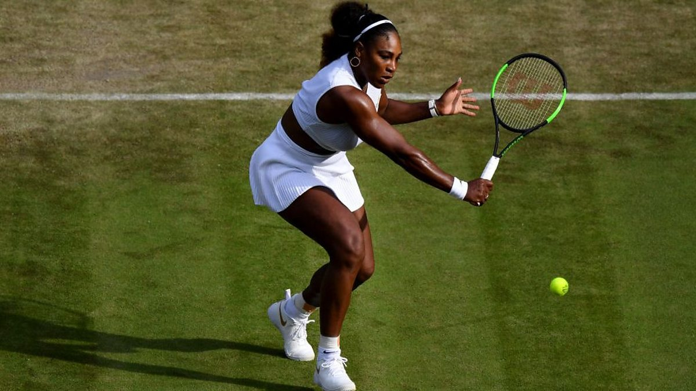
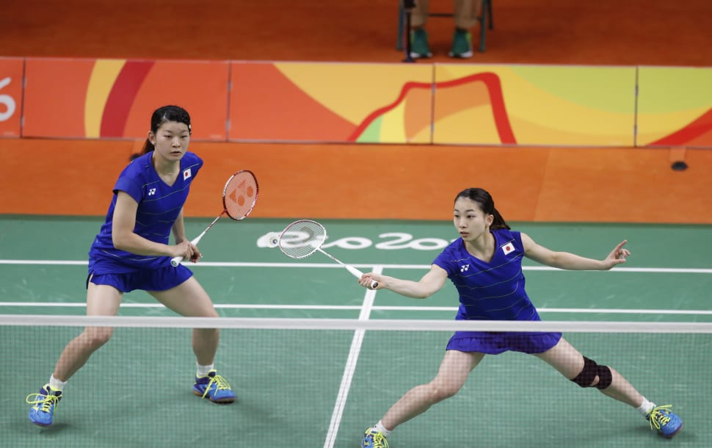
This Weeks Activities
For our final week of activities our focuses are agility, creative movement and striking the ball for distance. These activities work on several skills that once again are applicable to loads of sports agility being key in invasion based sports like football, basketball and rugby. Creative movement for sports such as dance and ballet. Our final activity striking for distance works on our hand eye coordination something which has been a heavy focus of our working from home P.E. but will be really important on your return to school with our current sporting focus being Tennis and Badminton. As always all of these skill are essential in children’s daily lives both now and as they grow into young adults.
Again this week there is a third main activity but with it being the last week of working from home I have added a fourth to give even more choice. That also means this week we’ve got more chances than ever to win those Gold medals with three activities as well as the 60 second challenges! Remember to have a go at all the different version of the activities in the videos in activity 1,2 and 3. Do this to improve your skills before playing the version of the game that is the focus of our medal challenge so that you have the best possible chance of getting that gold for each one. If you get Gold once you can always do it again; a good champion always looks to add further success and defend there titles!
As we are starting our new sports of Tennis and Badminton to help those not in School I have added some supplementary videos to help aid your understanding and help improve your technique when you get the chance to put it into practice in P.E.
Remember you don’t have to do all of these activities in one go! Spread them across the week if you want to keep you busy!

Slide 4
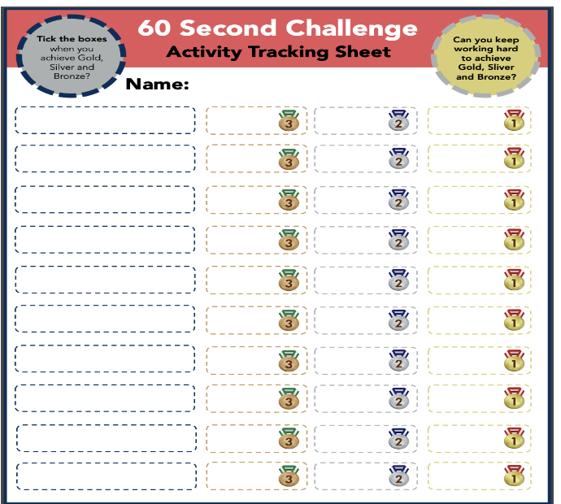
Activity 1: Agility and Throws
The video link below shows you how to play and what we are going to practice. The following three exercises that will improve your agility, balance and coordination. The three fundamental skills we will be working on are vital in everything we do. For example, playing tag, dodging a crazy dog or balancing to score the winning goal. Give all three games in the video a go!
https://www.youtube.com/watch?v=gRRnI3vB1WI&list=PLYGRaluWWTojV3An2WEgsQ4qGFy_91jDL&index=13
Courtesy of Yorkshire Sport Foundation
For our medal challenge play the third game in the video. To get those medals you’ve got to be quick and accurate.
Do the following to earn those medals;
Gold: In 60 seconds match 10 pairs of socks and throw them in the target.
Silver: In 60 seconds match 7 pairs of socks and throw them In the target.
Bronze: In 60 seconds match 4 pairs of socks and throw them in the target.
Submit your high scores to class dojo!

Slide 5
Activity 2: Creative Movement
Today’s second activity will focus on creating movement and improvisation. This is something we cover in a dance unit in schools. This activity will help children feel more confident about using their body in different ways. It will develop social skills, like teamwork and collaboration and also increase spatial awareness. The video link below shows you how to play and what we are going to practice.
https://www.youtube.com/watch?v=_pWus22nTVI&list=PLYGRaluWWTojV3An2WEgsQ4qGFy_91jDL&index=14
Courtesy of Yorkshire Sport Foundation
For our medal challenge we are going to earn them by working through all three activities and trying to create your own routines.
Do the following to earn those medals;
Gold: Complete all activities and create 3 of your own routines.
Silver: Complete all activities and create 2 of your own routines.
Bronze: Complete all activities and create 1 of your own routines.
Submit your high scores to class dojo!

Slide 6
Activity 3: Sock Wars
Here is another activity that utilises your socks for P.E. And looks at developing children’s agility when attacking and defending against an opponent. This is a really important skill in lots of invasion sports such as basketball, netball, football and rugby and in real life situations or emergency where the children might need to react or move really quickly. These games are great for children of any age and varying versions are often used as warm ups for many invasion style games.
The video link below shows you how to play and what we are going to practice.
https://www.youtube.com/watch?v=TUA9CqMxI8k&list=PLYGRaluWWTojV3An2WEgsQ4qGFy_91jDL&index=15
Courtesy of Yorkshire Sport Foundation
For our medal challenge we are looking at the third version of the activity in the video.
Do the following to earn those medals;
Gold: Play 5 games of the item collection game and beat your partner in three games.
Silver: Play 5 games of the item collection game and beat your partner in two games.
Bronze: Play 5 games of the item collection game and beat your partner in one game.
Submit your high scores to class dojo!

Slide 7
Activity 4: Striking for Distance
Striking an object is commonly used in sports such as cricket, tennis, badminton and even squash, and the main focus of this half terms sports (Tennis, Badminton) that we have started and you will be undertaking on your return to school. Having improved hand-eye coordination will also help you achieve better hand writing skills. Let’s have a look. The video link below shows you how to play and what we are going to practice.
https://www.youtube.com/watch?v=g4aNXE3i7AE&list=PLYGRaluWWTojV3An2WEgsQ4qGFy_91jDL&index=16
Courtesy of Yorkshire Sport Foundation
For our medal challenge we are looking at the fourth version of the activity in the video; “Hand Cricket”. Practice first by trying to get as many points you can in one go. The play a match with your partner play through 3 rounds of you batting and bowling.
Do the following to earn those medals;
Gold: Get a score of 12 from 3 shots in one go and win 3 games against your partner.
Silver: Get a score of 8 from 3 shots in one go and win 2 games against your partner.
Bronze: Get a score of 4 from 3 shots in one go and win 1 games against your partner.
Submit your high scores to class dojo!

Slide 8
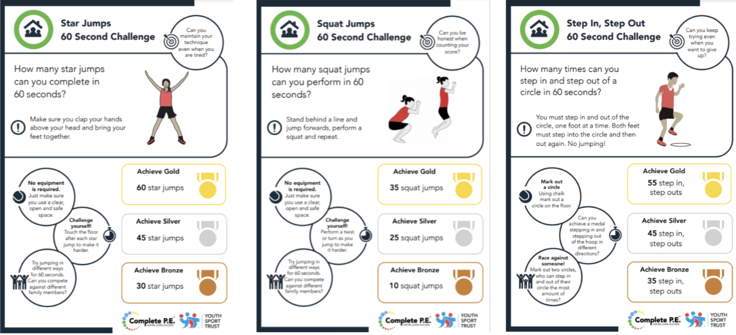
Activity 5: 60 second skill challenge *bonus*
Here are a few more 60 second challenges you can do to earn even more medals. Remember don’t worry if you don’t get Gold straightaway keep practicing to work your way up from Bronze, to Silver, to Gold. Remember to record your scores on the score sheet from the previous slide.

Slide 9
Activity 6: Workout Challenge
The below are a few links to videos from the wonderful YouTube channel of Joe Wicks who has been keeping the entire nation moving across all three of these lockdowns. They are some short exercise blasts that can be done in one go as a longer exercise workout or as a daily top up.
Active 8 Minute featuring Eloise and Charlie | The Body Coach TV
https://www.youtube.com/watch?v=pLuM18p9zbM&list=PLyCLoPd4VxBvPHOpzoEk5onAEbq40g2-k&index=14
Active 8 Minute Workout 3 | The Body Coach TV
https://www.youtube.com/watch?v=9uw9ug_g-gM&list=PLyCLoPd4VxBvPHOpzoEk5onAEbq40g2-k&index=19
Active 8 Minute Workout 3 | The Body Coach TV
https://www.youtube.com/watch?v=E5cmJpSFZB8&list=PLyCLoPd4VxBvPHOpzoEk5onAEbq40g2-k&index=16
FROGGY COACH Active 8 Minute Kids Workout | The Body Coach TV
https://www.youtube.com/watch?v=16FIVgWUklY&list=PLyCLoPd4VxBvPHOpzoEk5onAEbq40g2-k&index=21

Slide 10
Extra videos for inspiration for Tennis
If you have a tennis racket at home check out some of the Tennis Skill videos below, you could try some of these videos for practice or if you don’t have a racket at home, you could just watch to help understand how we play the sport. Our first video explains the basic rules of tennis.
The Rules of Tennis EXPLAINED (scoring, terms and more) - https://www.youtube.com/watch?v=jrhM3k84YJU
These Skill challenges come from the Ben Smith Tennis Youtube channel and are great ideas for some tennis themed challenges;
Skill Challenge 1 - Soft Hand Skills - https://www.youtube.com/watch?v=8VufajxfwDo
Physical Challenge 1 - 2 Ball Catch - https://www.youtube.com/watch?v=u-slncscADM
Skill Challenge 2 - Wall Ball - https://www.youtube.com/watch?v=4BoS5sb0ZEs
Physical Challenge 2 - The 100 Challenge - https://www.youtube.com/watch?v=4MkuR7BHmVM
Skill Challenge 3 - Ball Carousel - https://www.youtube.com/watch?v=zgjrN1eqWec
Physical Challenge 3 -Drop Touch Catch - https://www.youtube.com/watch?v=AR2OPtOQusk
Skill Challenge 4 – Volleywall - https://www.youtube.com/watch?v=IZGwm-LU4Pk

Slide 11

Activities to Keep You Moving This Half-term
I hope you’ve enjoyed these installments both the weekly activities and the other longer activities to try across the half term. If you’ve completed some of the activities for last half term that’s great and hopefully you feel healthier and stronger for doing them. Let us know which ones you enjoyed most. Now for you at home you will be back in school shortly so my final challenge to you is if there is any of the activities you haven’t done yet or have been wanting to do but haven’t got round to them give them a see if you can complete one last fitness goal before coming back to school.
Remember if you really enjoyed any of the activities over the last few weeks don’t forget about them keep doing them at home or in school where you can. If there are any activities that were related to any specific sport that you enjoyed don’t forget to have a look out for local classes and clubs starting back up again after lockdown for you to try and enjoy.

Slide 12
Online Weekly Sessions Timetable
The table below gives you an overview of what online classes are available that you can do at home for free and when they are streamed live on YouTube. All sessions are available on the providers channel after the stream so don’t worry if you miss them or can’t tune in at that time they can always be done later.
Monday | Tuesday | Wednesday | Thursday | Friday | Saturday | Sunday
Am | Am | Am | Am | Am | Am | Am
9am till 10am Joe Wicks P.E. At Home https://www.youtube.com/playlist?list=PLyCLoPd4VxBuS4UeyHMccVAjpWaNbGomt | 10:30am till 11am YST Healthy Movers (EYFS & Year 1) https://www.youtube.com/channel/UCJerWssJeAsbd1kY79oRm7g | 9am till 10am Joe Wicks P.E. At Home https://www.youtube.com/playlist?list=PLyCLoPd4VxBuS4UeyHMccVAjpWaNbGomt | 10:30am till 11am YST Healthy Movers (EYFS & Year 1) https://www.youtube.com/channel/UCJerWssJeAsbd1kY79oRm7g | 9am till 10am Joe Wicks P.E. At Home https://www.youtube.com/playlist?list=PLyCLoPd4VxBuS4UeyHMccVAjpWaNbGomt |  | England Rugby Weekly Rugby Skill & Fitness Sessions Mini & Juniors Age 7-17 https://www.youtube.com/playlist?list=PLcSP18b0KfWMlWu1fevzCT0yM5I8CQ5Yp
Pm | Pm | Pm | Pm | Pm | Pm | Pm
 | 5pm YST After School Sport Clubs https://www.youtube.com/user/YouthSportTrust/videos | 2pm till 2:45pm Chance to Shine Cricket Coaching https://www.youtube.com/results?search_query=chance+to+shine+live | 5pm YST After School Sport Clubs https://www.youtube.com/user/YouthSportTrust/videos

Slide 13


10 Minute Shake Up
Change4Life and Disney have teamed up to bring you play-along games inspired by your favourite Disney and Pixar characters. These 10-minute bursts of fun will really get kids moving and count towards the 60 active minutes they need every day!
There are 10 minute games for absolutely everyone. So if you want to play on your own or with a brother and sister or someone else at home you can. If you want to play a ball based game or a game with no equipment they’ve got them all. So if your favourite character is Elsa or your more a Buzz Lightyear fan that’s fine go and have a look what game your most loved character recommends.

Slide 14
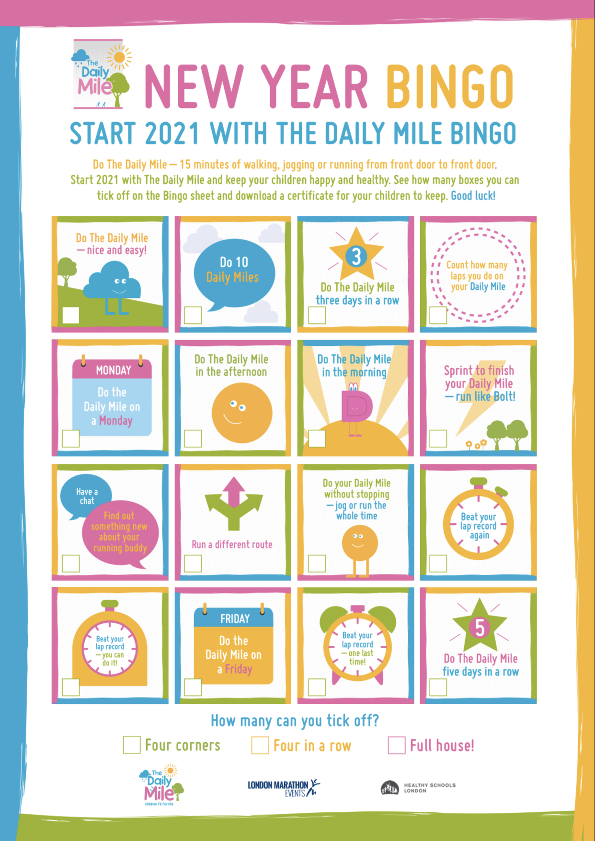
Daily Mile Bingo
Keep doing those daily miles at home but now you can win while you run, walk, hop, skip, jump, or however else you want to your mile?!
Our daily mile cool-down last week was a little reminder that we have done it for so long in school and everyone has got so good at it, doing it quicker and quicker each week, don’t stop doing it now in lockdown. Keep trying where you can to get it done and this daily mile bingo sheet should help with that.
Try doing your daily mile following these challenges and complete the whole card to earn your certificate. Go to this link to print off your daily mile certificate once completed:
https://thedailymile.co.uk/wp-content/uploads/2021/01/Daily-Mile_NY-Bingo-Certificate-2.pdf

Slide 15
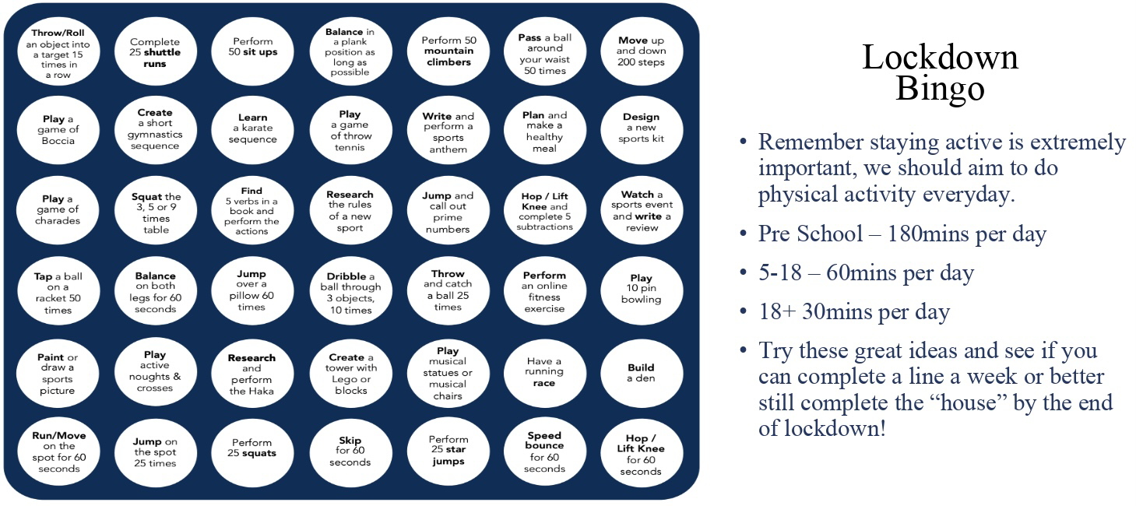
Lockdown Bingo!
Staying active is extremely important, we should aim to do physical activity everyday for 60 minutes if you are aged between 5-18.
Try these great ideas on our bingo sheet and see if you can complete a line a week or better yet complete the entire sheet by the end of lockdown and celebrate getting BINGO!!!
Has anyone got a line yet? Or even bingo?!

Slide 16

Mountain Climbers
Let’s climb a mountain! Using your stairs or just walking around the rooms in your house.
Every day this year we’ve been doing our daily mile and we don’t want to stop now just because of lockdown. So here’s a simple and challenging idea to keep it going. You climb the height of your chosen mountain by taking steps up your staircase. The current record for vertical height climbed by going up stairs is 18585m in 24 hours. We will be impressed if anyone beats that!
Your challenge is to pick a mountain you want to climb this lockdown find some facts about the mountain and work out how many steps you need to do to climb that mountain. Here’s a few already worked out for you:
Scarfell Pike: 6,180 steps
Snowdon: 7,120 steps
Ben Nevis: 8,810 steps
Whereas Mount Everest will take 58,070 steps!!!
*BONUS* Before lockdown I climbed Helvelyn in the Lake District. It is around 3500 steps to get from the bottom to the top on the route I took. Can anyone beat my time of 2 hours 30 minutes to get from the bottom to the top.
Don’t forget if you complete one you could always climb another there are plenty of mountains to climb.

Slide 17

Scavenger Hunt
Indoor scavenger hunt is the perfect challenge for being stuck inside.
Find some small items that you could hide around the house.
Get someone at home to hide them - you could start with just one room, or one item in each room.
Time how long it takes to collect them all.
Try it again and try and beat your time.
Ways to make it more challenging;
Add more items and try and make them smaller and smaller so they’re harder to spot.
Add more rooms to the hunt so you have got a bigger area to search in.
Try to do complete the scavenger hunt moving in different ways. Have to move on all fours, only allowed to hop on one leg etc.

Slide 18
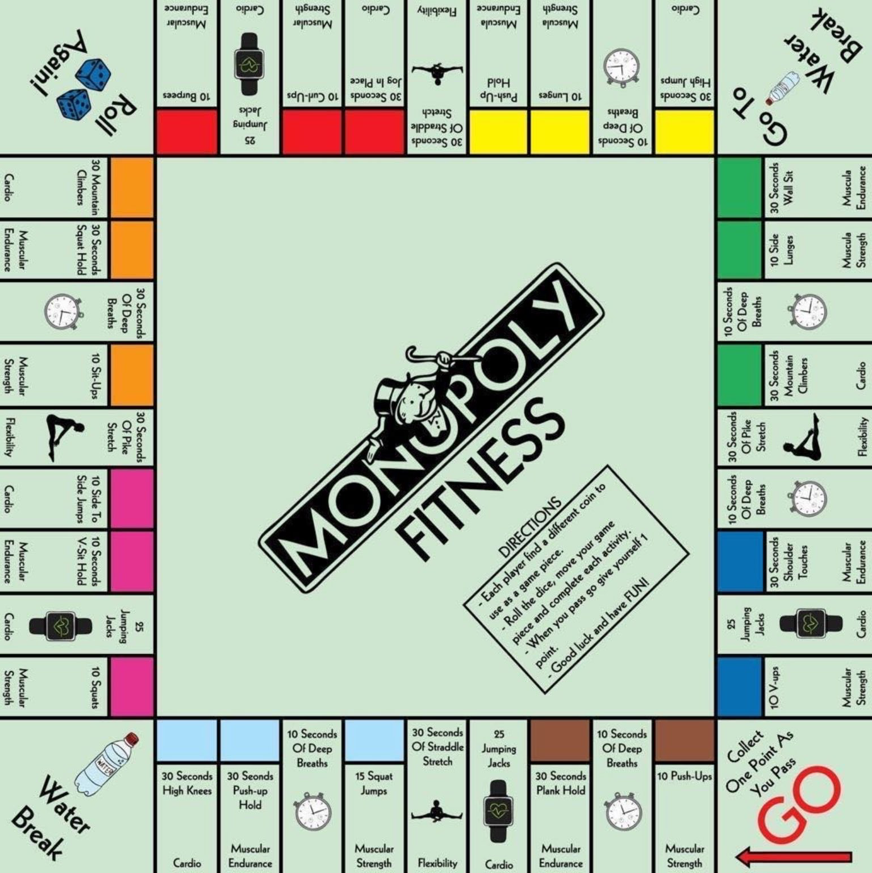
Monopoly Fitness
A fitness twist on the classic game. If you can, print off this slide and grab some coins as game pieces and some dice.
Roll the dice, move your game piece and complete each activity.
When you pass go give yourself one point. You could say first to 5 or 10 points is the winner. For a longer workout you could even do first to 20 points.
Good luck and have FUN!

Slide 19
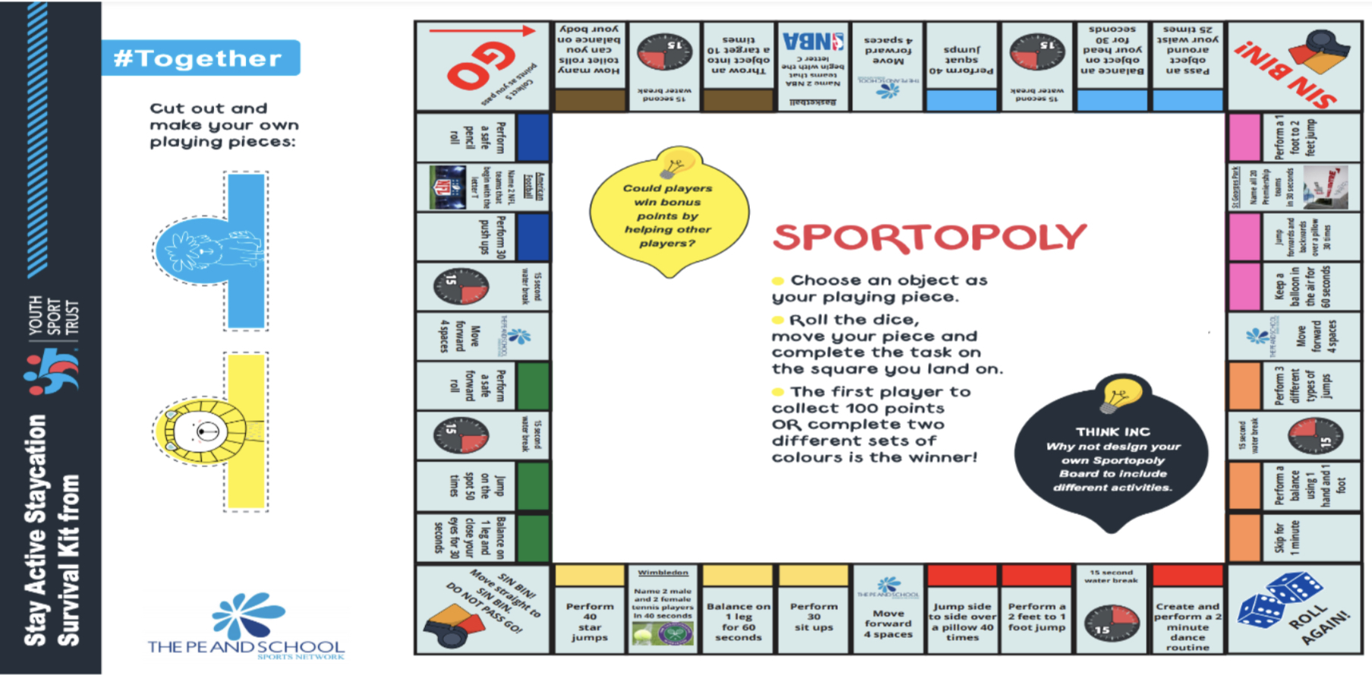
Monopoly Fitness Continued…Sportopoly!!
We’ve got a new version of our Fitness Monopoly that I know a lot of you enjoyed and were playing with parents and siblings.
This one has got new challenges for you to try, and some sport knowledge questions for you to have ago at. If you don’t know any of the answers don’t worry have a research and you can impress others with your new sporting knowledge.
First to 100 points or to complete two different sets of colours will be the winner. But remember even if you don’t win thats okay because you will have been keeping fit and exercising!
Again good luck and have FUN!

Slide 20
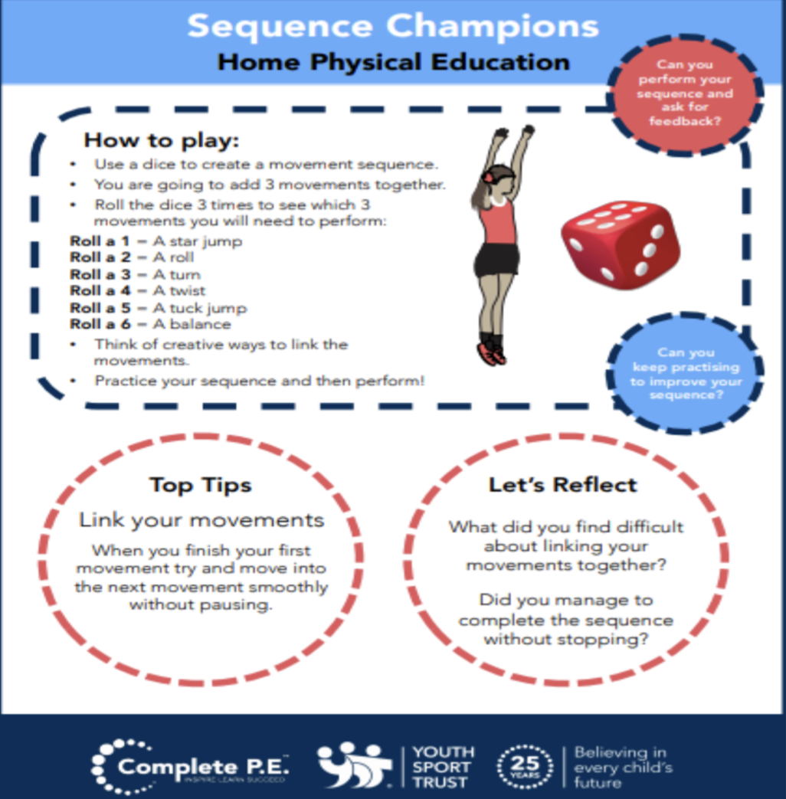
Create Your Own Workout
Following on from everyone enjoying creating their own workouts in the first week. I’ve added it to the half term activities so that you can carry on perfecting your work out routines. Keep working at them and hopefully when we are all back in school and we can use them as a warmups.
Try these extension tasks if your really enjoying this one:
Create your own list of movements to try.
Add some music to your routine and perform it for someone.
Choose 3 different balances and link each balance with a movement from your list e.g. a twist, a jump, a roll. Try and hold each balance for 3-5 seconds.

Slide 21
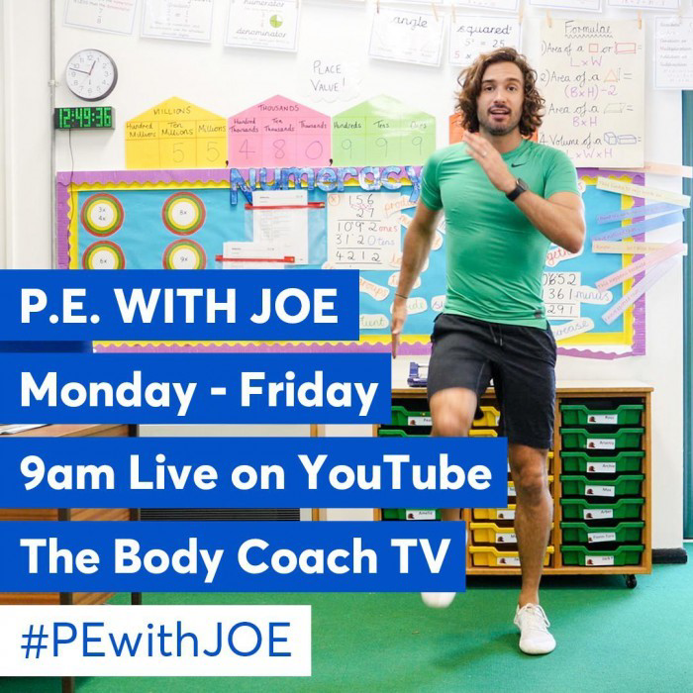
Joe Wicks: P.E at home
If you are still looking for more workout-based activities, Joe Wicks’ weekly workouts are great for kids of all ages.
They are three times a week: Monday, Wednesday and Friday live streamed from 9am.
YouTube channel link: https://www.youtube.com/channel/UCAxW1XT0iEJo0TYlRfn6rYQ
These videos are an excellent tool to use both at school and at home that many schools just like ours are taking advantage off and thankful for.

Slide 22

BBC Supermovers for KS1 and KS2
BBC Supermovers if a fun filled resource for all primary school ages both KS1 and KS2. It is packed with loads of ways to keep young people moving and active but at the same time learning and practicing other key subjects like Maths, English and Science.
The webpage link is: https://www.bbc.co.uk/teach/supermovers
There are up to a 100 different videos to choose from so go have a look and find some fun new ways to learn and be active at the same time.

