Slide 1


Mountain Climbers
Let’s climb a mountain! Using your stairs or just walking around the rooms in your house.
Every day this year we’ve been doing our daily mile and we don’t want to stop now just because of lockdown. So here’s a simple and challenging idea to keep it going. You climb the height of your chosen mountain by taking steps up your staircase. The current record for vertical height climbed by going up stairs is 18585m in 24 hours. We will be impressed if anyone beats that!
Your challenge is to pick a mountain you want to climb this lockdown find some facts about the mountain and work out how many steps you need to do to climb that mountain. Here’s a few already worked out for you:
Scarfell Pike: 6,180 steps
Snowdon: 7,120 steps
Ben Nevis: 8,810 steps
Whereas Mount Everest will take 58,070 steps!!!
*BONUS* Before lockdown I climbed Helvelyn in the Lake District. It is around 3500 steps to get from the bottom to the top on the route I took. Can anyone beat my time of 2 hours 30 minutes to get from the bottom to the top.
Don’t forget if you complete one you could always climb another there are plenty of mountains to climb.

Slide 2

Scavenger Hunt
Indoor scavenger hunt is the perfect challenge for being stuck inside.
Find some small items that you could hide around the house.
Get someone at home to hide them - you could start with just one room, or one item in each room.
Time how long it takes to collect them all.
Try it again and try and beat your time.
Ways to make it more challenging;
Add more items and try and make them smaller and smaller so they’re harder to spot.
Add more rooms to the hunt so you have got a bigger area to search in.
Try to do complete the scavenger hunt moving in different ways. Have to move on all fours, only allowed to hop on one leg etc.

Slide 3
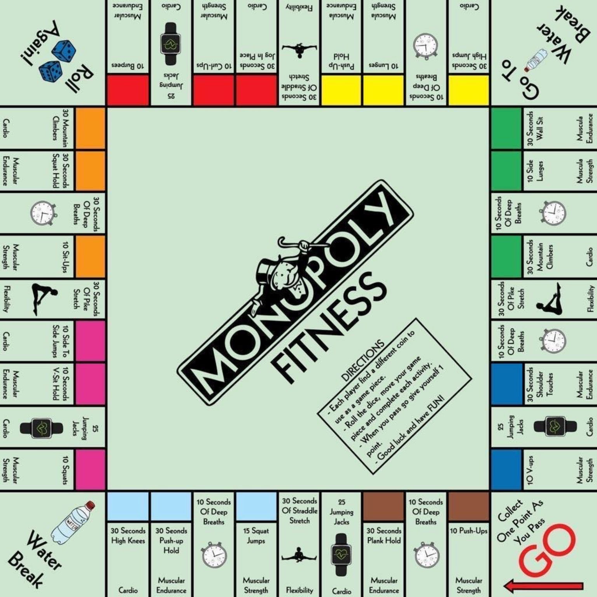
Monopoly Fitness
A fitness twist on the classic game. If you can, print off this slide and grab some coins as game pieces and some dice.
Roll the dice, move your game piece and complete each activity.
When you pass go give yourself one point. You could say first to 5 or 10 points is the winner. For a longer workout you could even do first to 20 points.
Good luck and have FUN!

Slide 4
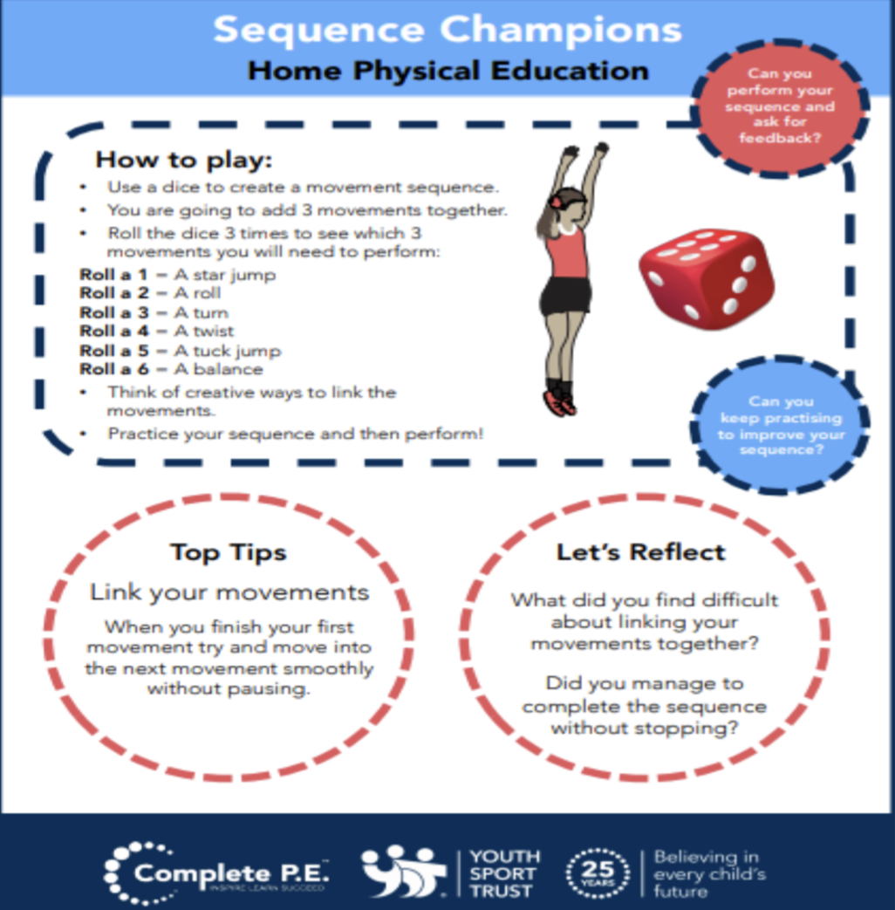
Create your own workout
Following on from everyone enjoying creating their own workouts in the first week. I’ve added it to the half term activities so that you can carry on perfecting your work out routines. Keep working at them and hopefully when we are all back in school and we can use them as a warmups.
Try these extension tasks if your really enjoying this one:
Create your own list of movements to try.
Add some music to your routine and perform it for someone.
Choose 3 different balances and link each balance with a movement from your list e.g. a twist, a jump, a roll. Try and hold each balance for 3-5 seconds.

Slide 5
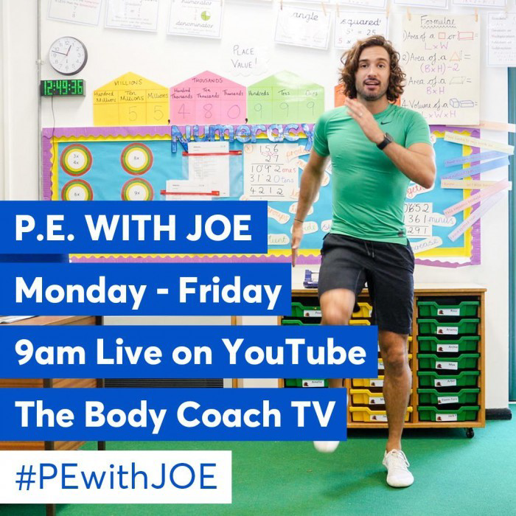
Joe Wicks: P.E at home
If you are still looking for more workout-based activities, Joe Wicks’ weekly workouts are great for kids of all ages.
They are three times a week: Monday, Wednesday and Friday live streamed from 9am.
YouTube channel link: https://www.youtube.com/channel/UCAxW1XT0iEJo0TYlRfn6rYQ
These videos are an excellent tool to use both at school and at home that many schools just like ours are taking advantage off and thankful for.

Slide 6

BBC Supermovers for KS1 and KS2
BBC Supermovers if a fun filled resource for all primary school ages both KS1 and KS2. It is packed with loads of ways to keep young people moving and active but at the same time learning and practicing other key subjects like Maths, English and Science.
The webpage link is: https://www.bbc.co.uk/teach/supermovers
There are up to a 100 different videos to choose from so go have a look and find some fun new ways to learn and be active at the same time.

Slide 7
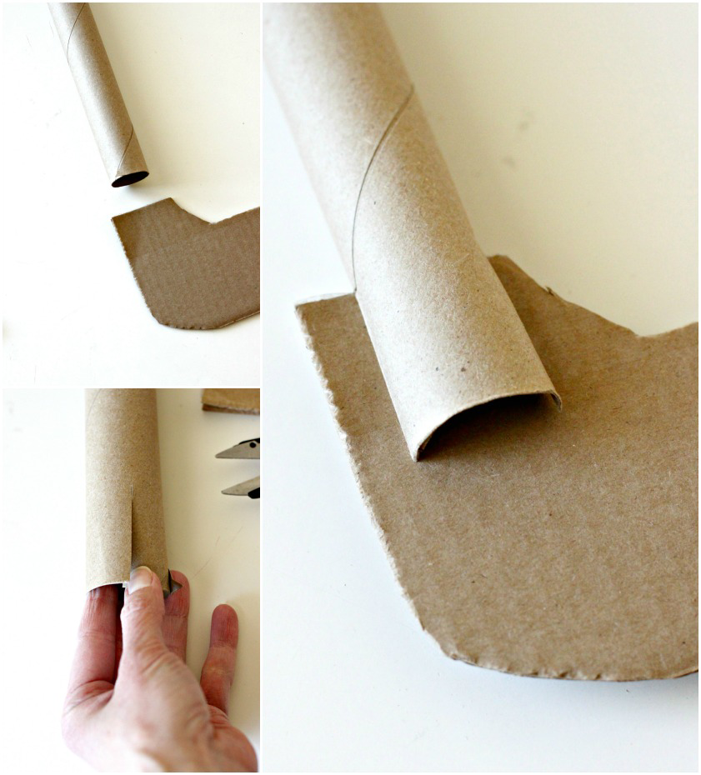
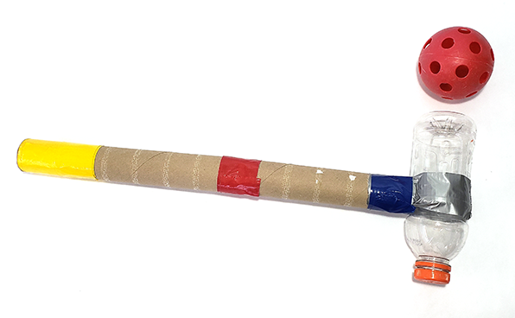
Bonus Challenge
If you haven’t already get creating your own hockey stick!
In anticipation of coming back to school you could be practicing your hockey skills. But to do this you’ll need a hockey stick. As a challenge over the next few weeks try and create one yourself and decorate it how you like. Here’s a few examples for you. Submit a picture of yours to your class dojo so we can see your creations.
On the next slide I have updated the hockey videos so if you’ve already made yours check them out and see if you can give some of them a go. If not just give them a watch to help with your Hockey development and learning.

Slide 8
Extra videos for inspiration for HOCKEY
If you have created your own Hockey stick you could try following these videos for practice or just watch to help understand how we play the sport.
Hockey Core Skills: Grips - Double V Grip:
https://www.youtube.com/watch?v=2GePCYSF6nY
Hockey Core Skills: Passing Skills - Hit:
https://www.youtube.com/watch?v=93xlxmH3_3U
Hockey Core Skills: Passing Skills - Forehand Sweep:
https://www.youtube.com/watch?v=hD49MCZAcV0

