Slide 1
Writing
Friday 12th February 2021

Slide 2
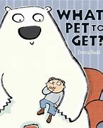
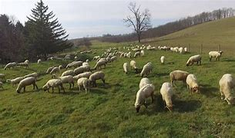
Today is our last day of our Pets and Animals topic.
During the term we have found out about different animals.

Slide 3
What have you enjoyed learning about the most?
Can you write a sentence to describe your favourite part?
I enjoyed finding about different animals on the farm. My favourite animal was a horse.

Slide 4
Main Activity:
Write about your favourite part of the animal topic.
You can choose how you want to present your work. You could write a sentence and draw a picture, make a model and write about your favourite animal, make a poster ….

