Slide 1
Writing
Monday 22nd February 2021

Slide 2
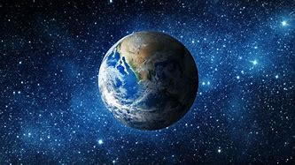
This term we are starting our new topic ‘Around the World’
Each week we will read a book from a different country.

Slide 3
Here is the front cover of our new book.
What can you see?
What is the girl holding?
Where do you think the story is set?

Slide 4
The title of the book is ‘Katie in London’
What do you know about London?

Slide 5
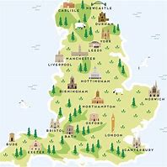
Can you find London on a map?
London is the capital city of England.
England is a country in the UK.
Where do you think Yarm is?

Slide 6
Listen to the story by clicking on the link.
https://www.youtube.com/watch?v=5jv8RhfDwW0

Slide 7
What is Katie holding on the front cover?
Katie is holding the flag of the United Kingdom.

Slide 8
Main Activity:
Main Activity: Make a flag of the United Kingdom. Can you write a list of what you needed to make your flag?
Remember to:
Sound out the words to spell using your phonic knowledge
Write each item on a new line
Think carefully about how you form your letters

