Slide 1
Writing
Thursday 4th February 2021

Slide 2
Today we are going to solve some farm animal riddles.
Complete the Farm Animals Riddles PowerPoint.
Listen carefully to the clues to decide which animal it is.

Slide 3
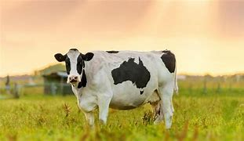
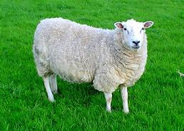
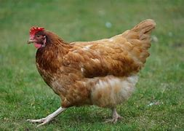
Can you think of your own clues to describe one of the animals?
e.g. I am white and black.
My babies are called calves.
I make milk.
What am I?

Slide 4
Main Activity:
Create your own farm animal riddles by choosing an animal and describing it.
Remember to:
Sound out the words to spell using your phonic knowledge
Spell the words and, the and to correctly in your writing if you need them.
Form your letters the correct way round
Use a capital letter to start your sentences
Use a full stops and question marks
Use finger spaces between each word

