Slide 1
Phonics
Friday 26th February 2021

Slide 2
Can you sing the alphabet song?
Remember to say the names of the letters not the sounds.
https://www.youtube.com/watch?v=0FfcNgYCW18

Slide 3
Practise your sounds using Flashcards Speed Trial on Phonics Play
Pick individual graphemes – Sets 1-10 + ow, oi, ear, air
Username: jan21
Password: home
https://www.phonicsplay.co.uk/resources/phase/2/flashcards-speed-trials

Slide 4
Can you read our tricky words:
me

Slide 5
Can you read our tricky words:
he

Slide 6
Can you read our tricky words:
we

Slide 7
Can you read our tricky words:
she

Slide 8
Can you read our tricky words?
my

Slide 9
Can you read our tricky words:
be

Slide 10
Can you read our tricky words:
was

Slide 11
Can you read our new tricky word?
you

Slide 12
Practise reading your keywords using Tricky Word Trucks on Phonics Play
Pick Individual Tricky Words: all Phase 2 + he, she, we, me, be, was, my, you
Username: jan21
Password: home
https://www.phonicsplay.co.uk/resources/phase/2/tricky-word-trucks

Slide 13
Can you spell the tricky word?

Slide 14
the

Slide 15
Can you spell the tricky word?

Slide 16
go

Slide 17
Can you spell the tricky word?

Slide 18
Can you spell the tricky word?
to

Slide 19
Can you spell the tricky word?

Slide 20
Can you spell the tricky word?
no

Slide 21
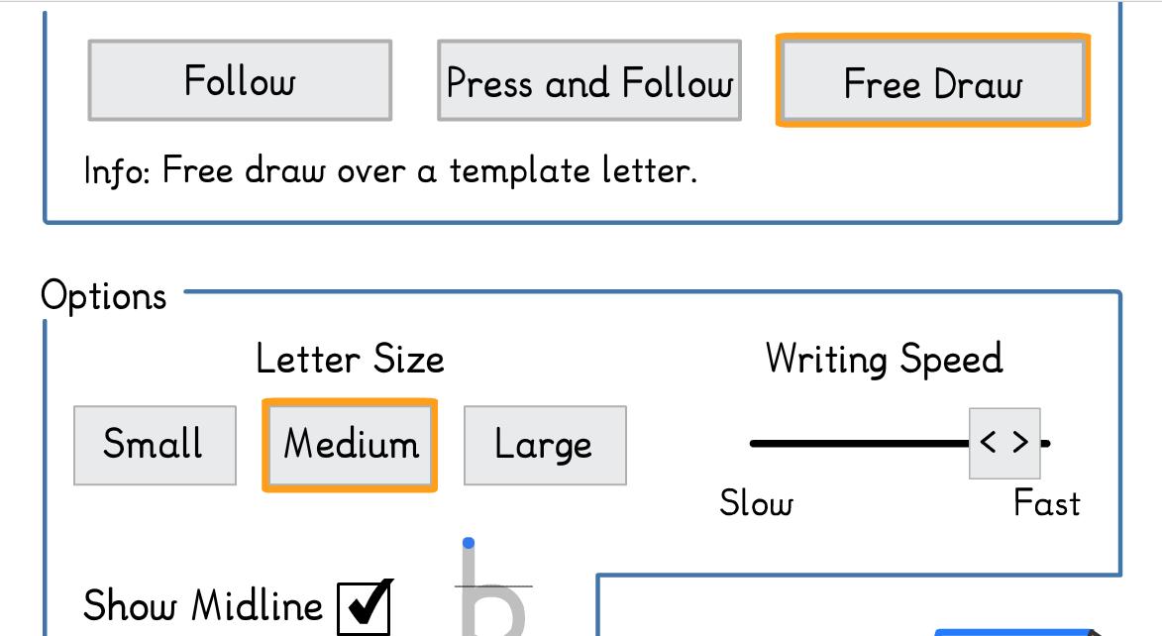
Main Activity:
Practise forming your letters for the letters a, b, c, d, e, f, g, h, i and j
Click on the link to Doorway Online.
https://www.doorwayonline.org.uk/literacy/letterformation/
You need to click on ‘Free Draw’.
You could also practise writing your letters on some paper.

