Slide 1
Maths
WB 18.1.21

Slide 2
Friday

Slide 3
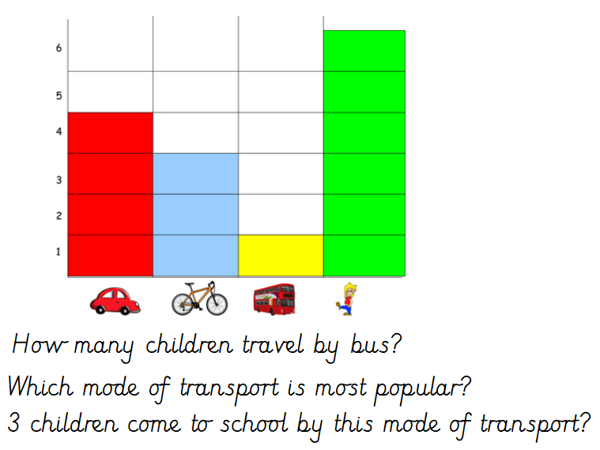
Starter –
Can you think of any other questions you could ask?
Notes:
Look at the picture and answer the questions on the screen. Can you think of your own questions? E.g. which mode of transport is least poplular?

Slide 4
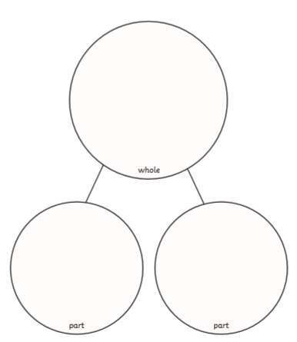
Main Input –
This is a part whole model – each part when added together makes a whole number e.g. two parts added together = 10

Slide 5
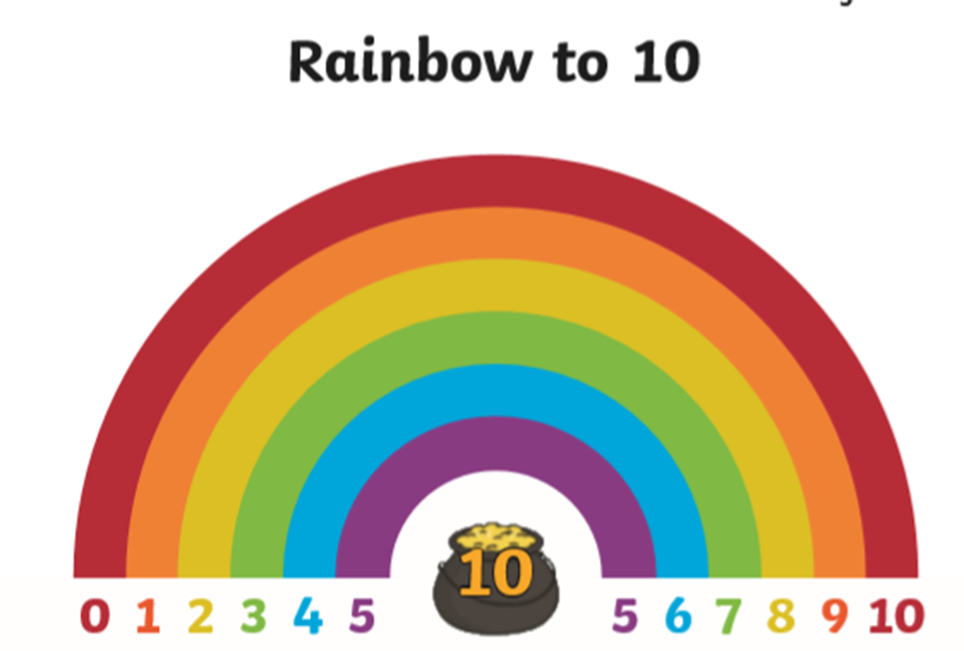
You have been given one part and the whole number (the answer).
Can you work out the missing part using the rainbow bonds to help you.
10
?
7
Notes:
Follow the instructions on the screen.

Slide 6
You have been given one part and the whole number (the answer).
Can you work out the missing part using the rainbow bonds to help you.
10
5
?
Notes:
Follow the instructions on the screen.

Slide 7
You have been given one part and the whole number (the answer).
Can you work out the missing part using the rainbow bonds to help you.
10
10
?
Notes:
Follow the instructions on the screen.

Slide 8
You have been given one part and the whole number (the answer).
Can you work out the missing part using the rainbow bonds to help you.
?
2
8
Notes:
Follow the instructions on the screen.

Slide 9
Can you work out the missing parts using the rainbow bonds to help you.
Notes:
Complete the Part Whole Number bonds Worksheet

