Slide 1
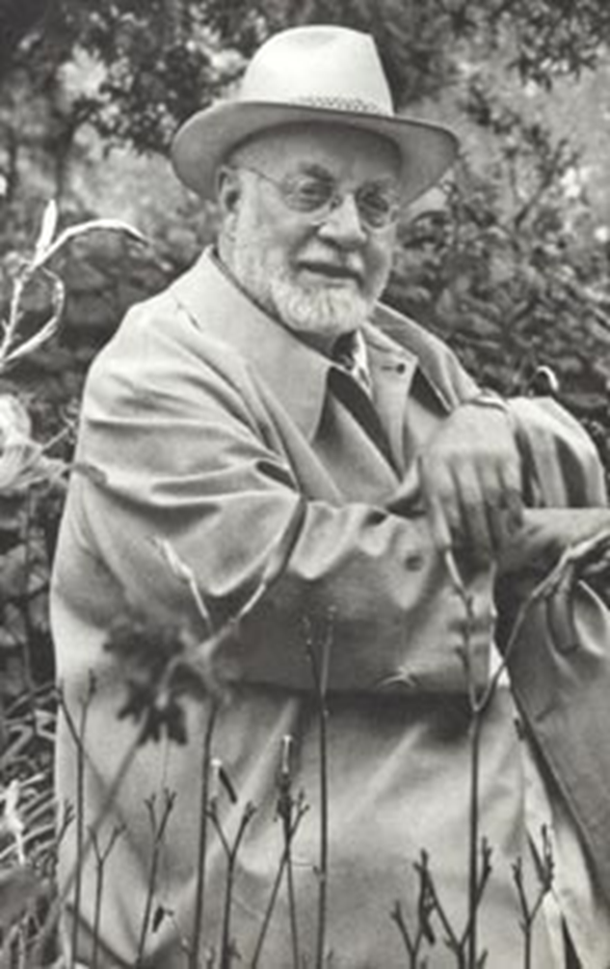

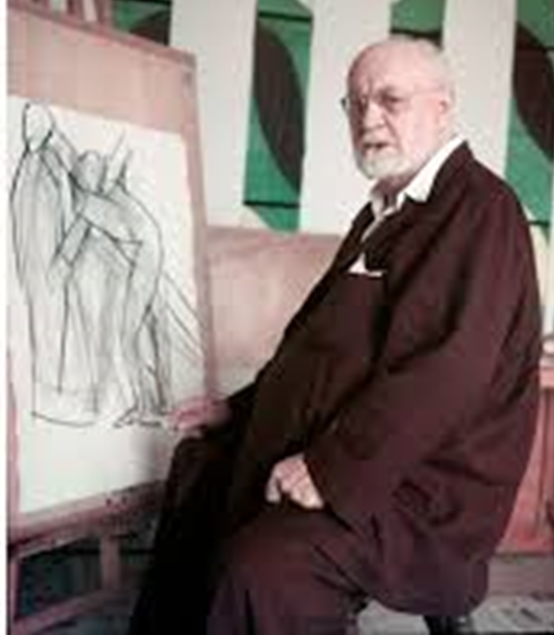
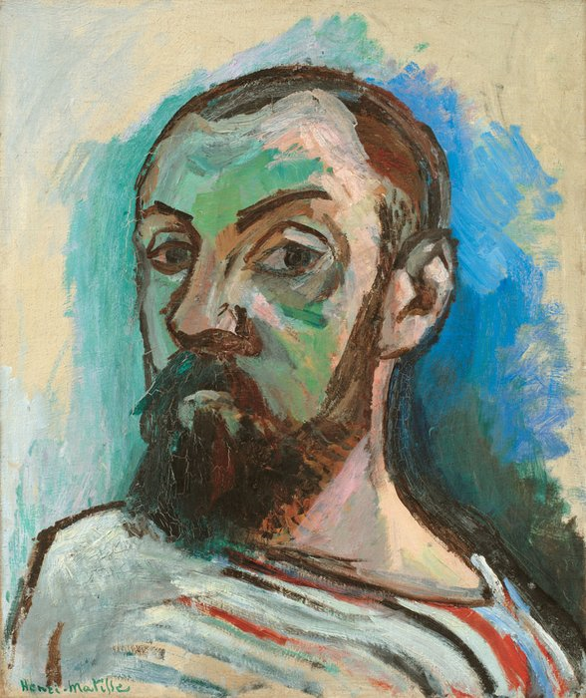

Slide 2
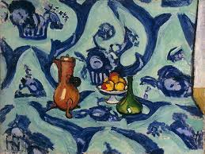
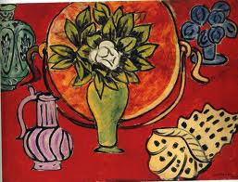
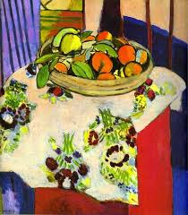
Still life
A still life) is a work of art depicting mostly still (unmoving) subjects, typically common objects which are either natural (food, flowers, dead animals, plants, rocks, shells, etc.) or man-made (drinking glasses, books, vases, jewellery, coins, pipes, etc.)
At the start of his career Matisse painted still lifes…
Choose 3 objects from around the house and arrange them like Matisse. Take a photo – if you want to you could draw them too…

Slide 3
What can you see in the paintings?
What are the 3 most common colours Matisse used?
How do the paintings make you feel?
Which of these 3 paintings would you want in your room? Why?
Why do you think Matisse painted them?

Slide 4
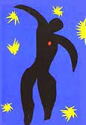
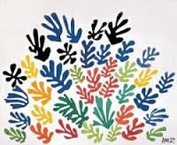
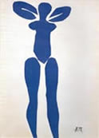
At the end of this life Matisse used a different way of working –
Paper cut collage.
Practice your cutting skills – draw around your hand and cut it out – cut out as many as you can (get someone else to help too!) Arrange them in a way you like and take a picture…

Slide 5
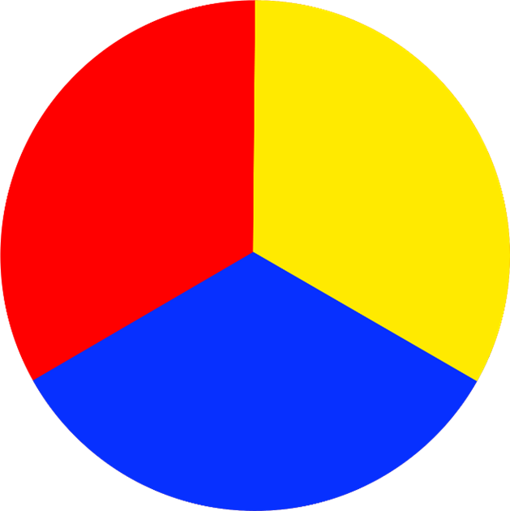
For us to be able to think carefully about Matisse’s work we need to remind ourselves about what we know about colour…
Primary colours
There are 3 primary colours – red, yellow & blue.
They can be mixed together to make other colours…

Slide 6
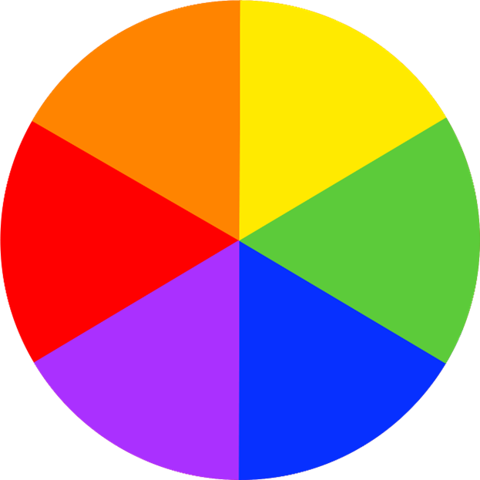
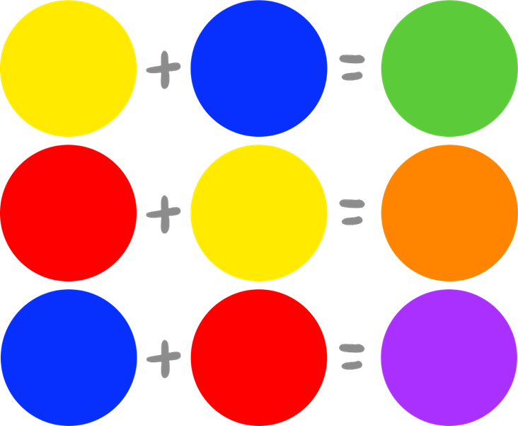
Secondary colours
We use primary colours to make secondary colours – green, orange & purple.

Slide 7
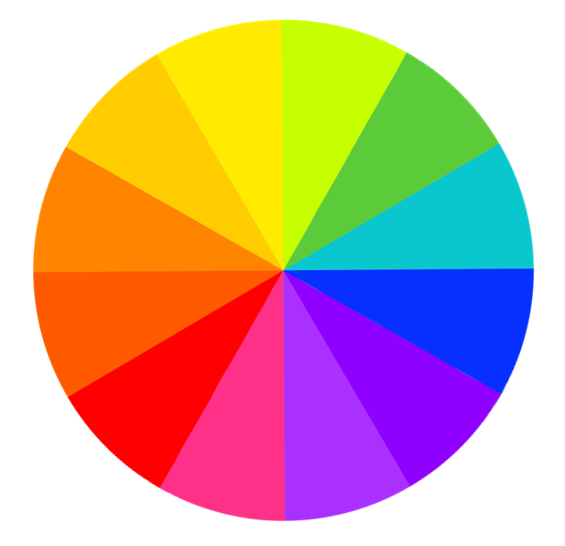
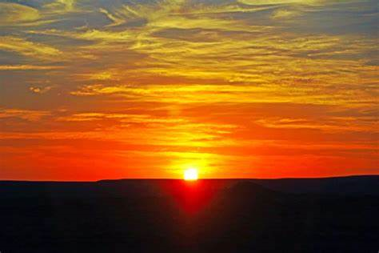
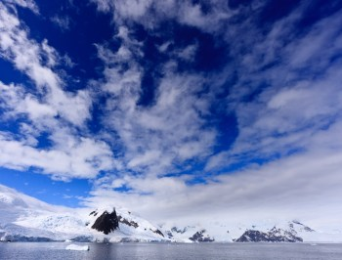
Warm and cool colours
Green, blue and purple are cool colours. They make us think of fresh, calm and chilly things.
Red, orange and yellow are warm colours. They make us think of sun, warmth and cosy things.

Slide 8
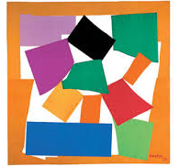
This is one of Matisse's’ most famous pictures. It uses the paper cut collage way of working.
Can you guess what it is?

Slide 9
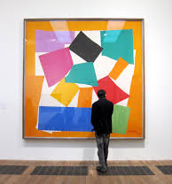
The Snail
1953
The Tate Gallery
London
Did you guess?
Look how BIG it is?

Slide 10
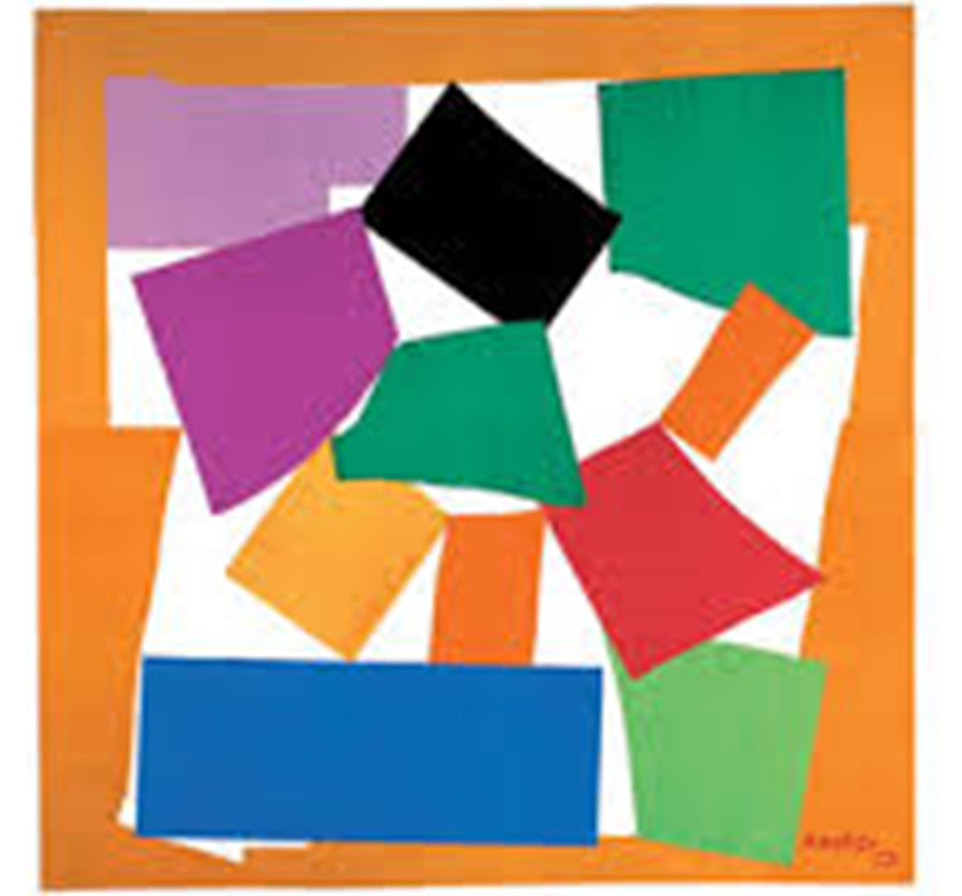
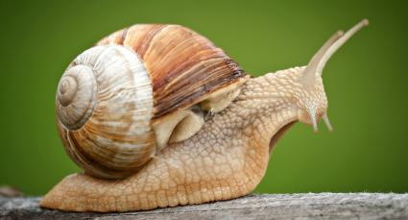
Look at it carefully again…
Can you see the snail shell and the head?
What else can you see?
What colours did Matisse use?

Slide 11
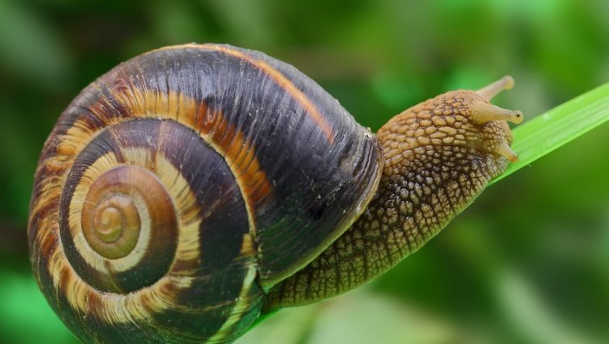
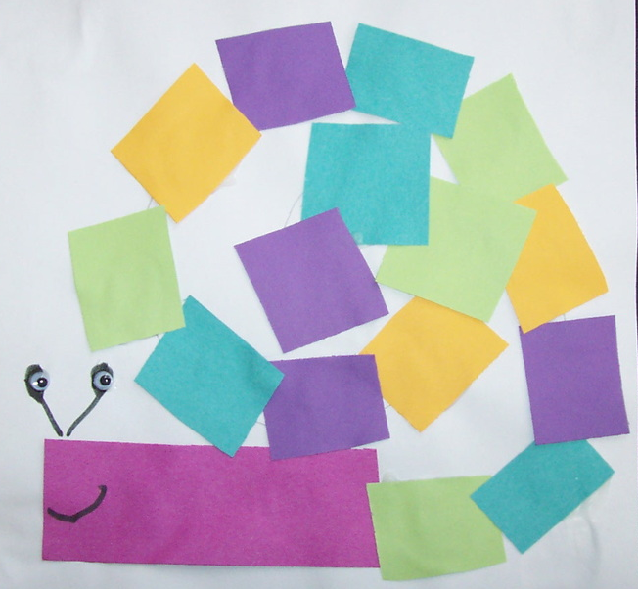
Now it’s your turn!
You can use any kind of paper – you can colour or paint some if you want to.
Rip or cut strips and shapes and arrange them to make your version of The Snail – remember there is no way you can get this wrong as it is your piece of art and will be fabulous! You don’t have to stick the shapes down – you can take a photo and then use the shapes again for another picture…
You could make a little snail OR if you have chalk, go outside and make an enormous one OR a cardboard box one…
You could make a model if you have playdoh or modelling clay.

Slide 12
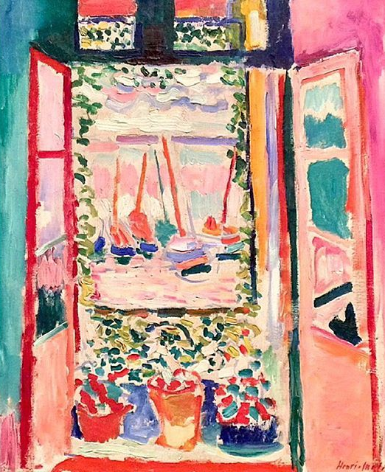
Think about what you have learned about colour and how they can make you feel.
What do you know about mixing colour?
What are 2 facts you have learned about Matisse?
Do you have a favourite painting of his?
Do you have a favourite picture that you have made?
If you don’t have paint to use, don’t worry – when we are back in school you will have some opportunities to develop this using paint…
I can’t wait to see your art work – Mrs W. x
This is my favourite Matisse painting – The open window.
Can you guess why I like it?

