Slide 1
Yarm Primary
EY2 | Enquiry Question: What makes a good friend?
Subject Specific Vocabulary​ |  |  | Sticky Knowledge about
Friend | A person who you know well and who you like a lot, but is usually not a member of your family. | For the following half term, our PSHCE topic will be around healthy and happy friendships. We will explore how to make friends and get along.
 |  |  | A friend is a person who you know well and who you like a lot, but who is usually not a member of your family.
​Kind | Wanting or liking to do good and to bring happiness to others
 |  |  | Some examples of being kind are looking after someone, sitting together, sharing and playing together.
​Unkind | not kind or sympathetic
​Welcoming | to show friendliness towards others.
Happy | feeling or showing pleasure |  | Some examples of being unkind are not sitting with someone, leaving someone out of a game and taking something that doesn’t belong to you.
​Sad | Feeling without joy. | ​
​share | to let someone else have or use a part of something that belongs to you. |  | Our Golden Rules are: We are gentle. We are kind and helpful. We listen. We are honest. We work hard. We look after property.
Turn take | to alternate doing something
Scared | feeling fear or afraid
​Embarrassed | to make someone feel confused and foolish in front of other people.

Slide 2
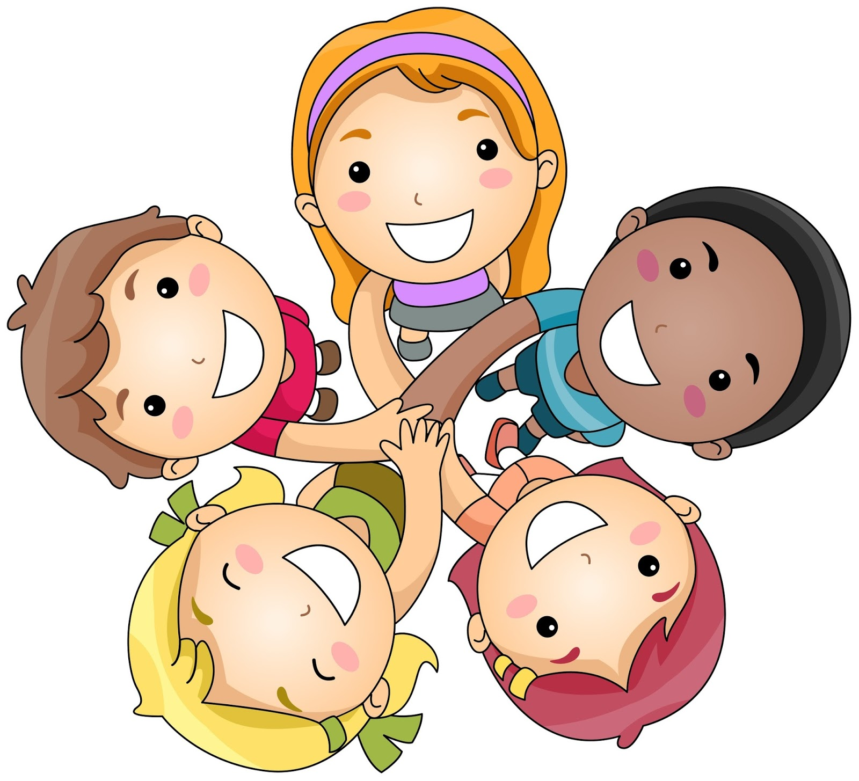
Height Monitor – Note down your height every Monday morning over the 6 weeks holidays to see how much you have grown!
GOAL!- Set yourself a GOAL (or 2) to achieve by the bend of the 6 weeks – take photos of you achieving your goal.
Growth Jar – When you do something you are proud of over the holidays get an adult to write it down and put it in your growth jar – at the end of the 6 weeks holidays read all of your achievements !

