Slide 1
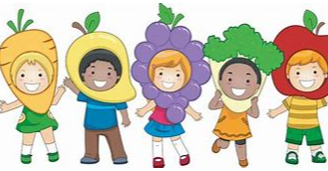
Yarm Primary
EY2 | Enquiry Question: How can we keep healthy?
Subject Specific Vocabulary​ |  |  | Sticky Knowledge
Healthy | In good shape or condition. | For the following half term, our PSHCE topic will be around keeping healthy. We will explore the importance of keeping healthy and find out about some of the ways that we can do this.
 |  |  | It is important to keep our bodies healthy
Bodies | The main structure of a human or animal.
 |  |  | There are lots of different ways to keep healthy
Mind | The part our bodies that help us think and feel.
Exercise | Physical or mental activity. |  | It is important to eat a varied diet
 |  | ​
Germs | Tiny organisms or living things that can cause disease.
 |  |  | Our Golden Rules are: We are gentle. We are kind and helpful. We listen. We are honest. We work hard. We look after property.
Variety | A collection of things which are different.

Slide 2
How can we keep healthy? – How many ways can you think of keeping healthy? Can you write a list?
Healthy Meal – Can you design a healthy meal? What foods would you include?
Activity Challenge – Can you create an obstacle course to complete? What exercises would you include?

