Slide 1
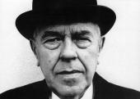
Rene Magritte
There are many different styles of art. These different styles are often known as movements. Artistic movements include cubism, expressionism and realism. We are going to learn about an artist who belonged to the surrealist movement…

Slide 2
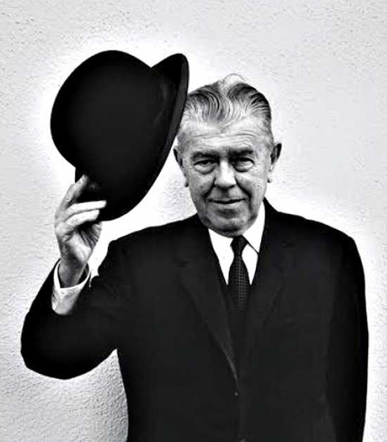
Some Magritte facts:
Belgian
1898 – 1967
Has an asteroid named after him
Worked in a wallpaper factory
Worked designing posters
Produced first surreal painting in 1926
His paintings are in art galleries all over the world.

Slide 3
So what is surrealism?
Artists painted unnerving, illogical scenes with photographic precision, creating strange creatures from everyday objects and developing painting techniques that allowed the unconscious to express itself.
Surrealist works feature the element of surprise!
Look carefully at the following Magritte surrealist paintings…be curious – ask yourself questions…

Slide 4
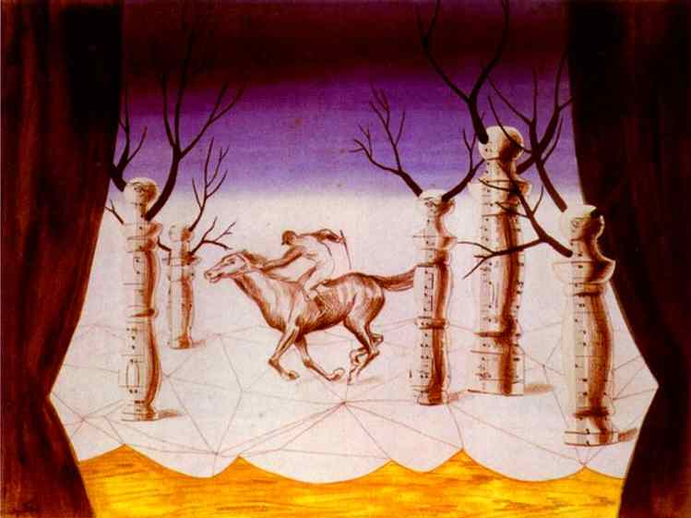
The Lost Jockey

Slide 5
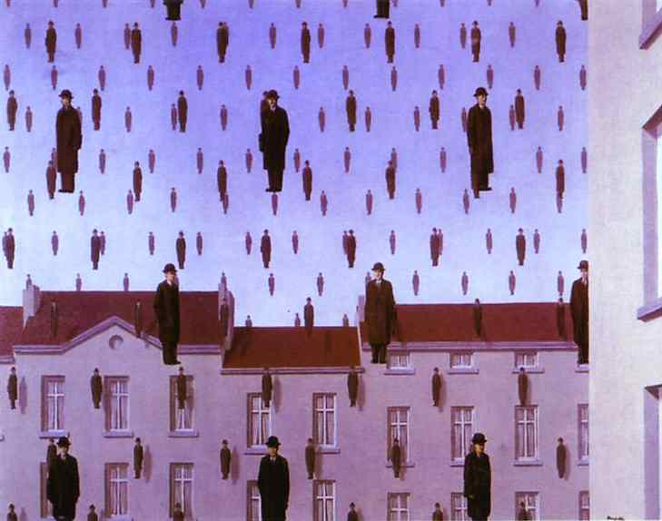
Gonconda

Slide 6
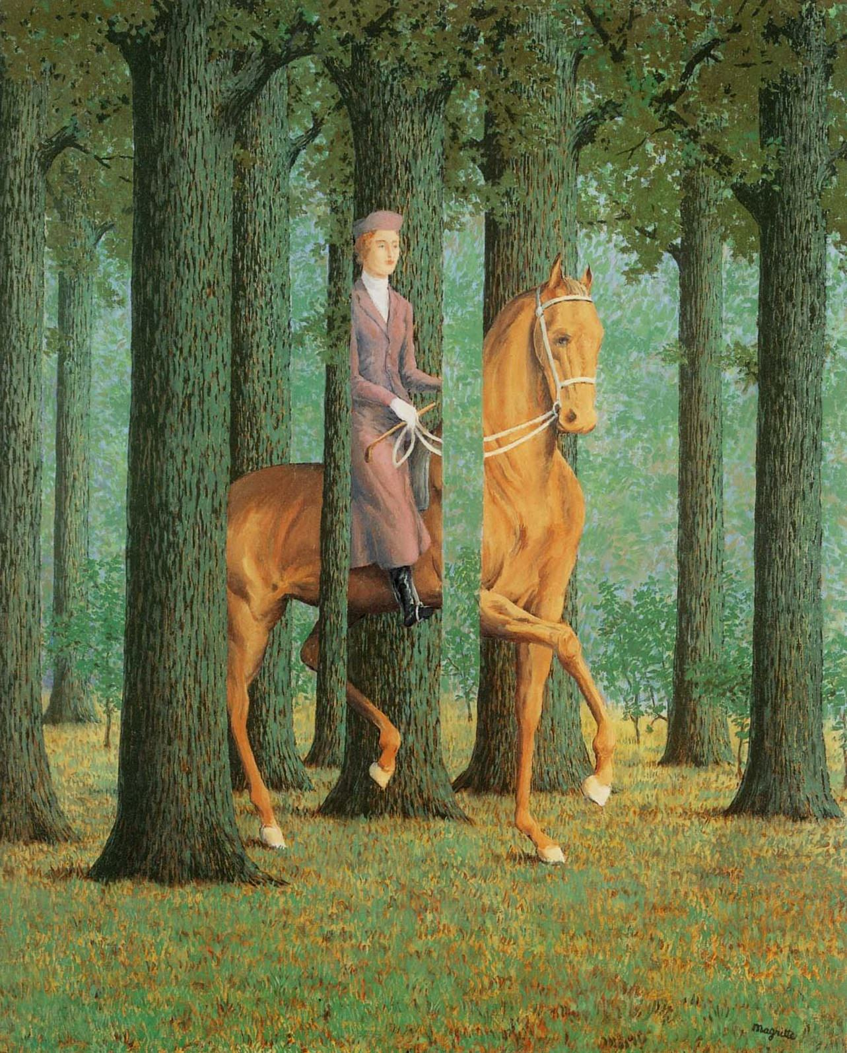
Le blanc seing
Look at how the trees feature – could this really happen?

Slide 7
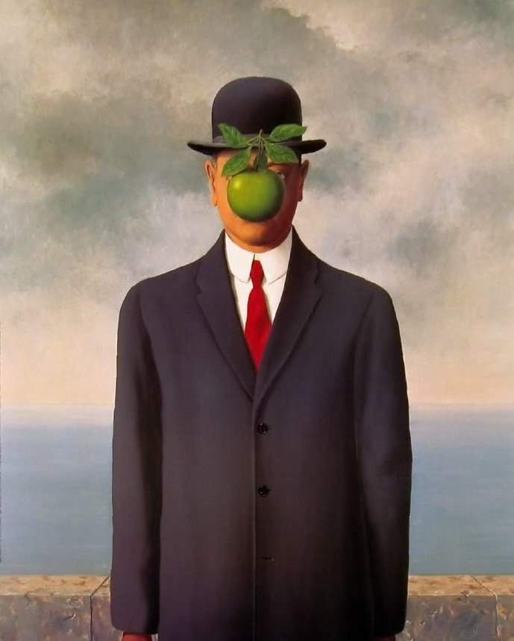
Son of man

Slide 8
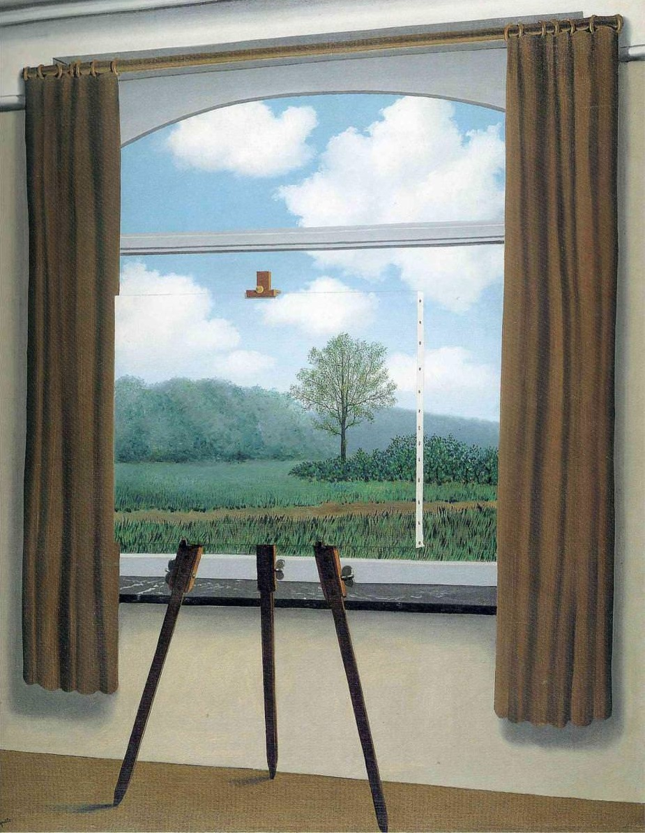
The human condition

Slide 9
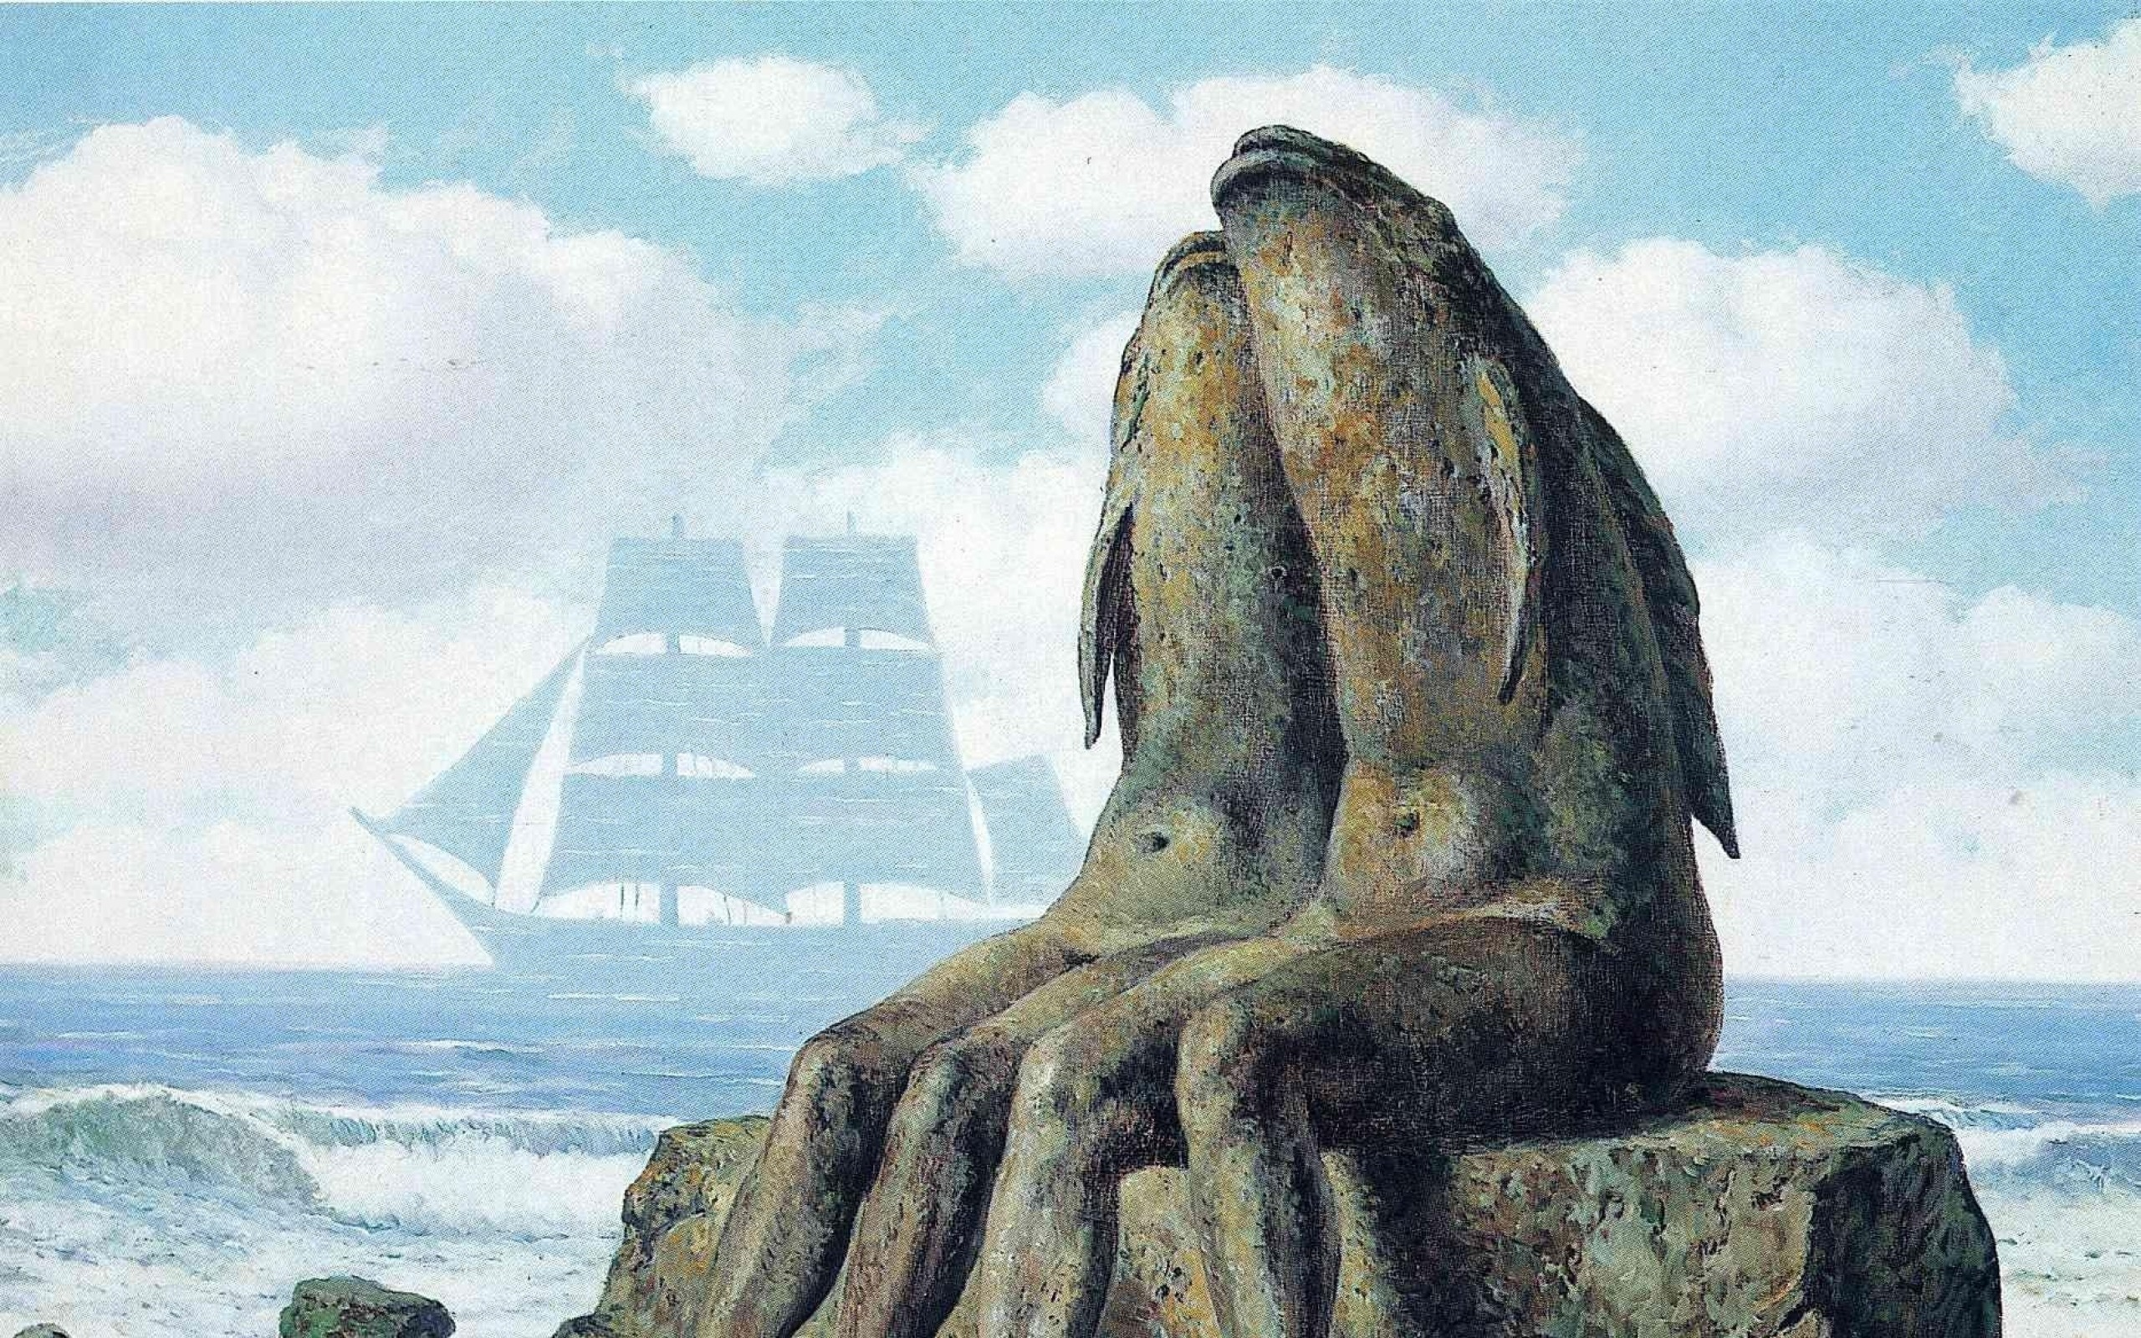
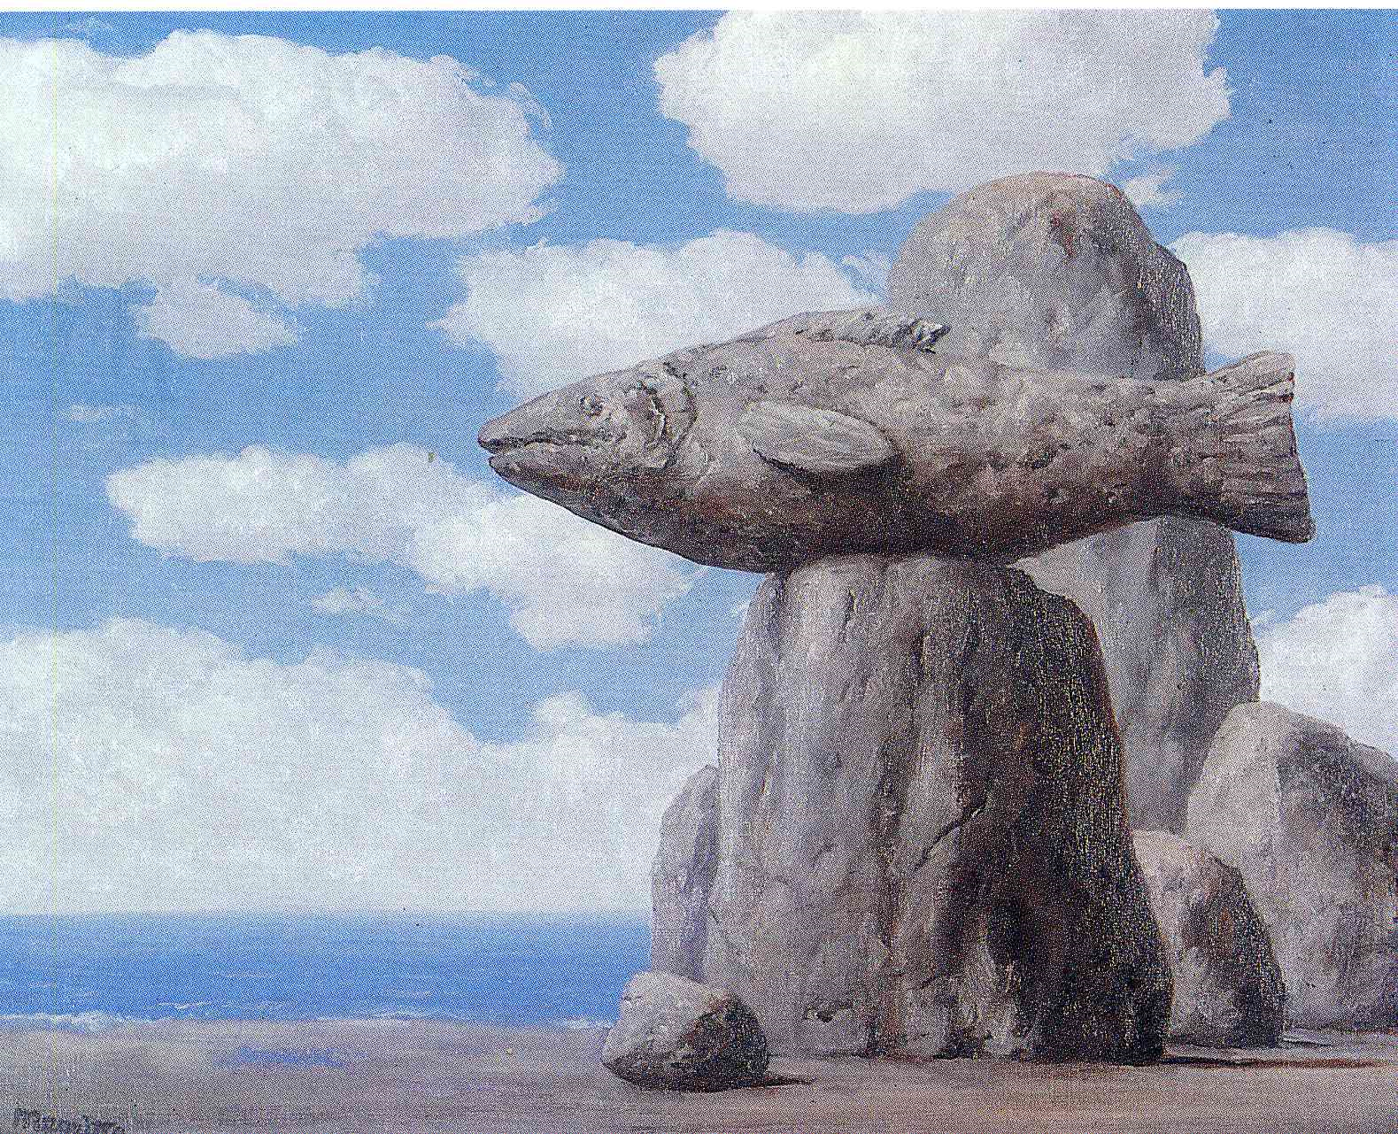
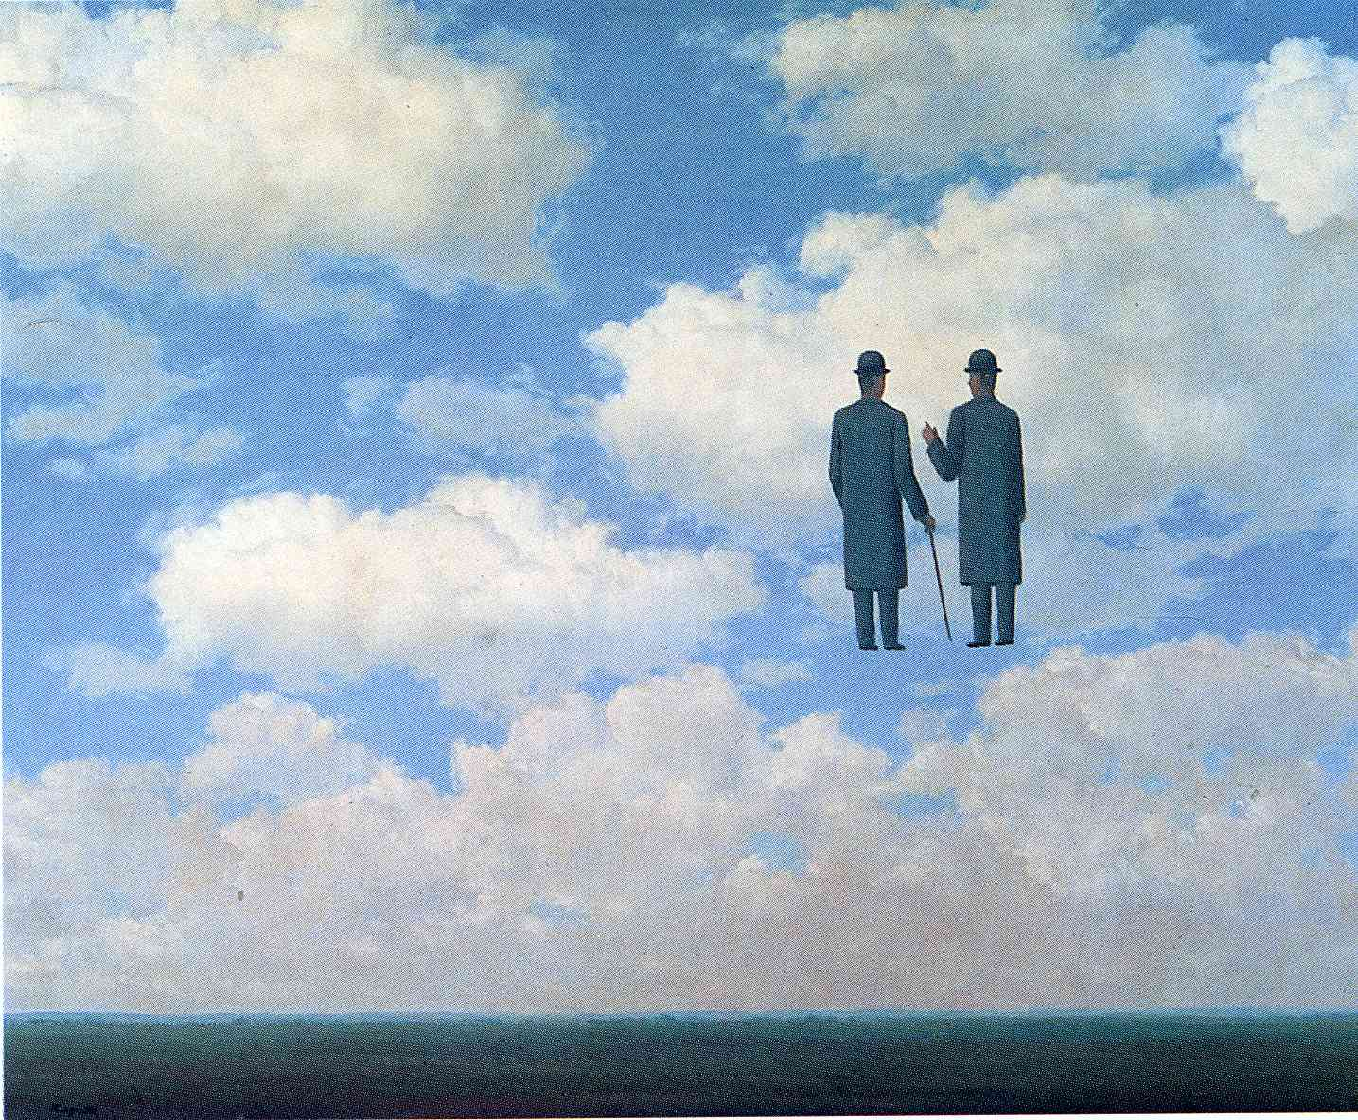
Much of the work Magritte created depicted similar scenes, and recurring themes. Some of his favourites were floating rocks, or creating a painting within a painting, and he also used many inanimate objects, within a human figure, creating the distinct styles which other artists did not.

Slide 10
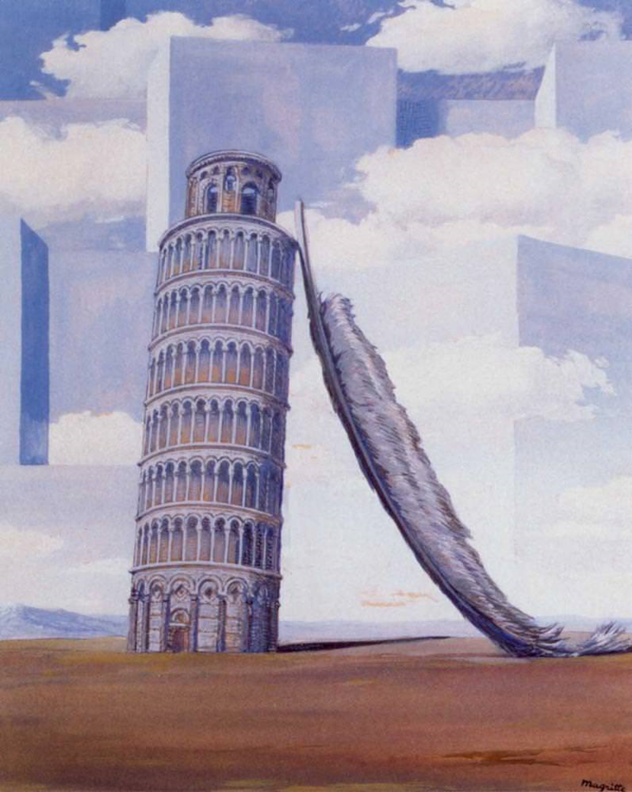
Magritte’s paintings also feature bowler hats And he often wore one himself.
Another theme is objects being the wrong size, for example a feather being shown as the same size as a tower. This gives the paintings a strange, dream-like quality, which is an important part of surrealism.
Memory of a journey

Slide 11
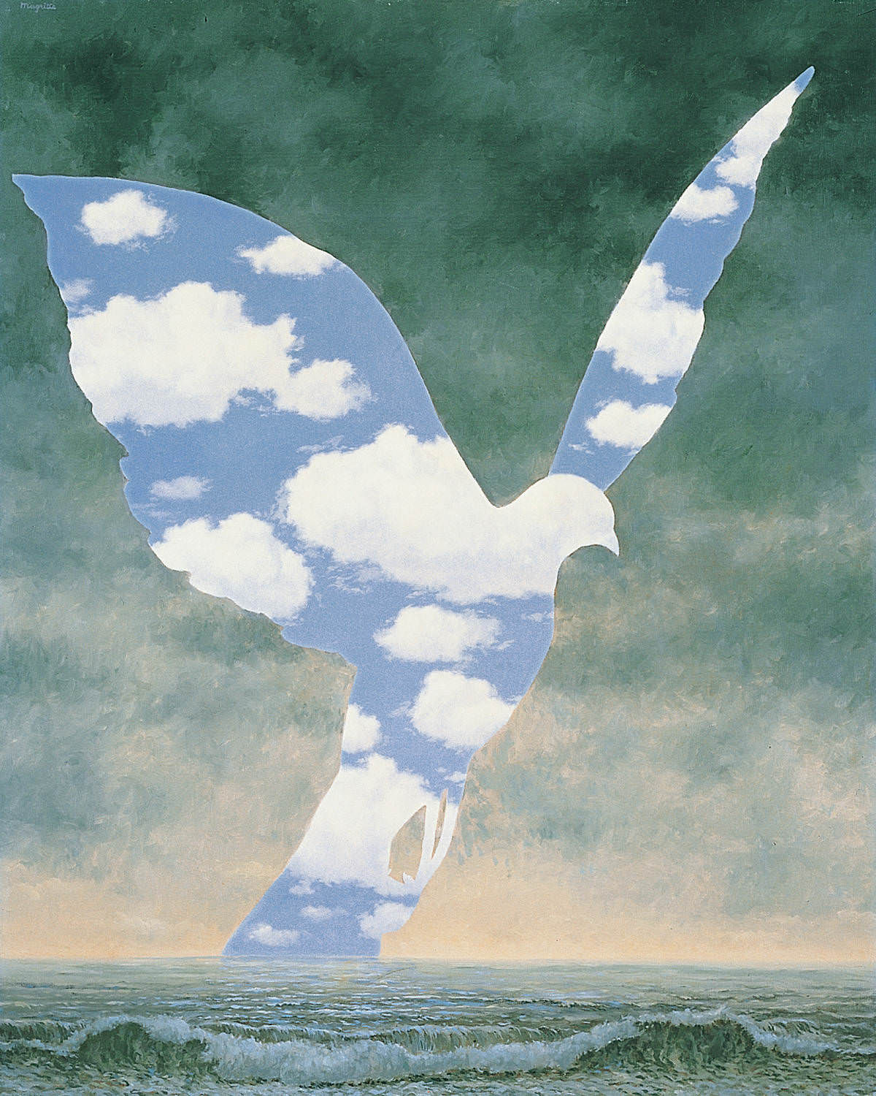
The large family

Slide 12
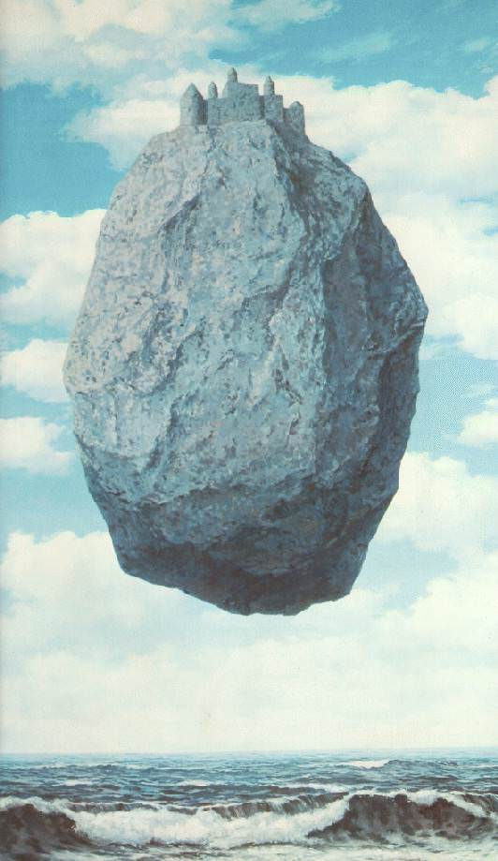
Castle in the Pyrenees
Imagine if this were a 100 word challenge picture – think of your story for a couple of minutes in your head …
Surrealism encourages us to imagine and get lost in our thoughts…

Slide 13
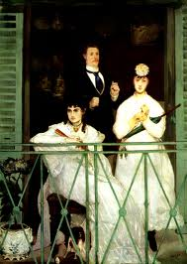
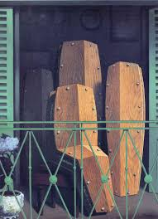
During the course of his career, Rene Magritte would also use famous paintings, which were created by other artists, to put his own surrealist twist on it. One of the works he did, was recreate The Balcony (a piece that was designed by Manet), and in this piece he replaced the figures that were in the image, with coffins.
This, was one way for Magritte to showcase his style, and to create a unique design, forcing viewers of his pieces, to look outside of the norm, and focus on the distinctive features which were not originally present.

Slide 14
The Balcony
Manet
Edouard Manet was a successful 19th Century French artist who was one of the first to paint modern life. It is thought that the people in the picture were all from his life but didn’t know each other…

Slide 15
The Balcony
Magritte
What do you think?

Slide 16
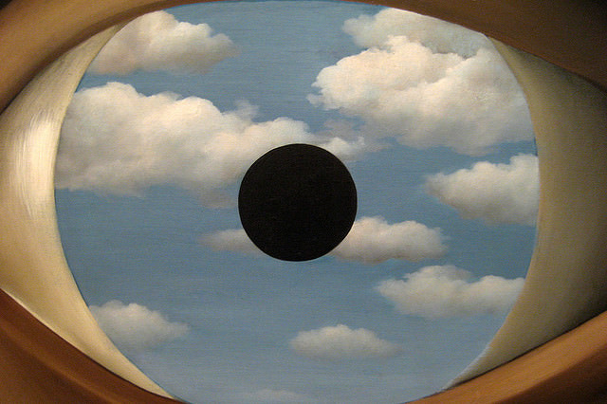
The False Mirror

Slide 17
Now look at the False Mirror with your scientific eye – if you’ve forgotten about Austin's butterfly follow the link to remind yourself… https://www.youtube.com/watch?v=hqh1MRWZjms
Create your own version of the False Mirror – What will you draw in the eye?
What will it mean to you?
You could work very small scale or make it BIG!
THEN
Think about how Austin developed his observation skills – fold a piece of paper into ¼ s.
Look at yourself in a mirror – draw one of your eyes in as much detail as possible – don’t worry about adding colour unless you want to. Repeat until all your spaces are filled – ask someone to give you feedback between each one (remember that the time for each one is quite short).

Slide 18
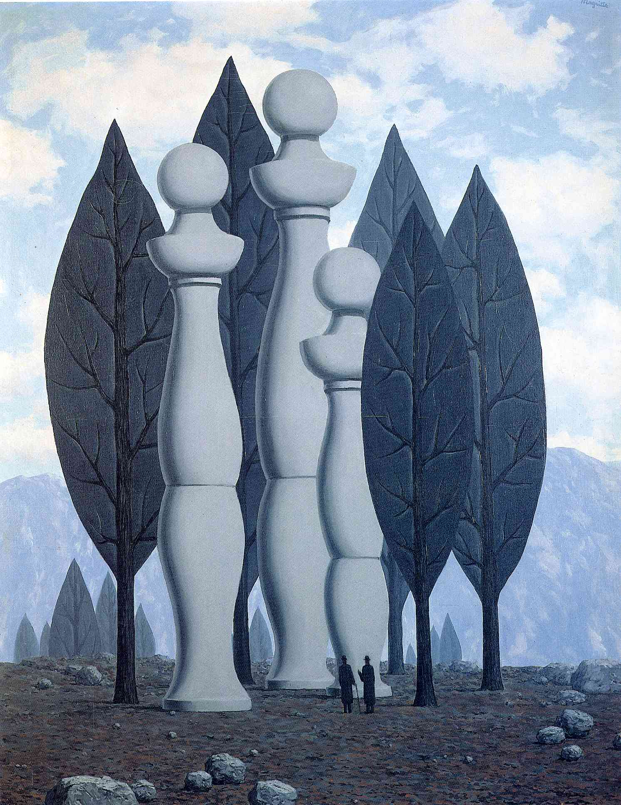
This is my favourite Magritte painting – The art of conversation.
Can you guess why I like it?
Think about what you have learned about what you might expect to see and when this is not the case…and how it makes you feel…
What are 3 things you have learned about Magritte?
Do you have a favourite painting of his?
Do you have a favourite picture that you have made?
If you don’t have paint to use, don’t worry – when we are back in school you will have some opportunities to develop this using paint…
I can’t wait to see your art work – Mrs W. x

Slide 19
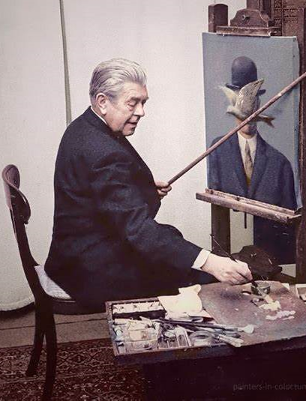
If Magritte is inspiring you, take this additional challenge…

