Slide 1
4 $+$ $=$ 9
4 $+$ $=$ 13
4 $+$ $+$ 5 $=$ 15
$\frac{\text{13}}{\text{7}}$ $=$ whole $+$ sevenths
$\frac{\text{3}}{\text{5}}$ $+$ $\frac{\text{1}}{\text{5}}$ $=$

Slide 2
5
4 $+$ $=$ 9
4 $+$ $=$ 13
4 $+$ $+$ 5 $=$ 15
$\frac{\text{13}}{\text{7}}$ $=$ whole $+$ sevenths
$\frac{\text{3}}{\text{5}}$ $+$ $\frac{\text{1}}{\text{5}}$ $=$
9
$\frac{\text{7}}{\text{7}}$
6
$\frac{\text{6}}{\text{7}}$
1
6
$\frac{\text{4}}{\text{5}}$

Slide 3
What we covered yesterday…
Have a think
What do you notice?
Add the numerators
Keep the denominators
the same

Slide 4
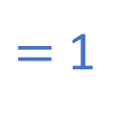
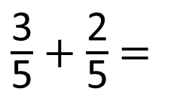
$\frac{\text{3}}{\text{5}}$ $+$ $\frac{\text{2}}{\text{5}}$ $=$
$\frac{\text{5}}{\text{5}}$
$=$ 1
Have a think

Slide 5
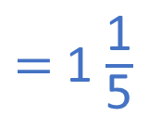
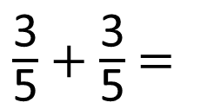
$\frac{\text{3}}{\text{5}}$ $+$ $\frac{\text{2}}{\text{5}}$ $=$
$\frac{\text{5}}{\text{5}}$
$=$ 1
$\frac{\text{3}}{\text{5}}$ $+$ $\frac{\text{3}}{\text{5}}$ $=$
$\frac{\text{6}}{\text{5}}$
$=$ 1 $\frac{\text{1}}{\text{5}}$
Have a think

Slide 6
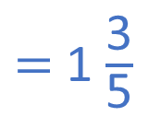
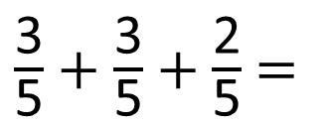
$\frac{\text{3}}{\text{5}}$ $+$ $\frac{\text{3}}{\text{5}}$ $+$ $\frac{\text{2}}{\text{5}}$ $=$
$\frac{\text{8}}{\text{5}}$
$=$ 1 $\frac{\text{3}}{\text{5}}$
Have a think

Slide 7
$\frac{\text{3}}{\text{5}}$ $+$ $\frac{\text{3}}{\text{5}}$ $+$ $\frac{\text{2}}{\text{5}}$ $=$
$\frac{\text{8}}{\text{5}}$
$=$ 1 $\frac{\text{3}}{\text{5}}$
Method A
Method B

Slide 8
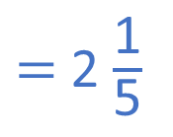

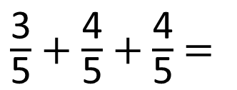
$\frac{\text{3}}{\text{5}}$ $+$ $\frac{\text{4}}{\text{5}}$ $+$ $\frac{\text{4}}{\text{5}}$ $=$
$\frac{\text{11}}{\text{5}}$
$=$ 2 $\frac{\text{1}}{\text{5}}$
Have a think

Slide 9

2
$\frac{\text{4}}{\text{7}}$ $+$ $\frac{\text{2}}{\text{7}}$ $=$ $\frac{\text{6}}{\text{7}}$

Slide 10
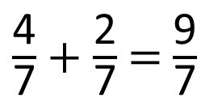
2
$\frac{\text{4}}{\text{7}}$ $+$ $\frac{\text{2}}{\text{7}}$ $=$ $\frac{\text{6}}{\text{7}}$
5
$\frac{\text{4}}{\text{7}}$ $+$ $\frac{\text{2}}{\text{7}}$ $=$ $\frac{\text{9}}{\text{7}}$
Have a think

Slide 11
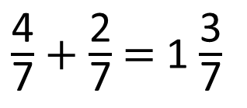
6
$\frac{\text{4}}{\text{7}}$ $+$ $\frac{\text{2}}{\text{7}}$ $=$ 1 $\frac{\text{3}}{\text{7}}$

Slide 12
6
15
$\frac{\text{4}}{\text{7}}$ $+$ $\frac{\text{2}}{\text{7}}$ $+$ $\frac{\text{5}}{\text{7}}$ $=$ $\frac{\text{15}}{\text{7}}$ $=$ 2 $\frac{\text{1}}{\text{7}}$
Have a think

