Slide 1

Wednesday 10th February
Sikhism Fact File

Slide 2
Year 1 - Days of the week and common exception words
Monday
Tuesday
Wednesday
Thursday
Friday
Saturday
Sunday
there
here
they
Year 2 – common exception word
fast
last
father
class
grass
pass
plant
path
bath
people
Look, cover, say, write and check.

Slide 3
Today we are learning to... I am learning to read and write facts. I am learning to create a non-chronological report.
I will be successful if ... I can think of an interesting title. I can spell key words correctly. I can use capital letters for the start of a sentence and for proper nouns. I can use finger spaces and full stops. I can use conjunctions.

Slide 4
This week we are creating a booklet about Sikhism
Each day we will complete a different section of our fact file.
Today we will look at the facts about the 5K’s and clothing.
On Thursday we will write about food.
On Friday we will create a contents page and back cover.

Slide 5
Task:
Create a page about the 5K’s.
Use this link to find some facts:
https://www.bbc.co.uk/bitesize/topics/zsjpyrd/articles/zkjpkmn
Have a look at this video:
https://www.bbc.co.uk/bitesize/clips/zvn34wx

Slide 6
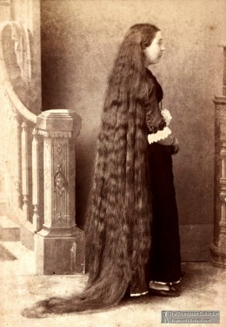
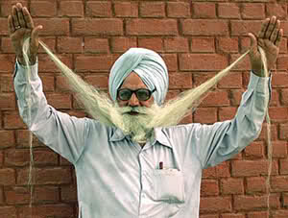
5 K’s of Sikhism
Kesh - not cutting hair.

Slide 7
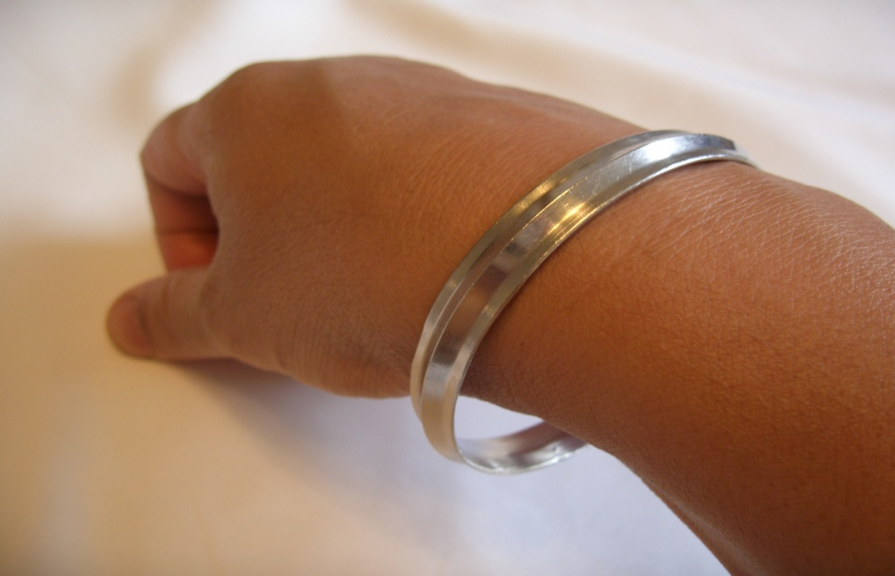
5 K’s of Sikhism
Kara - a steel bracelet

Slide 8
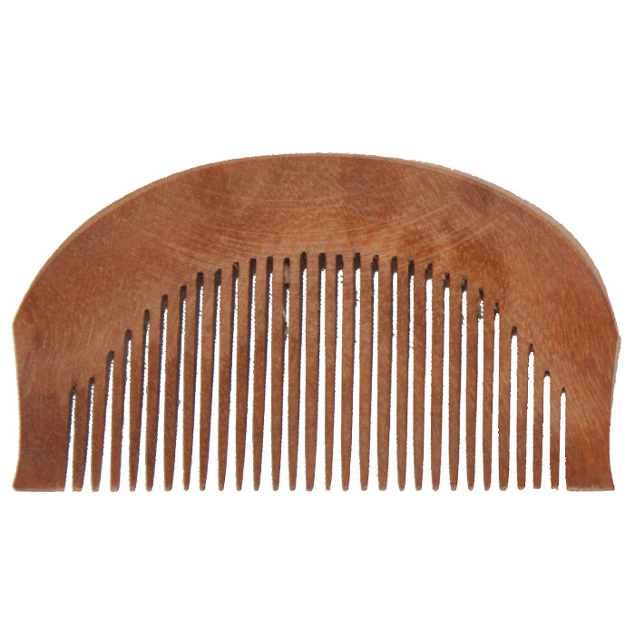
5 K’s of Sikhism
Kanga - a comb.

Slide 9
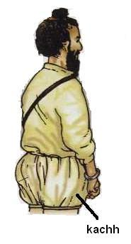
5 K’s of Sikhism
Kaccha - shorts

Slide 10
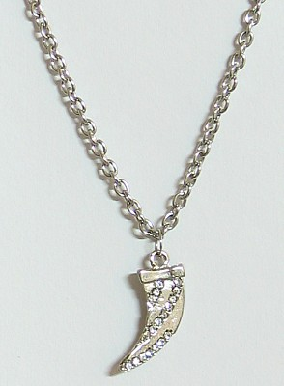
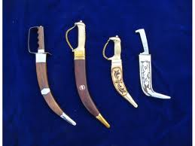
5 K’s of Sikhism
Kirpan - ceremonial dagger.

Slide 11
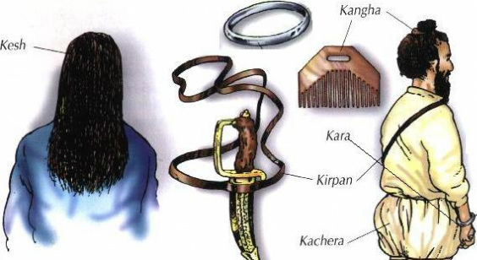
The 5 K’s
Here is an example:
The 5 K’s date from the creation of the Khalsa Panth by Guru Gobind Singh in 1699.
The 5 K’s taken together symbolise that the Sikh who wears them has dedicated themselves to a life of devotion and submission to the Guru.
The 5 K’s are 5 physical symbols worn by Sikhs who have been initiated into the Khalsa.
The five K’s are:
Kesh (uncut hair)
Kara (a steel bracelet)
Kanga (a wooden comb)
Kaccha - also spelt, Kachh, Kachera (cotton underwear)
Kirpan (steel sword)

