Slide 1
Tuesday 2nd February
Non-chronological report

Slide 2
Year 1 Spellings – Adding –er and –est to adjectives where no change is needed to the root word
grander
grandest
fresher
freshest
quicker
quickest
taller
tallest
slower
slowest
Year 2 Spellings – the or sound spelt a before l or ll
all
ball
call
walk
talk
always
small
wall
fall
altogether
Write a list of your spellings. Discuss the tricky parts.
Adult say 5 sentences with the last 5 spellings in. Child should write each sentence down.

Slide 3
Today we are learning to... I am learning to read and write facts. I am learning to create a non-chronological report.
I will be successful if ... I can think of an interesting title. I can spell key words correctly. I can use capital letters for the start of a sentence and for proper nouns. I can use finger spaces and full stops. I can use conjunctions.

Slide 4
This week we are creating a booklet about Queen Elizabeth II
Each day we will complete a different section of our fact file.
Today we are going to create a page about the Queen’s childhood.
On Wednesday we will write facts about the tasks that the Queen does as part of her role.
On Thursday we will write about the Queen’s family.
On Friday we will create a contents page and back cover.
You can add in extra pages over the week if you wish.

Slide 5
Task: Create a page about the Queen’s childhood. In order to do this, we must know some facts, please use the PowerPoint provided and the internet to support you with this.

Slide 6
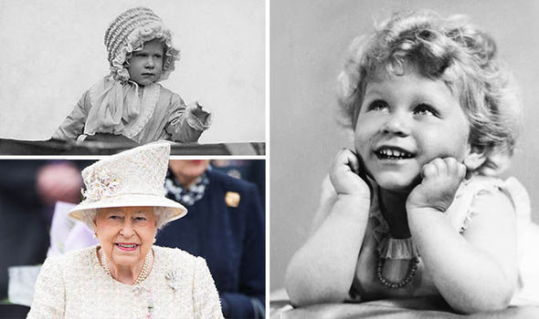
Childhood
Here is an example:
On 21st April, 1926, a baby girl was born at number 17 Bruton Street, London. Her parents were the Duke and Duchess of York. When she was five weeks old, the little girl was christened at Buckingham Palace. She was names Princess Elizabeth Alexandra Mary.
When Elizabeth was four years old, her sister was born. Neither of the princesses went to school. Instead, a governess gave them English, French and history lessons at home.
In 1936, when Princess Elizabeth was 10 years old, her life changed for ever. Her grandfather, King George the Fifth, died. His eldest son then became king. But, he later decided that he did not want to be king. Princess Elizabeth’s father was next in line to become king. From then on, Princess Elizabeth lived in Buckingham Palace with her family. Elizabeth was the older sister which meant she would take over from her father one day.
When Elizabeth was 13, she went to the Royal Naval College at Dartmouth in Devon. She met Prince Philip of Greece. Later, Princess Elizabeth joined the Auxiliary Territorial Service where she was taught how to drive.

