Slide 1
Tuesday 23rd February 2021
Writing

Slide 2
Year 1
The sound /k/ spelt with ‘k’ not ‘c’, before e, i and y
Kent
sketch
kit
skin
frisky
skill
risky
kettle
kilt
king
Year 2
The u sound spelt with o
other
mother
brother
nothing
Monday
money
cover
honey
discover
wonder
Can you practise your spelling for 5 minutes? Look at how many letters are in each word.
Write the last 5 words in sentences.

Slide 3
Today we are learning to:
I am learning to look closely at a picture and draw it.
I am learning to use a range of interesting adjectives
I am learning to write 2A phrases with a comma
I will be successful if:
Draw a detailed picture
Discuss what the character looks like
I use 2 amazing adjectives for each phrase
I remember the comma to separate the adjectives
My writing is beautiful and neat

Slide 4
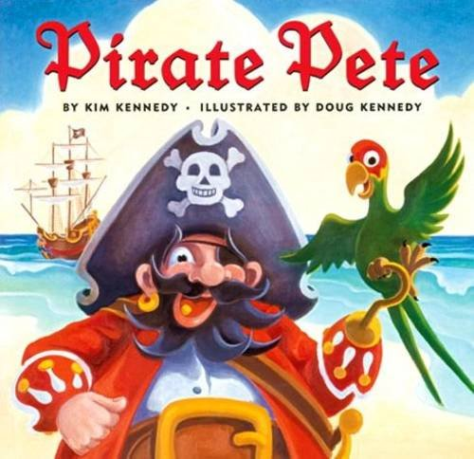
Our story is called Pirate Pete.
What kind of character do you think he might be? Why?

Slide 5
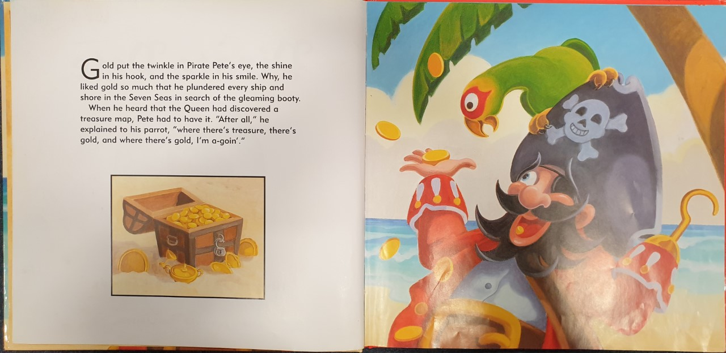

Slide 6
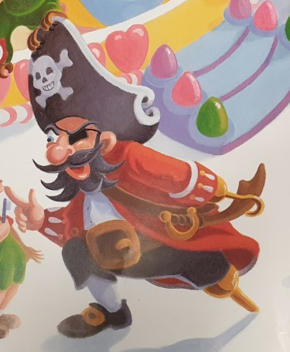
Task 1: Draw a picture of pirate Pete
Write 2A phrases to describe him.
A 2A phrase is 2 adjectives (describing words) with a comma between them followed by the noun (thing you are describing).

Slide 7
Task 2: Write 2A phrases to describe him.
A 2A phrase is 2 adjectives (describing words) with a comma between them, followed by the noun (thing you are describing). Not full sentences!
I like to start at the top of a character and work my way down when describing someone.
E.g.
massive, black hat
wild, long eyebrows
bright, blue eye
The only punctuation you need to remember is the comma!

Slide 8
Here is a list of things you may describe:
hat
eyebrows
eye
eyepatch
nose
ears
earring
beard
moustache
tooth/teeth
face
coat
shirt
hook
belt
trousers
socks
legs
shoes
Write at least ten 2A phrases

