Slide 1
Wednesday 24th February 2021
Writing

Slide 2
Year 1
The sound /k/ spelt with ‘k’ not ‘c’, before e, i and y
Kent
sketch
kit
skin
frisky
skill
risky
kettle
kilt
king
Year 2
The u sound spelt with o
other
mother
brother
nothing
Monday
money
cover
honey
discover
wonder
Can you practise your spelling for 5 minutes? Discuss the tricky part. Look, cover, say, write and check

Slide 3
Today we are learning to:
I am learning to use a range of interesting adjectives
I am learning to write 2A sentences with a comma
I will be successful if:
Discuss what the character looks like
I use 2 amazing adjectives for each 2A sentence
I remember the comma to separate the adjectives
I remember to use all the line. It is not a list, so you do not need to start a new line for each 2A sentence
I start my sentences in different ways
I check that I have written a full sentence
My writing is beautiful and neat

Slide 4
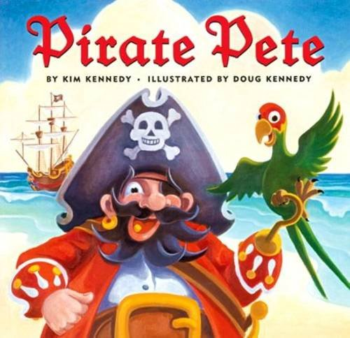
Our story is called Pirate Pete.
What kind of character do you think he might be? Why?

Slide 5
Task: Use your 2A phrases from yesterday and put them into FULL SENTENCES
A 2A sentence needs 2 adjectives (describing words) with a comma between them followed by the noun (thing you are describing).
E.g.
The crazy pirate wears a massive, black hat on his head. His eye brows are black, long and wild.
Remember that after the full stop you do a finger space and continue to fill the rest of the line with your next sentence.

Slide 6
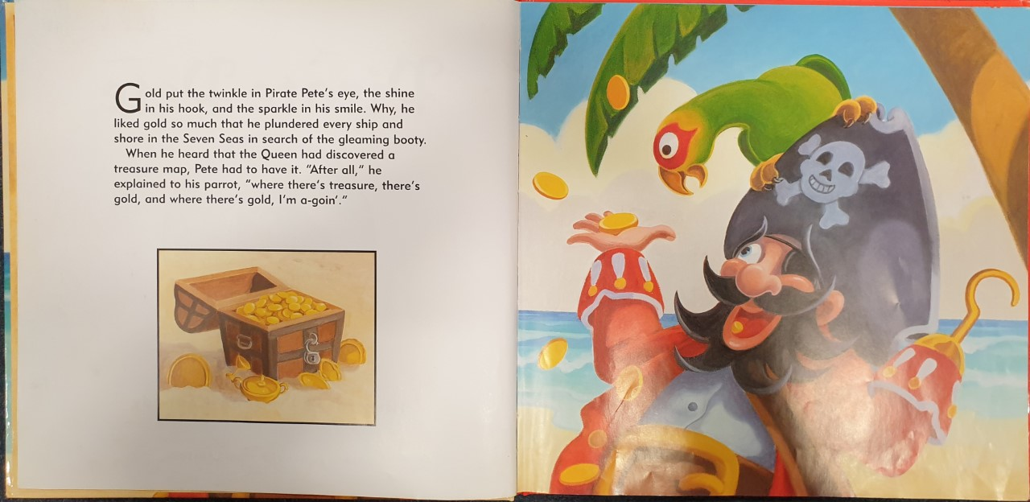
Here is a list of things you may describe:
hat
eyebrows
eye
eyepatch
nose
ears
earring
beard
moustache
tooth/teeth
face
coat
shirt
hook
belt
trousers
socks
legs
shoes
Write at least eight 2A sentences

