Slide 1
Wednesday 3rd March 2021
Writing

Slide 2
Year 1 - The split vowel
digraphs ‘a-e’ and ‘e-e’
made
came
same
take
safe
date
lake
these
theme
complete
Year 2 - the ee sound spelt ey
key
donkey
monkey
chimney
valley
trolley
turkey
hockey
parsley
journey
Can you practise your spelling for 5 minutes? Look at how many letters are in each word. Write a list of all 10 spellings.
Write the last 5 words in sentences.

Slide 3
Today we are learning to:
I am learning to use speech marks/ inverted commas accurately.
I will be successful if:
My writing is beautiful and neat.
I can start a new line for a new speaker.
I remember to put an inverted comma before the character talks.
I end what the character is saying with inverted commas.
I can use interesting synonyms for ‘said’.
I spell key words correctly.

Slide 4
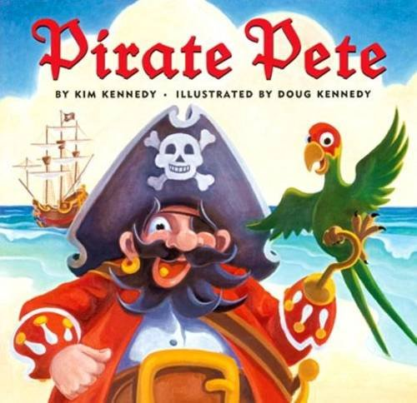
What have we found out so far in the story?
Who are the main characters?
Where have they visited?

Slide 11
What could Pirate Pete be saying to his parrot? How do you think he feels?

Slide 12
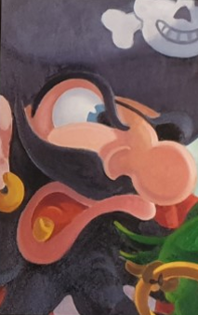
Task: Write speech sentences. Write a conversation between the characters. Each character should respond at least two times.
“ I can see a lush, green island and I bet that it is full of precious, golden booty. We are heading there now” roared Pirate Pete.
“ You said we wouldn’t veer off course again, Captain. Do you think that is a good idea?” squeaked the concerned, little bird.
I will be successful if:
My writing is beautiful and neat.
I can start a new line for a new speaker.
I remember to put an inverted comma before the character talks.
I end what the character is saying with inverted commas.
I can use interesting synonyms for ‘said’.
I spell key words correctly.

