Slide 1
Thursday 4th February
Non-chronological report

Slide 2
Year 1 Spellings – Adding –er and –est to adjectives where no change is needed to the root word
grandr, grander
grandest, grandist
fresher, freshr
freshest. freshist
quickr, quicker
quickist, quickest
taller, tallerr
tallist, tallest
slower, slowr
slowest, slowist
Year 2 Spellings – the or sound spelt a before l or ll
all, orl, arl
ball, borl, bal
call, corl, cal
walk, worlk, wolk
tork, tolc, talk
always, allways, arlways
smorl, small, smal
worl, wall, wole
fall, forl, fal
altogethr, altogether, altogever
Which spelling is correct? Write each correct spelling down in a list.

Slide 3
Today we are learning to... I am learning to read and write facts. I am learning to create a non-chronological report.
I will be successful if ... I can think of an interesting title. I can spell key words correctly. I can use capital letters for the start of a sentence and for proper nouns. I can use finger spaces and full stops. I can use conjunctions.

Slide 4
This week we are creating a booklet about Queen Elizabeth II
Each day we will complete a different section of our fact file.
Today we are going to write facts about the Queen’s family.
On Friday we will create a contents page and back cover.
You can add in extra pages over the week if you wish.

Slide 5
Task: Create a page about the Queen’s family. In order to do this, we must know some facts, please use the PowerPoint provided and the internet to support you with this.

Slide 6
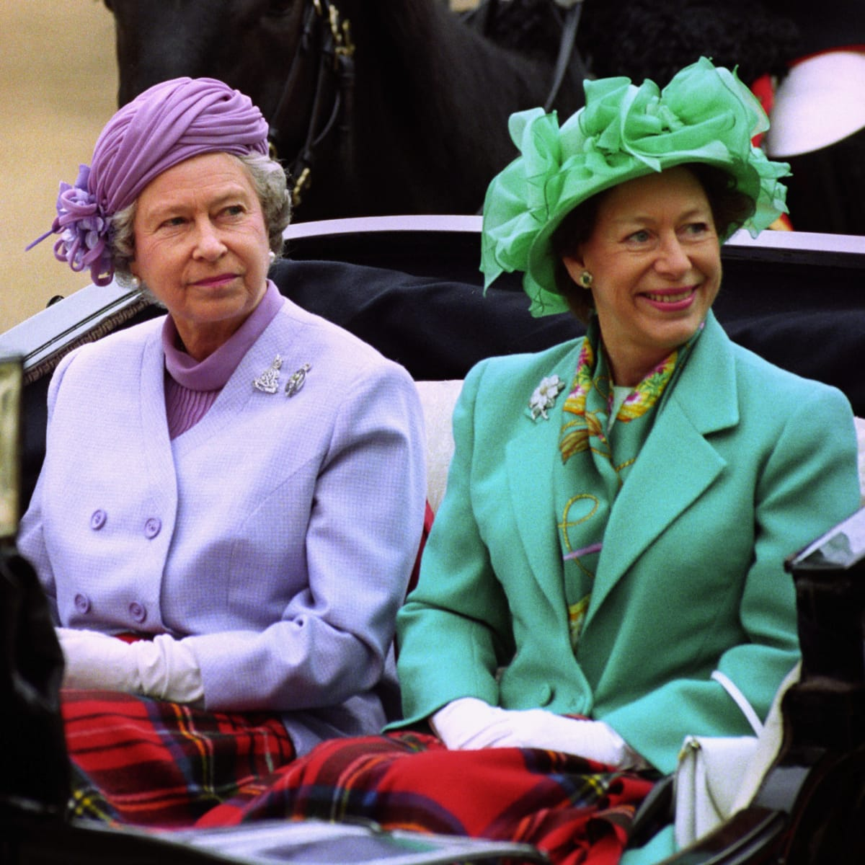
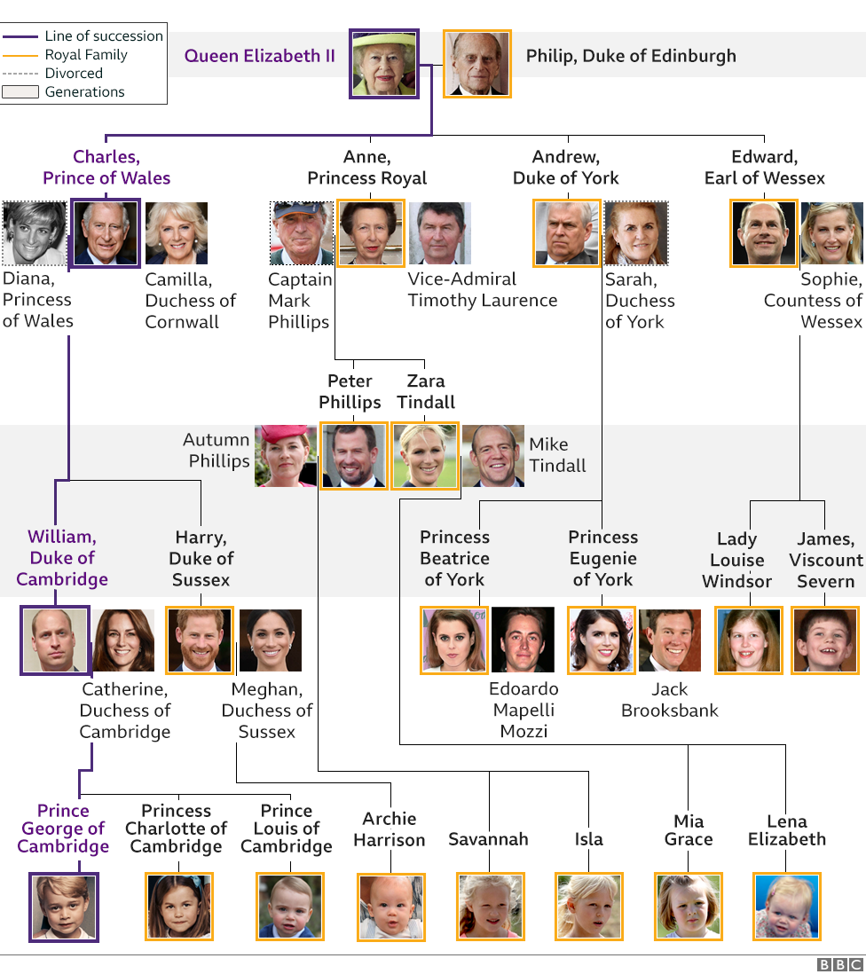
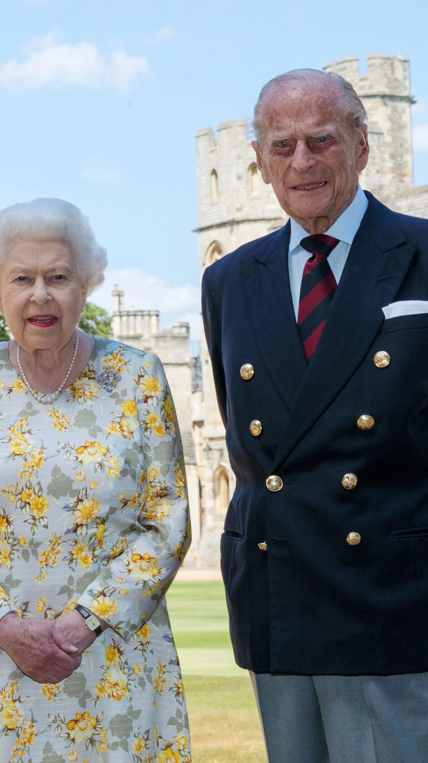
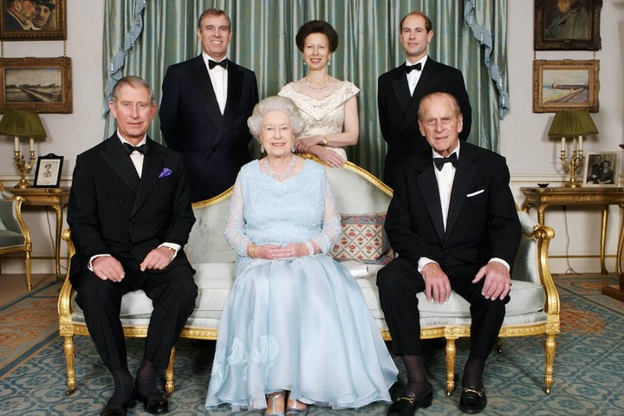
The Royal Family
Here is an example:
The Queen has a younger sister named Margaret.
In 1947 she married Philip, Duke of Edinburgh, a former prince of Greece and Denmark, with whom she has four children: Charles, Prince of Wales; Anne, Princess Royal; Prince Andrew, Duke of York; and Prince Edward, Earl of Wessex.

