Slide 1
Writing
Friday 15th January 2021

Slide 2
This week our story is ‘What Pet to Get?’
https://www.youtube.com/watch?v=GU4rmVkQtUc

Slide 3
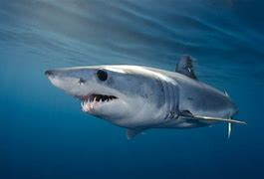
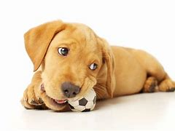
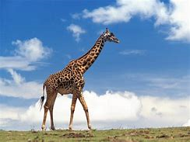
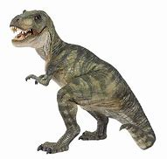
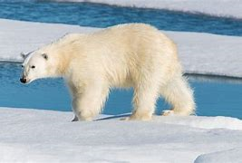
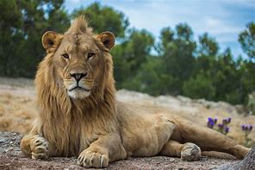
Which animal from the story would you like as a pet?
Can you write a sentence? Remember to sound out to spell the words.
E.g. I wud lighk a jiraf.

Slide 4
Why did you choose the animal?
Can you write a sentence? Remember to sound out to spell the words.
E.g. It haz a long neck.

