Slide 1
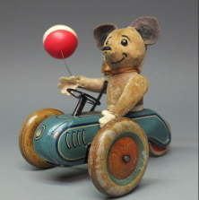
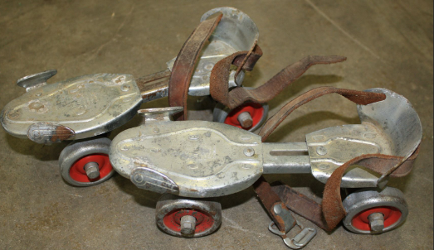
Yarm Primary
Year Two | Enquiry Question: Let’s Play – how have toys changed?
Subject Specific Vocabulary​ |  |  | Sticky Knowledge about
Toys | An object for a child to play with. | After half term, we will be learning about toys and how they have changed since the Victorian times. Children will consider present day toys, and compare them to toys from the past.
 |  |  | Be able to explain about the toys they play with today – including materials they are made from.
​modern | Something from recent times.
 |  |  | Recognise old and new toys and explain how they know this. Understand that in Victorian times, boys and girls had different toys, as did rich and poor children.
​present | The period of time that is now.
​21st century | The years from 2000, to 2999.
past | The period of time that has already happened. |  | Describe features of different toys – old and new.
​Victorian | A period of time when Queen Victorian was Queen – 1837 to 1901. | ​
 |  |  | explain how we can find out about toys from the past -
​future | A period of time that is yet to come
 |  |  | Use vocabulary relating to the passing of time.
old | Something that has been around for a long time.
changes | Make something different
 |  |  | Understand the chronology of toys and how they have evolved.
​source | Somewhere / someone we get information about something from.

Slide 2
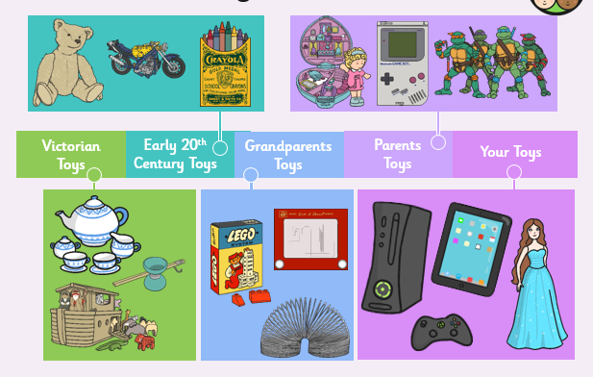
Toys timeline

