Slide 1
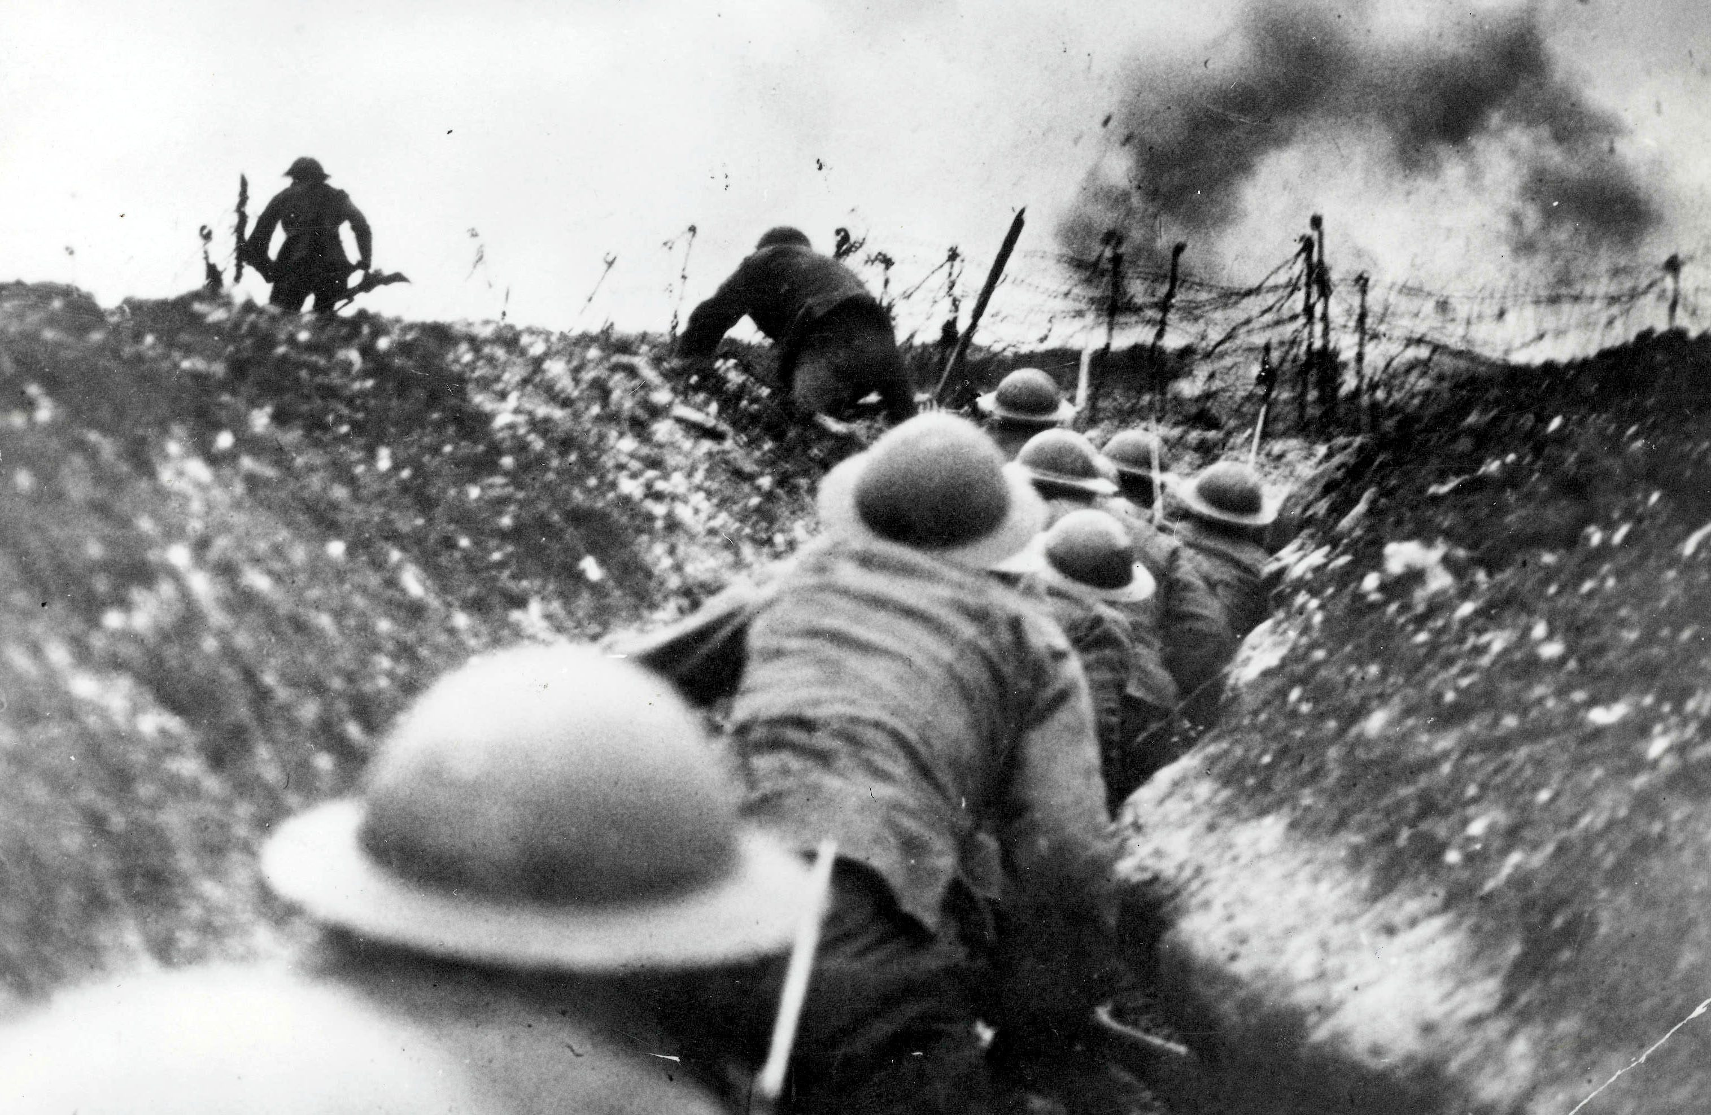
World War 1
English
Daily grammar lessons/spelling session
Weekly spellings to learn
Class Texts – Narnia and Last
Setting descriptions
Diary entries
Edit and revise
Maths
Represent, read and write numbers up to 1 million
Order and compare 5 and 6-digit numbers
Rounding numbers up to the nearest 100,000
Counting forwards and backwards through 0 to include negative numbers
Recognising Roman Numerals to 1000
Represent, read and write decimal numbers up to 3 decimal places
Compare, order and round decimal numbers
Identify 3d shapes from nets
History
Europe before WW1
Allies v Axis – who went to war
Why did WW1 start?
What was trench warfare?
Comparing different battles (Battle of the Somme, Battle of Verdun, Battle of Ypres)
How did WW1 end?
Science
Forces
Explaining the effect of gravity on falling objects
Identifying the effects of air resistance, water resistance and friction that act between moving surfaces
Mechanisms (including levers, pulleys and gears)
Working scientifically – planning scientific enquiries
Term 1 - Year 5
Value of the term:
Trust
Art – Drawing
Exploring the art of typography
Looking at artists: Louise Fifi, Grayson Perry, Paula Scher and Chris Kenny
Designing a map
Making observational drawings
Drawing from a bird’s eye view perspective
Computing
Digital Literacy – Computing Systems and Networks
Online Safety – Self Image and Identity and Privacy and Security
RE – Sikhism
How far would a Sikh go for his/her religion?
PSHE – Jigsaw framework
My Year Ahead
Being A Citizen of My Country
Year 5 Responsibilities
Rewards and Consequences
French
Phonetics
PE
Multi skills
Music
Musical theatre

