Slide 1
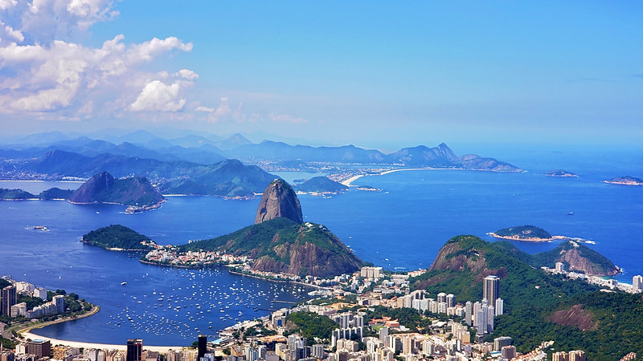
Science –Electricity
•To identify common appliances that run on electricity
•To know how to construct a simple circuit, identifying and naming its basic parts
•To identify whether or not a lamp will light in a simple circuit
•To recognise that a switch opens and closes a circuit
- To recognise some common conductors and insulators
Hook:
creating carnival masks
Fabulous finish to the topic:
Reading work to partner class
Maths
Regognise the value of and represent 4 digit numbers
Read and write 4 digit numbers in both numerals and words
Count backwards through 0
Build the 6 x tables
Build the 7 x tables
Build the 9 x tables
Multiply by 1 and 0
Value of the term:
Trust
‘South America: Brazil’
Term 1
Year 4
English
‘The great Kapok tree’ by Lynne Cherry
‘Taking Flight’ (animation – literacy shed)
Using fronted adverbials for time place an manor
Use Expanded Noun Phrases with adjectives, punctuated correctly.
Using coordinating conjunctions used to expand sentences.
Use apostrophes for contractions and singular possession.
Use simple past tense – -ed suffix and irregular verbs spelled correctly.
Use adverbs to modify expanded noun phrases.
Use subordinating conjunctions ‘if’ and ‘when’ in the middle of the sentence.
Geography – South America: Brazl
-Know the terms equator, hemisphere and tropics (including Cancer and Capricorn) and temperate.
-Know that Brazil is the largest country in South America and that Rio de Janeiro is the second largest city in Brazil.
-Know some similarities and differences between the UK and Brazil with a focus on human features.
PE
Multi-skills
Music
Recorders
DT
Cooking and Nutrition – adapting a recipe
French
Fruits and vegetables
RE –
Bushism: is it possible for everyone to be happy?
PSHE – being me
To know how my attitudes and actions make a difference to the class team
To understand who is in my school community, their roles and how I fit in
To understand how democracy works at Zouch
To understand how groups come together to make decisions
To understand how democracy and having a voice benefits the school community
ICT Skills in Computing
Digital literacy

