Slide 1
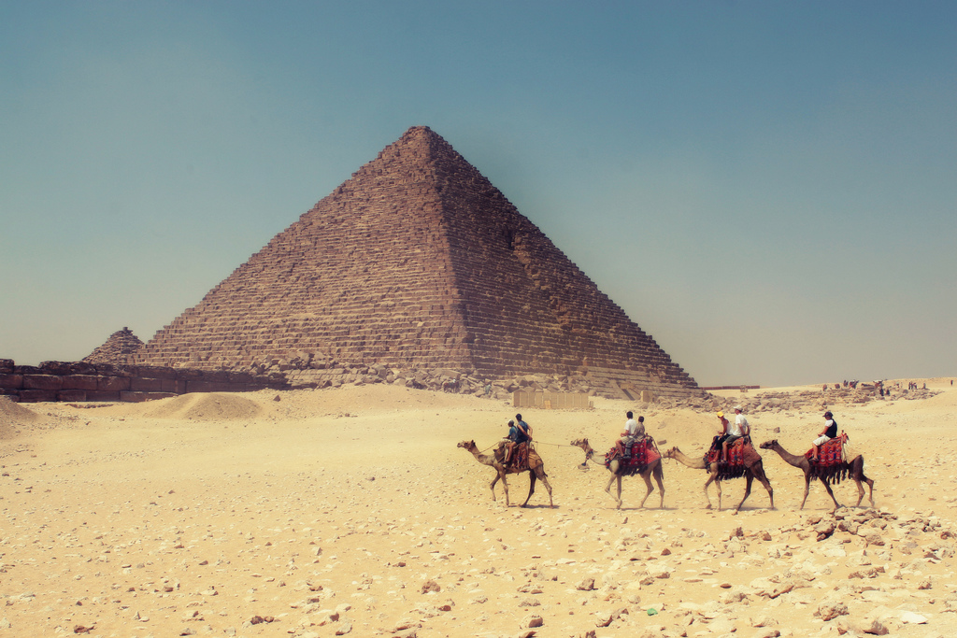
English
Core Text: ‘The BFG’
Daily spelling sessions with weekly spellings
Handwriting taught weekly using cursive style
Reading lessons (daily) and individual reading (at least once a week)
Grammar rules taught explicitly
Narrative – character description, retelling a scene, dialogue between characters, retelling a chapter
Nonfiction – Bullet points, adverbs for time, instruction,
Hook:
Junk model pyramid challenge
Fabulous finish to the topic:
Show off work to parents
Maths
Fractions: Calculating
Find out fractions of a number of objects and an amount
Add and subtract fractions with the same denominator within one whole
Measurement (Time):
Know the number of seconds in a minute and multiple minutes
Tell the time to one minute intervals past the hour on an analogue clock
Draw the hands on a clock to show one minute intervals past the hour on an analogue clock
Calculate duration of events
Read digital and analogue time
PSHE
Relationships
‘Ancient Egypt’
Term 5
Year 3
History
What was important to people during Ancient Egyptian times?
What does the evidence tell us about everyday life for men, women and children in Ancient Egypt?
What sources of evidence have survived and how were they discovered?
How would we find out who really did build the pyramids?
What did the Ancient Egyptians believe about life after death and how do we know? (mummification)
What did the Ancient Egyptians believe about life after death and how do we know? (Book of the Dead)
Science - Light
Recognise that they need light in order to see things and that dark is the absence of light
Recognise that they need light in order to see things and that dark is the absence of light.
To notice that light is reflected from surfaces.
To recognise that shadows are formed when the light from a light source is blocked by an opaque object.
To find patterns in the way that the size of the shadows change.
Art – Painting: Cloth, thread, paint.
This pathway aims to enable pupils to respond to artworks using visual literacy skills.
Children then go on to make their own creative response to the artworks, using layering of shape, colour and line using painting and sewing.
RE
Religion:
Sanatana Dharma
Key question:
What do some deities tell Sanatanis about God?
Computing
- Recognising how, text, and, images, convey, information and that text and layout can be edited.
- Choosing appropriate page settings
- Adding content to a desktop, publication
- Considering how different layouts, can suit different purposes and the benefits of desktop publishing,
Value of the term:
Patience
PE
Tennis and Rounders
Music
Ballads

