Slide 1
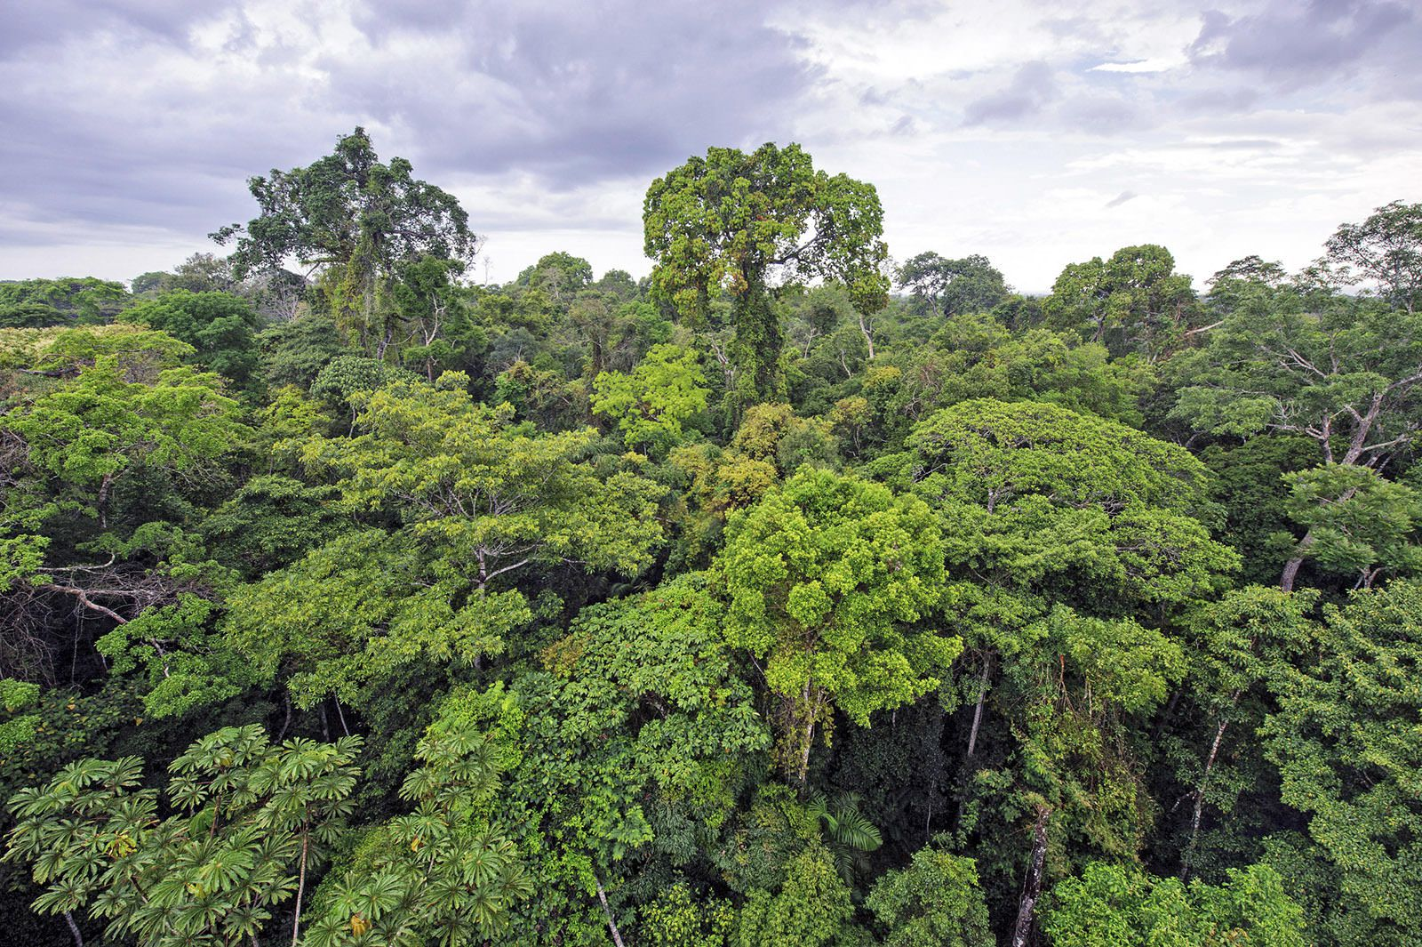
English
‘Wisp: A Story of Hope’ by Zana Fraillon
Fiction - Write a setting description for an additional memory that the boy visits.
Accurately manage tense, consistently
Maintain cohesion through the use of nouns and pronouns.
Begin to edit and identify unnecessary repetition.
Correctly use commas with subordination and fronted adverbials.
Non fiction - Write a set of instructions about how to turn ‘scrap’ into something.
Use noun phrases with prepositional phrase
Use paragraphing and sub-headings appropriately in non-fiction writing.
Maths
Daily counting
Times tables up to 12x12
Decimals and fractions - counting up and down in hundredths, read, represent and compare numbers with 2-decimal places, compare 2 decimal places with 1 decimal places, dividing 1-digit by 100 and a 2-digit by 10 and 100, converting from pence to pounds
Value of the term:
Thoughtfulness
DT
Structure
‘Amazon’
Term 5
Year 4
Science – sound
identify how sounds are made
find patterns between the pitch of a sound and features of the object that produced it ▪
find patterns between the volume of a sound and the strength of the vibrations that produced it ▪
recognise that sounds get fainter as the distance from the sound source increases
Geography – rainforests
locate the main countries and significant physical features of South America
describe the location of places in Brazil using four figure grid references
understand the journey a river makes
identify and explain the physical and human features of the Amazon River
to know the features of the amazon rainforest
to compare the Amazon rainforest and a Sherwood Forest
RE –
Buddhism - What is the best way for a Buddhist to lead a good life?
PSHE – Relationships
Know that there are leaders and followers in groups
Know the facts about smoking and its effects on health
Know the facts about alcohol and its effects on health, particularly the liver
Know ways to resist when people are putting pressure on them
Know what they think is right and wrong
Music Recorders
PE Tennis and Rounders
Computing
Data programming
French the classroom

