Slide 1
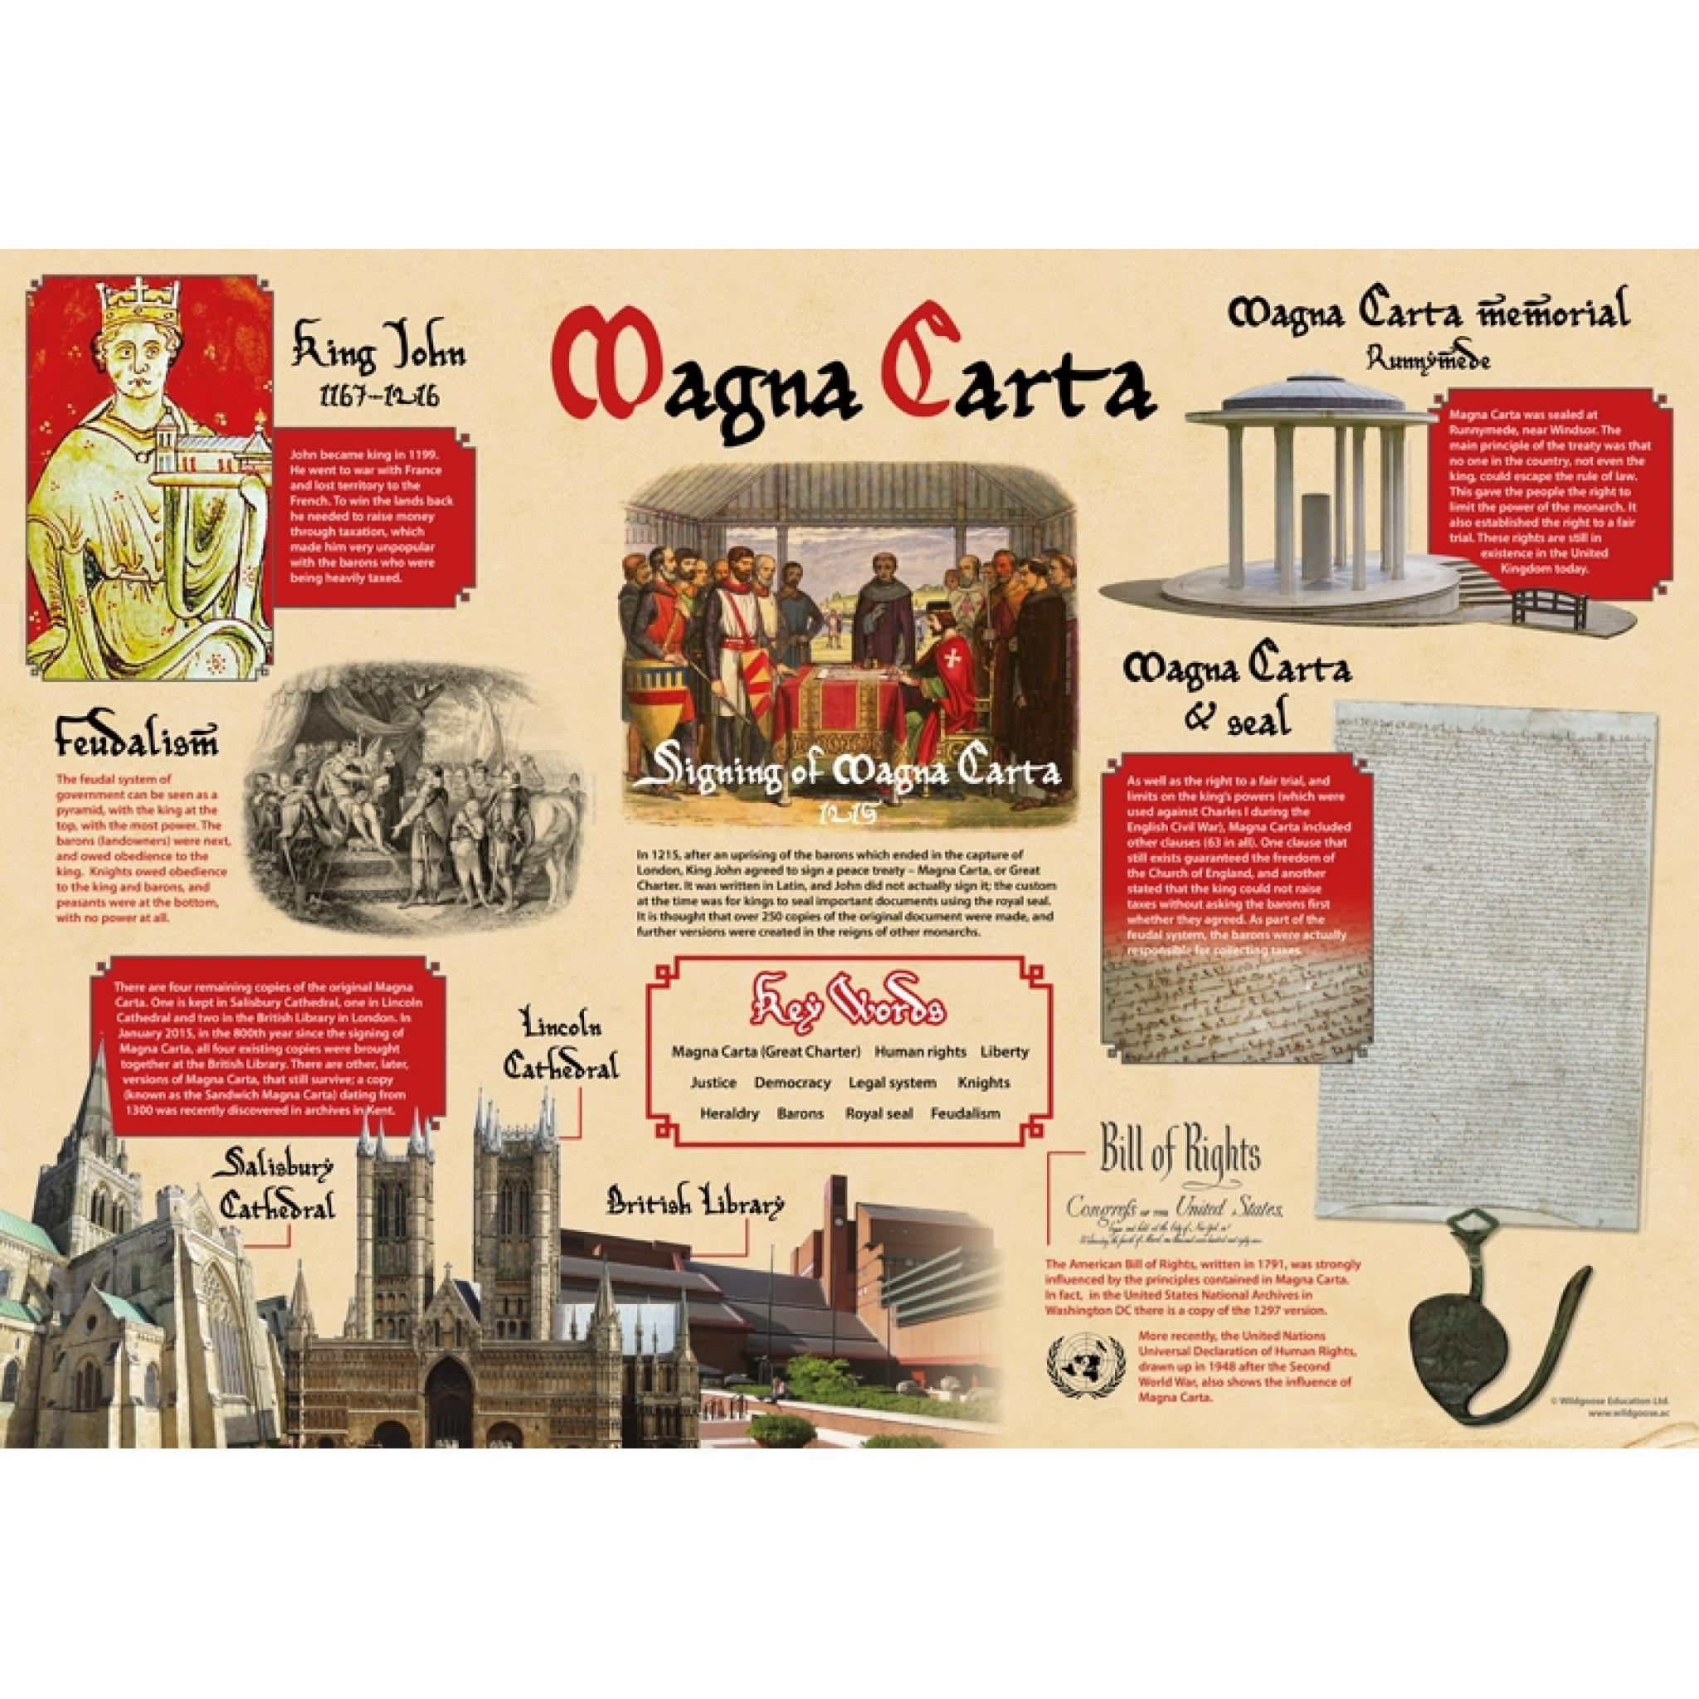
English
Daily grammar lessons/spelling session
Weekly spellings to learn
Class Text – ‘Letters from the lighthouse’
Comparing setting descriptions
Character description
Daily Reading Theatre
Computing – Multimedia
Creating vector drawings
Online safety linked to Health, Well-being and Lifestyle
Science –Changes to Materials
Changes of states of matter
Reversible and irreversible changes
Soluble and insoluble substances
Effective separation techniques
Scientists who have created new substances
Magna Carta – Medieval Britain
Art – Making Monotypes
Focus artist: Kevork Mourad
French:
Do you have a pet? (I)
Music
South and West Africa
PE – Tennis and Rounders
Peregrines swimming (Monday )
Value of the term:
Patience
Year 5 – Term 5
PSHE – Relationships
Recognising who I am
Online communities
Online gaming and relationships with technology
History
Exploring what life was like in Medieval Britain.
Reach informed conclusions about how society was organised in Medieval Britain
Make reasoned judgements about the significance of King John in Medieval Britain
Explain the significance of the Magna Carta on British history
Maths
Converting between proper and improper fractions
Adding fractions
Subtracting fractions
Multiplying fractions
Maths practices focused on previous arithmetic learning
RE – Sikhism
What is the best way for Sikhs to show commitment to God?

