Slide 1
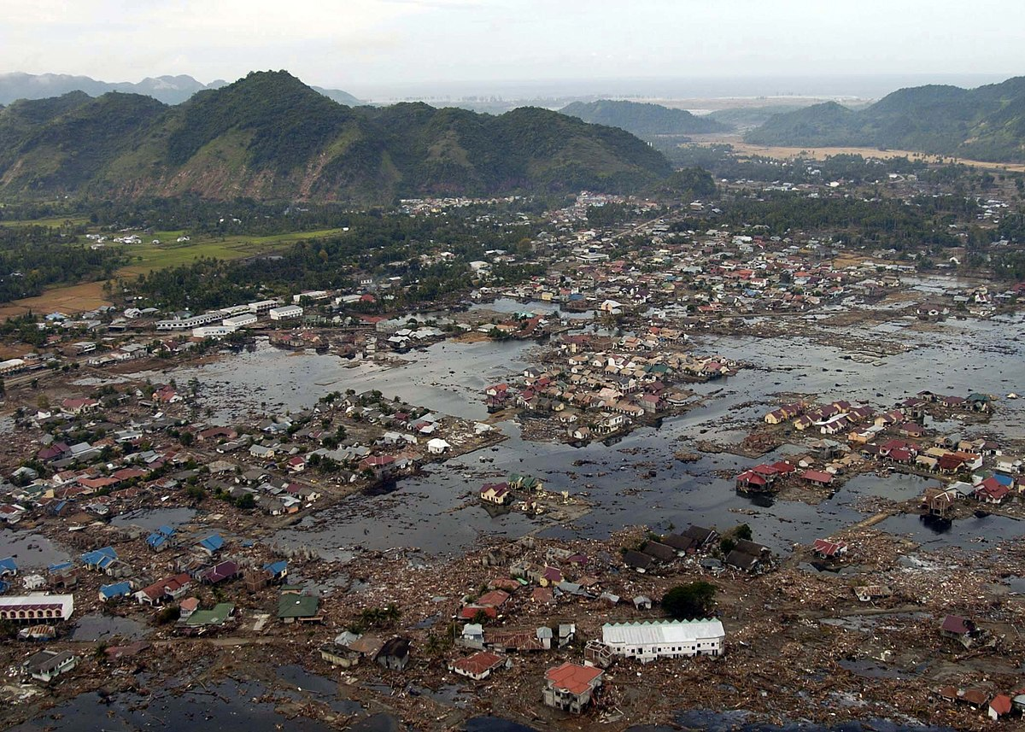
English
Daily grammar lessons/spelling session
Weekly spellings to learn
In preparation for SATs, we will be revising all of the grammar concepts and applying all of these to our writing.
Narrative writing: dialogue for characterisation and retelling a warning story from an animation (Alma).
Non-fiction writing: an eye-witness account using the same animation.
Science – Electricity
associate the brightness of a lamp or the volume of a buzzer with the number and voltage of cells used in the circuit
compare and give reasons for variations in how components function, including the brightness of bulbs, the loudness of buzzers and the on/off position of switches
use recognised symbols when representing a simple circuit in a diagram.
Computing
Information Technology – 3D modelling
Online safety: Online Relationship
Natural Disasters
Year 6 Term 5
DT
Structures - Designing a playground featuring a variety of different structures, giving consideration to how the structures will be used.
French:
à l'école (At school)
Geography:
Understanding the term ‘natural disaster’ and exploring different examples of these.
A case study on the 2004 tsunami.
Understand how people’s lives are affected by these disasters.
Value of the term:
Patience
Music
Continuing with cornet lessons
Developing a knowledge of reading music
PSHE – Relationships
- Highlighting the importance of taking care of mental health
-Understanding the feeling of loss when we lose someone.
- Online safety focus
Maths
Daily mental arithmetic practise
Targeted revision of key elements of mathematics in preparation for SATs
RE – Islam
Does belief in Akhirah (life after death) help Muslims lead better lives?
PE
Tennis and rounders with a focus on throwing and striking.

