Slide 1

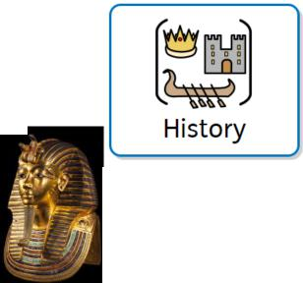
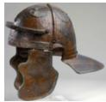
Curriculum Intent
History at
Zouch
Curriculum Implementation
At Zouch Academy, our History curriculum acknowledges that history is one of the richest mediums to teach children about life. By finding out about how life has developed over time, children understand how the past influences the present. They will explore the diversity of human experience, and begin to understand more about themselves as individuals as well as members of society. When learning about history, children have the opportunity to act as historians do, stimulating their curiosity about the past. We enable history to come to life through a wide range of active and cross-curricular activities, so children understand that they are learning about real people and real events locally, nationally and globally.
Starting in the Early Years, children begin to make sense of their own personal and family history through their Understanding of the World. In Key Stages 1 and 2, bi-termly themes enable children of all abilities and backgrounds to develop a wide range of knowledge, skills, understanding and vocabulary in a progressive manner.
All history themes carefully consider the contexts and communities of our children. With a large proportion of military families, we often select themes that allow the exploration of relevant issues such as migration and warfare as well as considering the wealth of history in the local area. Trips and visitors help to enrich this learning: in recent years children have visited local historical sites including Butser Ancient Farm and Salisbury cathedral.
Like other foundation subjects, History lessons have a clear process which involves recapping prior learning to embed knowledge and understanding, exploring History as a subject, presenting a clear objective and key vocabulary as well as summarising the knowledge and skills the children will learn.
History makes up part of our outer curriculum and reflects our embedded values including respect, appreciation and understanding.
Curriculum Impact
By the time children leave Zouch, the teaching and learning they will have received through history will have developed:
A secure knowledge and understanding of people, events and contexts from the range of historical periods covered.
The ability to think critically and reflectively about history and communicate confidently in styles appropriate to a range of audiences.
The ability to consistently support, evaluate and challenge their own and others’ views using detailed, appropriate and accurate historical evidence derived from a range of sources.
The ability to think about, reflect on, debate, discuss and evaluate the past, forming and refining questions and lines of enquiry.
An interest in history and an enthusiastic engagement in learning, which develops their sense of curiosity about the past and their understanding of how and why people interpret the past in different ways.
A respect for historical evidence and the ability to make robust and critical use of it to support their explanations and judgements.
A desire to embrace challenging activities, including opportunities to undertake high-quality research across a range of history topics.
Assessment
Assessment in History is woven throughout each unit in the form of regular retrieval of previous learning, including through the use of entry and exit tickets within lessons. At the end of each unit of learning, children partake in a carefully-tailored multiple choice quiz to test the knowledge they have learnt and they also respond to essay questions on the key learning to help show their understanding of each theme. The aim of these assessments is to help children remember more so they can build a chronological awareness of History.

