Slide 1

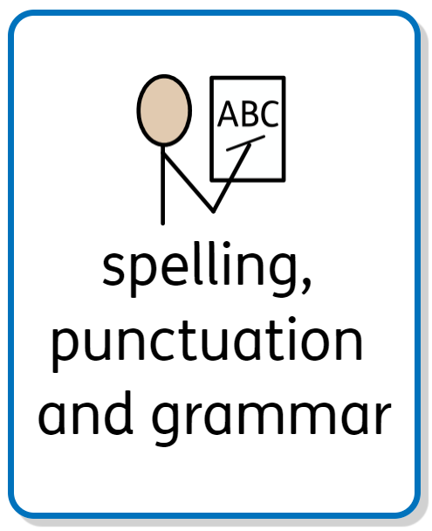

Curriculum Intent
As stated within the overall English Writing Intent statement, our spelling, punctuation and grammar (SPaG) curriculum aims to empower all children to acquire the vocabulary, skills, knowledge and understanding necessary for confident and effective written communication both now and in the future. Our SPaG curriculum – which forms part of the outer curriculum - is broad and balanced to cover a range of skills such as spelling, handwriting, grammar, vocabulary, syntax, composition and creativity; these skills are then applied across all other subjects.
We therefore intend for every child to accurately spell high frequency and common exception words and to understand the key patterns, rules and etymology of spelling as well as understanding the key rules of English grammar and punctuation, applying these accurately in their writing.
Curriculum Implementation
Spelling: In KS1 and KS2, the use of spelling progression grids have been designed – using the national curriculum - for each term that highlights the spelling rules and common exception words.
In both KS1 and KS2, a ‘phonics first’ approach will be used, wherein the primary method for spelling words should be to segment and blend the individual phonemes in words. Where this is not suitable, further morphemic or graphic approaches will be introduced.
Spelling in KS2 is organised into a Lower Key Stage Two curriculum and an Upper Key Stage Two curriculum. Due to this, children across KS2 will have the same rule to focus on each week. To ensure progression across year groups, the complexity of the words increases with the year group. In addition, words from the explicit Year 3/4 and Year 5/6 statutory common exception word lists will be covered.
Punctuation and grammar: In KS1 and KS2, punctuation and grammar skills will be taught daily at the beginning of each English lesson during phases 1 and 2 of the writing sequence. In year 6 and year 2 they will also teach these skills in phase 3. During phase 2 of the writing sequence, some lessons may be dedicated to learning a punctuation or grammar skill, particularly if it is a new skill to that year group.
To ensure an even coverage of the punctuation and grammar objectives for each year group, the Zouch Grammar Guide will be used to select relevant objectives from each strand (Word, Sentence, Text, Punctuation) throughout each fiction or nonfiction sequence. Where possible, these should be relevant to the text type being taught or to the set text, as well as responding to the needs of the children as a result of daily formative assessment.
Spelling, Punctuation and Grammar at Zouch
Curriculum Impact
The implementation of this curriculum ensures that when all children leave Zouch Academy, they will have acquired the skills to utilise the spelling, grammar and punctuation knowledge taught to them within their writing independently. This will enable the children to express themselves through their writing and therefore write effectively for a range of purposes.
Assessment
Teachers will assess the children’s spelling, grammar and punctuation understanding through a variety of summative and formative assessment. We will assess through: 100 statutory words test relevant to each year group in December, April and June; weekly spelling test based on their previous week’s spelling learning; end of Autumn, Spring and Summer term teacher assessments; end of KS1 and KS2 SATs - spelling, punctuation and grammar results; end of Autumn, Spring and Summer term grammar assessments and evidence of spelling application in writing will be identified through book scrutiny.
Our values
Our values

